Slide 1
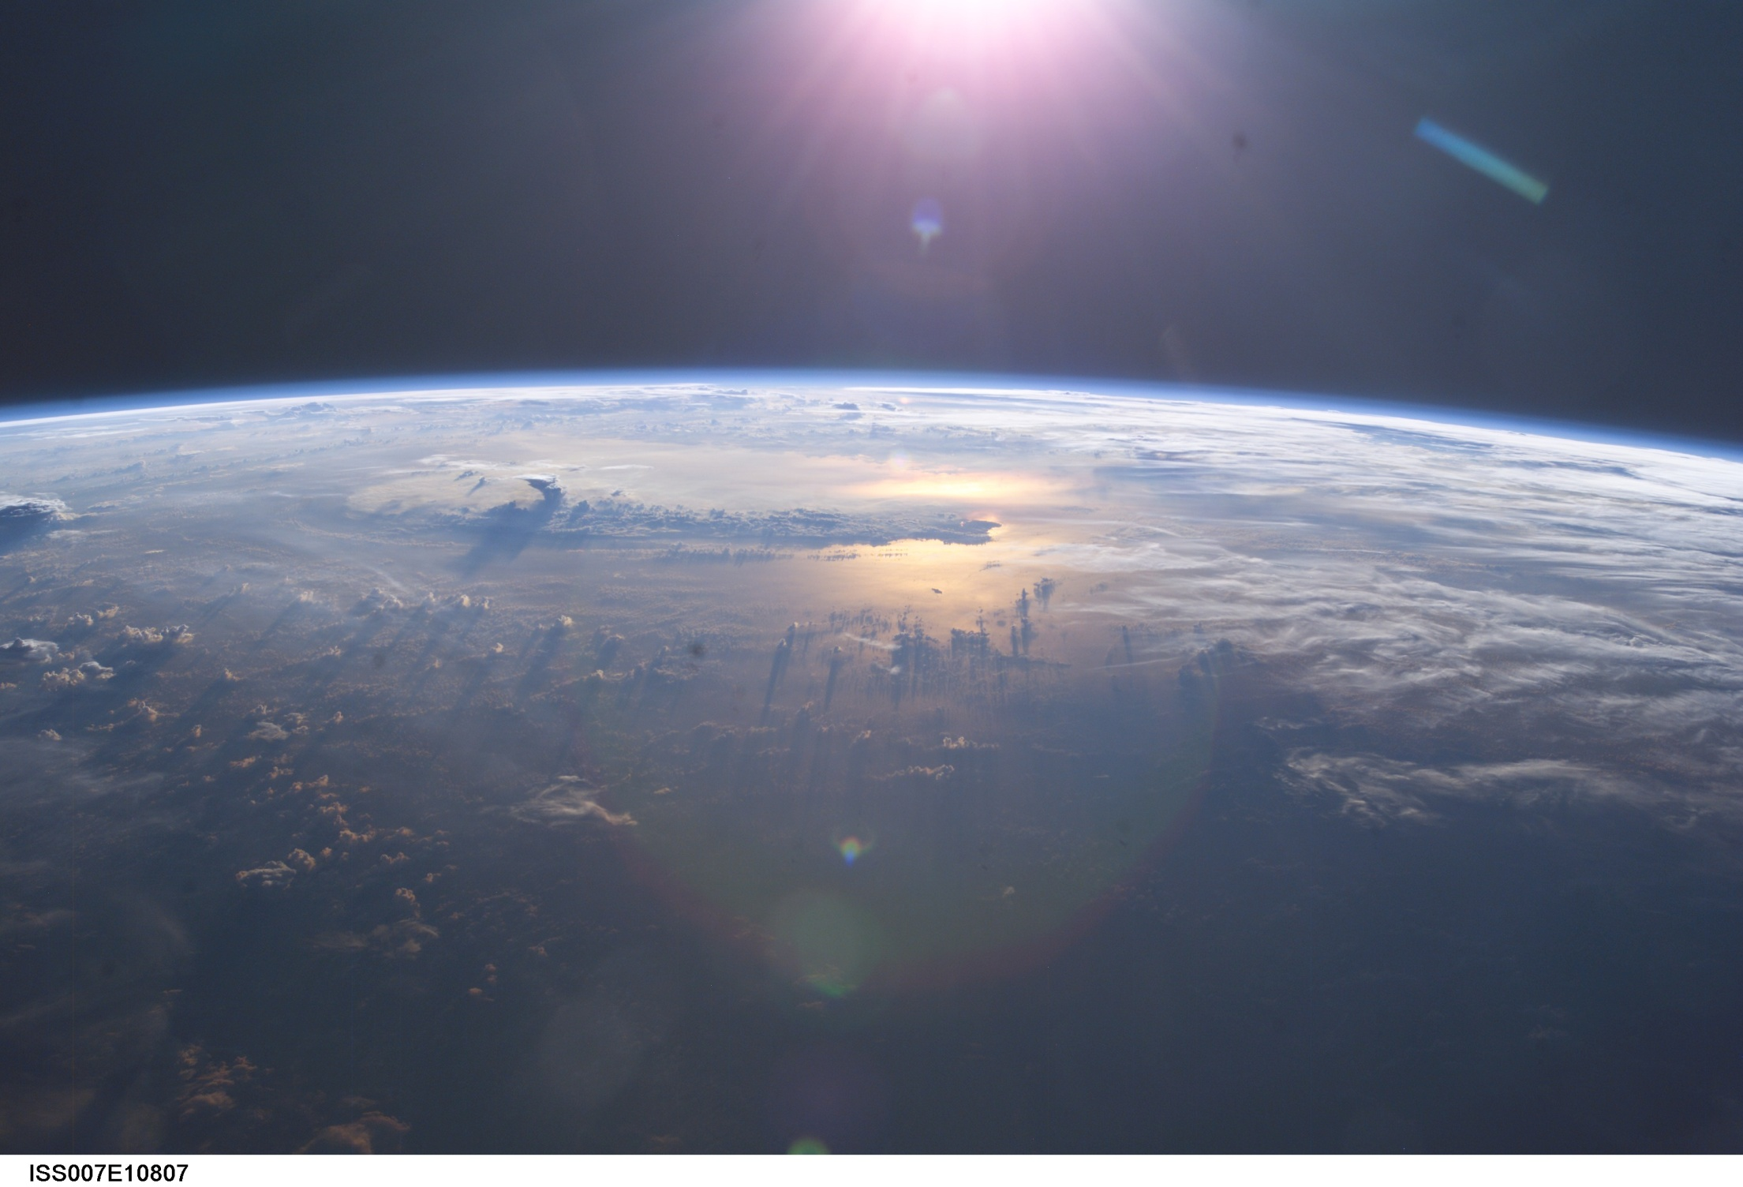


SATELLITE METEOROLOGY
Part 1: An Incompleat History of Meteorological Satellites
Dr. Sam Miller
Professor of Meteorology
Plymouth State University
Open Educational Resource

Slide 2
October 4, 1957…

Slide 3
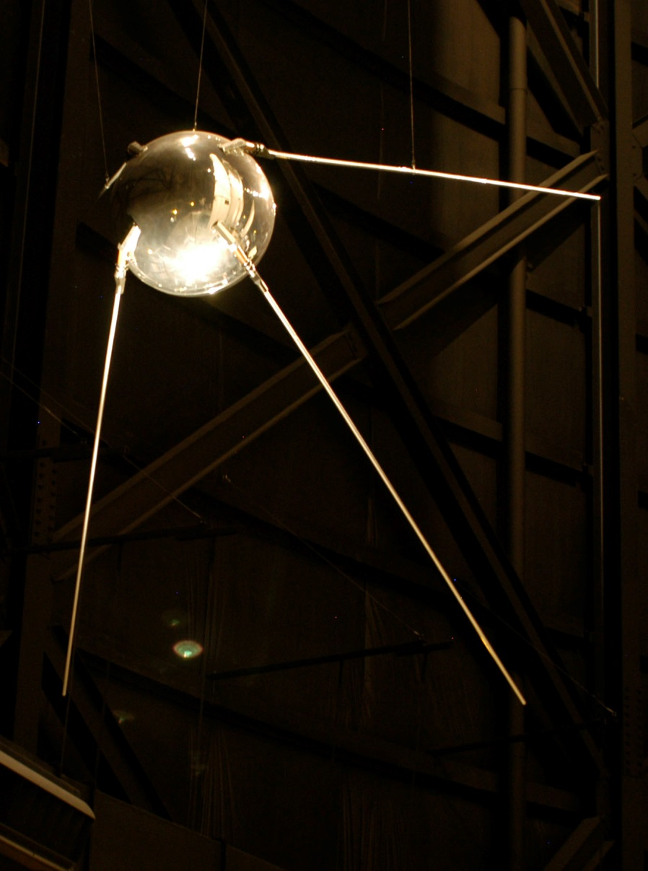
October 4, 1957…
Sputnik - 1
World’s first artificial satellite is launched by the USSR

Slide 4
October 4, 1957…
Sputnik 1 (Спу́тник-1)
“Satellite”
Launched during International Geophysical Year
Lasted 22 days
Drag on satellite provided information about density of upper atmosphere

Slide 5
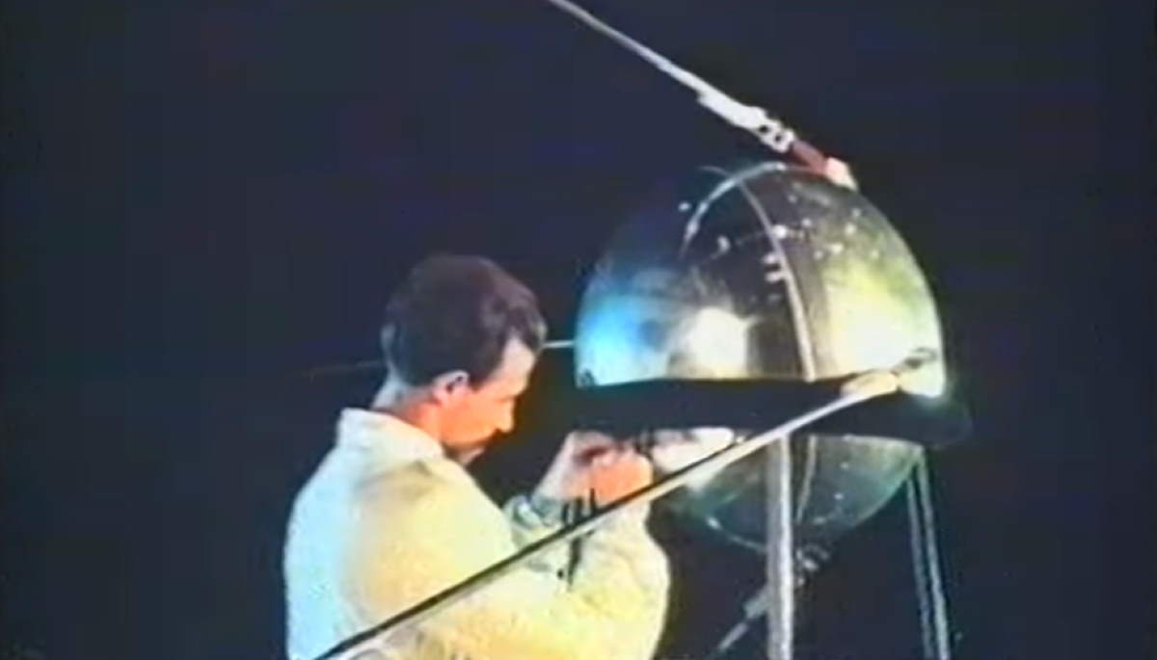
October 4, 1957…
Sputnik 1 (Спу́тник-1)
“Satellite”
Launched during International Geophysical Year
Lasted 22 days
Drag on satellite provided information about density of upper atmosphere

Slide 6
October 4, 1957…
Sputnik - 1
World’s first artificial satellite is launched by the USSR

Slide 7
October 4, 1957…
Sputnik - 1
World’s first artificial satellite is launched by the USSR
Русские идут!

Slide 8
October 4, 1957…
Sputnik - 1
World’s first artificial satellite is launched by the USSR
Русские идут!
(The Russians are coming!)

Slide 9
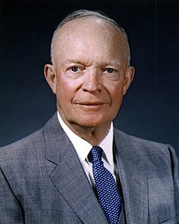
October 4, 1957…
Get a civilian satellite up there, NOW.
Use whatever you need.
Sputnik - 1
World’s first artificial satellite is launched by the USSR
Русские идут!
(The Russians are coming!)
Eisenhower

Slide 10
US Response: Explorer (Late 1950s)
Apogee: 1088 km
Perigee: 556 km
Period: 101.3 minutes
Orbits not equatorial; not polar.

Slide 11
Explorer (Late 1950s)
Apogee: 1088 km
Perigee: 556 km
Period: 101.3 minutes
Orbits not equatorial; not polar.
Orbits are elliptical, not circular (Kepler)
Apogee = Highest point in orbit
Perigee = Lowest point in orbit
Types of orbits used in modern weather satellites:
Equatorial = geostationary; elevation about 36,000 km
Polar = Sun synchronous; elevation about 850 km

Slide 12
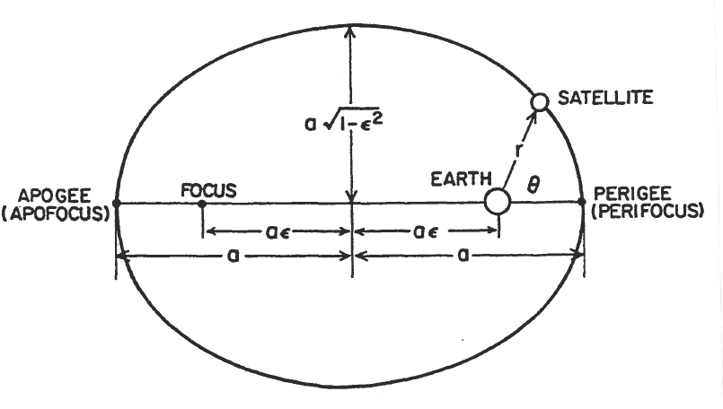
Explorer (Late 1950s)
Apogee: 1088 km
Perigee: 556 km
Period: 101.3 minutes
Orbits not equatorial; not polar.
KEPLER’S DESCRIPTION OF ORBITS
(Image: Kidder and Vonder Harr, 1995)

Slide 13
Explorer 7 (October, 1959)
Carried first radiometer (quantitative radiation sensor).
First successful meteorological instrument.

Slide 14
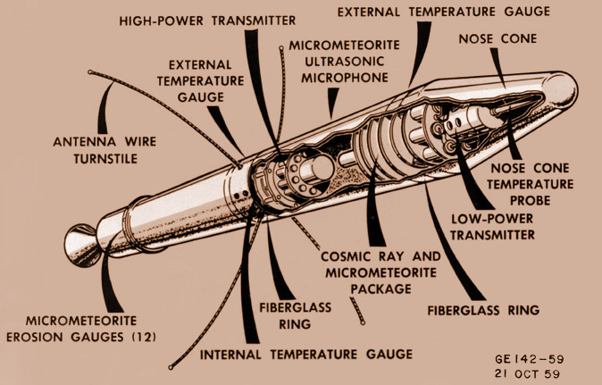
Explorer 7 (October, 1959)
Returned first photo from Earth orbit.
Highly elliptical orbit.

Slide 15
Explorer 7 (October, 1959)
Returned first photo from Earth orbit.
Highly elliptical orbit.
Launch Vehicle = JUNO II Intercontinental Ballistic Missile

Slide 16
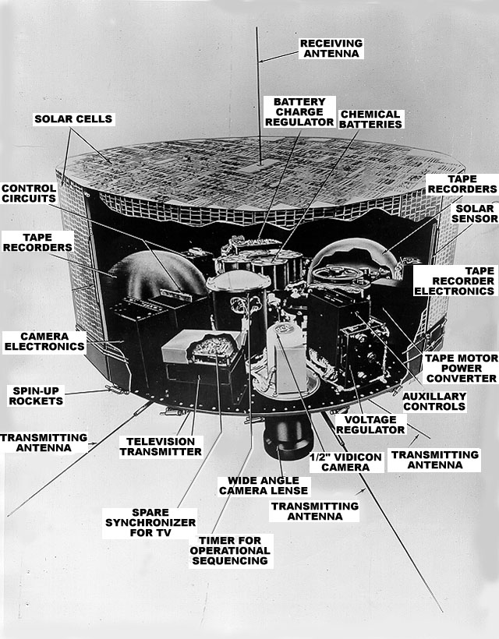
TIROS (Early/Mid 1960s)
TIROS 1 lasted 79 days.
Returned about 23,000 images.

Slide 17
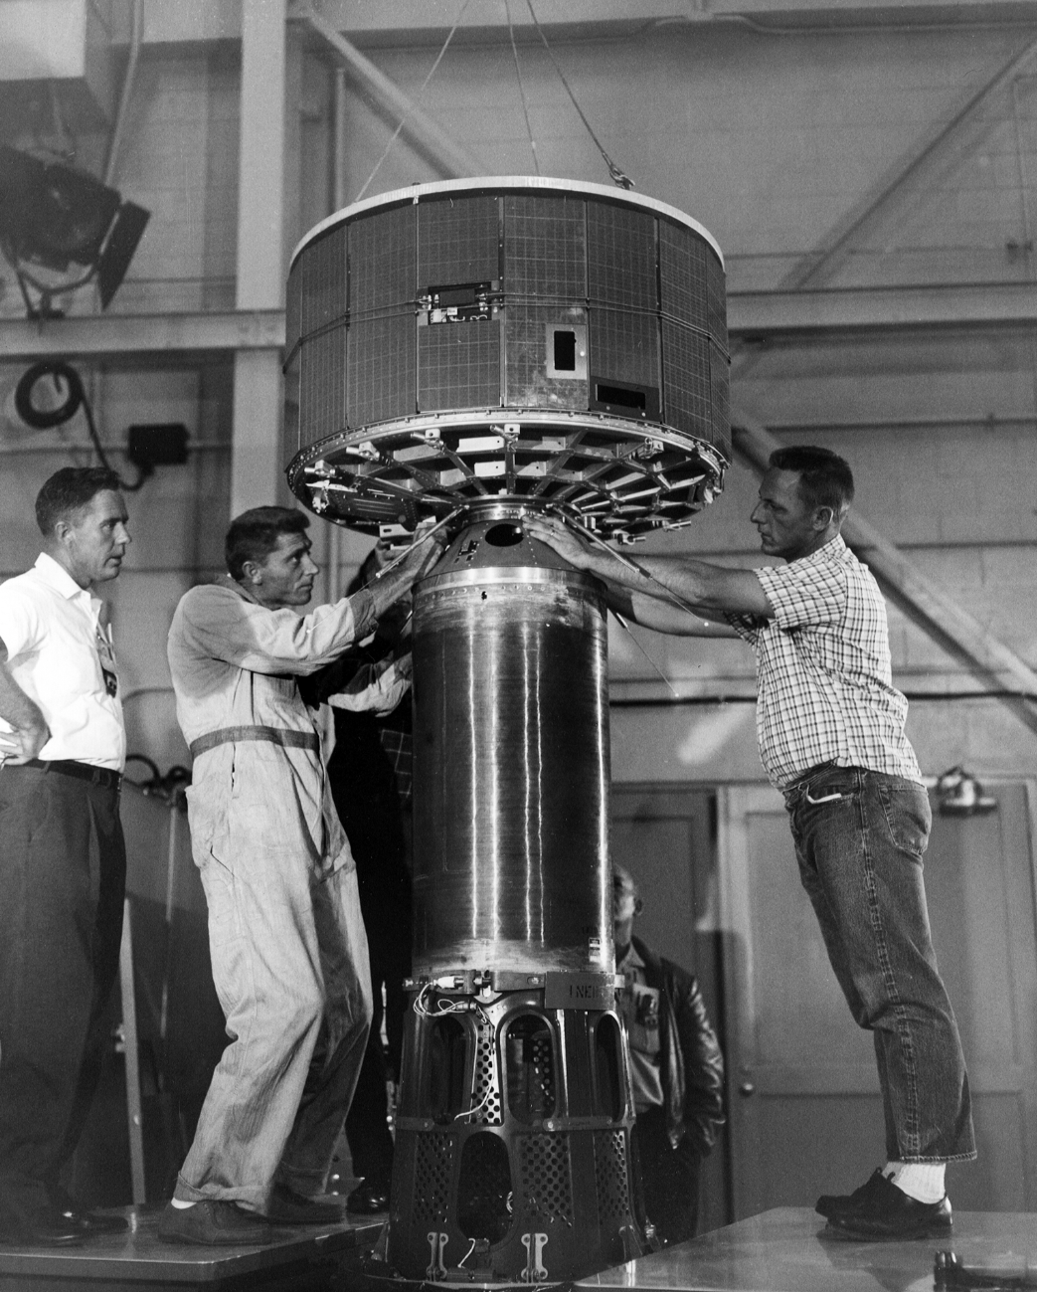
TIROS (Early/Mid 1960s)
TIROS 1 lasted 79 days.
Returned about 23,000 images.

Slide 18
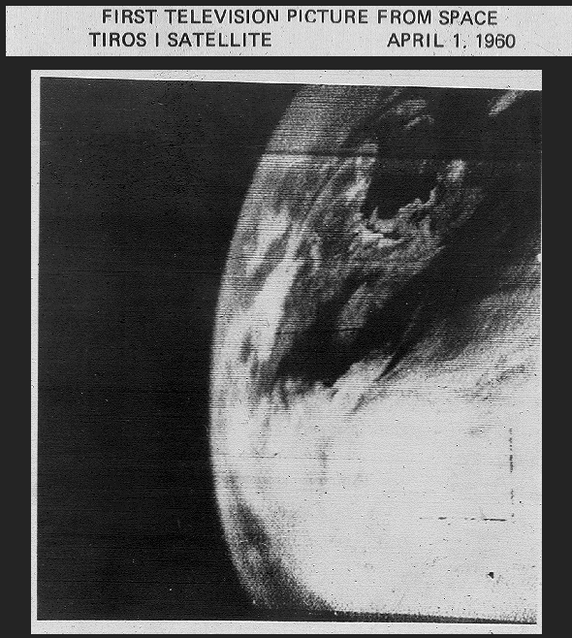
TIROS (Early/Mid 1960s)
FIRST IMAGE RETURNED BY TIROS

Slide 19
TIROS (Early/Mid 1960s)
Television and Infrared Observational Satellites
Carried standard TV camera – one complete image every 2 seconds.
Ten TIROS satellites launched in original program – last one launched in 1965.

Slide 20
TIROS (Early/Mid 1960s)
Television and Infrared Observational Satellites
Carried standard TV camera – one complete image every 2 seconds.
Ten TIROS satellites launched in original program – last one launched in 1965.
Apogee: 722 km
Perigee: 677 km
Period: 98.7 min
Orbits not equatorial; not polar.

Slide 21
TIROS (Early/Mid 1960s)
First 4 TIROS were put into orbit with inclination (i) of 48 degrees.

Slide 22
TIROS (Early/Mid 1960s)
First 4 TIROS were put into orbit with inclination (i) of 48 degrees.
Angle of inclination = tilt of orbital plane above the equator
Equatorial orbits are inclined 0 degrees
Polar orbits are inclined more than 90 degrees

Slide 23
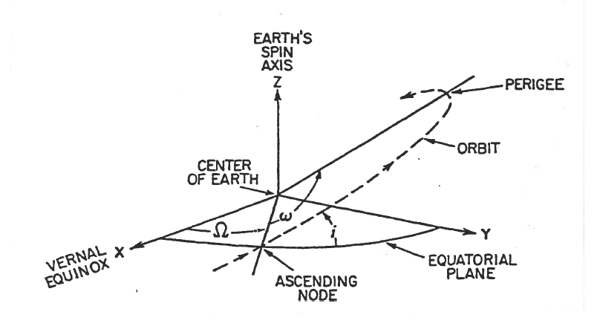
TIROS (Early/Mid 1960s)
First 4 TIROS were put into orbit with inclination (i) of 48 degrees.
ONE VARIATION ON THE CELESTIAL COORDINATE SYSTEM
(Image: Kidder and Vonder Harr, 1995)

Slide 24
TIROS (Early/Mid 1960s)
First 4 TIROS were put into orbit with inclination (i) of 48 degrees.
TIROS 5 - 10: i set to 58 deg – gave better images of poles.

Slide 25
TIROS (Early/Mid 1960s)
First 4 TIROS were put into orbit with inclination (i) of 48 degrees.
TIROS 5 - 10: i set to 58 deg – gave better images of poles.
TIROS 8: Introduced Automatic Picture Transmission (APT) – Images broadcast to Earth via VHF.

Slide 26
TIROS (Early/Mid 1960s)
First 4 TIROS were put into orbit with inclination (i) of 48 degrees.
TIROS 5 - 10: i set to 58 deg – gave better images of poles.
TIROS 8: Introduced Automatic Picture Transmission (APT) – Images broadcast to Earth via VHF.
TIROS 9: Changed camera orientation, making mosaic photos possible.

Slide 27
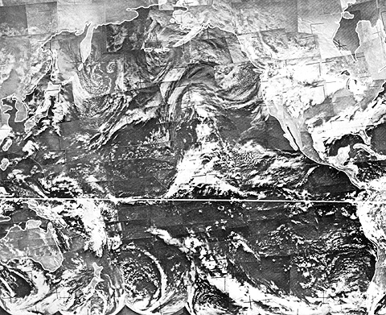
TIROS (Early/Mid 1960s)
MOSAIC IMAGE RETURNED BY TIROS

Slide 28
TIROS
First 4 TIROS were put into orbit with inclination (i) of 48 degrees.
TIROS 5 - 10: i set to 58 deg – gave better images of poles.
TIROS 8: Introduced Automatic Picture Transmission (APT) – Images broadcast to Earth via VHF.
TIROS 9: Changed camera orientation, making mosaic photos possible.
TIROS N (1978) began 3rd generation of U.S.-launched polar orbiters.

Slide 29
TIROS
First 4 TIROS were put into orbit with inclination (i) of 48 degrees.
TIROS 5 - 10: i set to 58 deg – gave better images of poles.
TIROS 8: Introduced Automatic Picture Transmission (APT) – Images broadcast to Earth via VHF.
TIROS 9: Changed camera orientation, making mosaic photos possible.
TIROS N (1978) began 3rd generation of U.S.-launched polar orbiters.
TIROS/NOAA 20 launched in 2017 – Now called JPSS.

Slide 30
Polar Orbiters

Slide 31
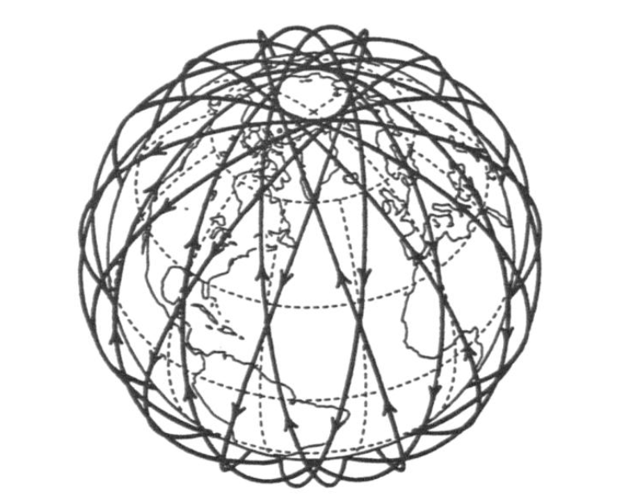
PATH TRACED OUT BY POLAR ORBITER OVER TIME
(Image: Kidder and Vonder Harr, 1995)

Slide 32
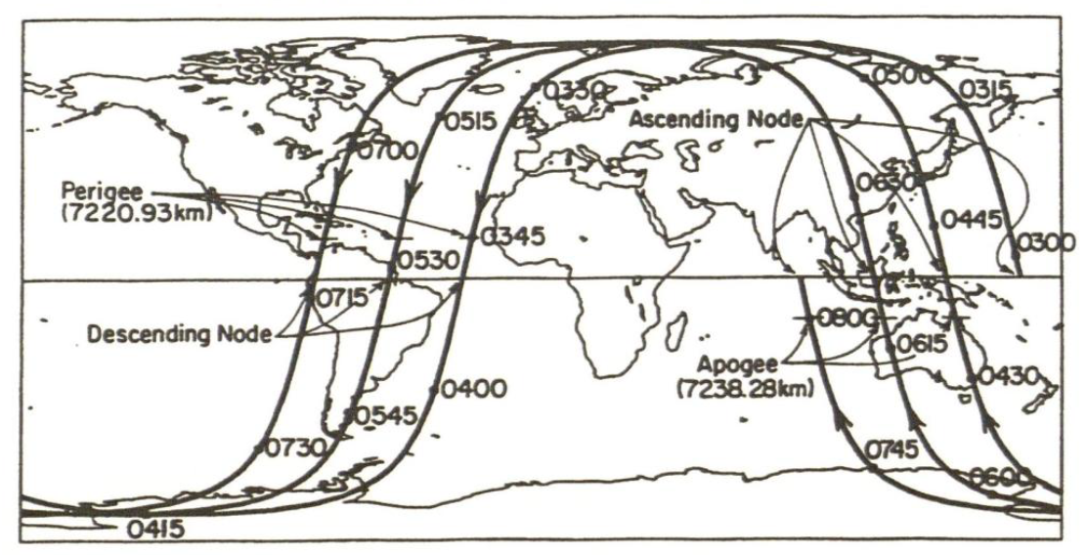
New instrumentation types:
Advanced Technology Microwave Sounder (ATMS) – Replaces current AMSU-A/B
Cross-track Infrared Sounder (CrIS) – Replaces current HIRS/3
Visible Infrared Imaging Radiometer Suite (VIIRS) – Replaces current AVHRR
Others: Radiation budget, ozone mapper.
POLAR ORBITER GROUND TRACK
(Image: Kidder and Vonder Harr, 1995)

Slide 33
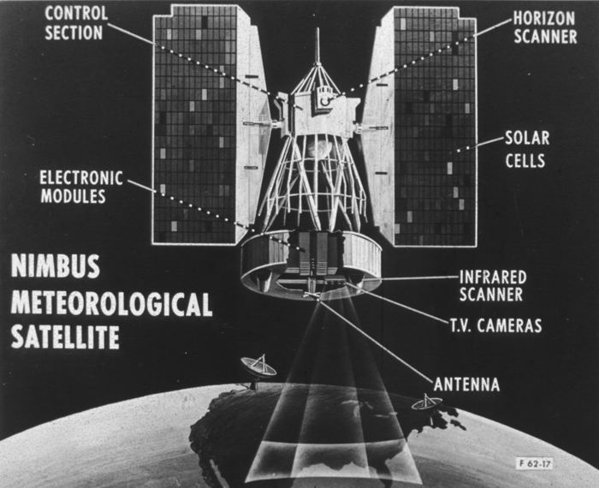
NIMBUS (Mid 1960s)

Slide 34
NIMBUS (Mid 1960s)
Stabilized on 3 axes using flywheels (gyroscopes).
Rotated on its own axis once/orbit so that instruments pointed “down” at Earth all the time.
Carried High-Resolution Infrared Radiometers (HRIR) similar to modern-day instruments.
NIMBUS 1 was first sunsynchronous satellite – passed over points on Earth surface at about the same time of day.

Slide 35
NIMBUS (Mid 1960s)
NIMBUS 3 carried instrumentation to estimate atmospheric soundings from space.
NIMBUS 4 carried Backscatter Ultraviolet instrument for measuring ozone.
NIMBUS 7 (last) remained operational through 1994.

Slide 36
NIMBUS (Mid 1960s)
NIMBUS 3 carried instrumentation to estimate atmospheric soundings from space.
NIMBUS 4 carried Backscatter Ultraviolet instrument for measuring ozone.
NIMBUS 7 (last) remained operational through 1994.
Apogee: 937 km
Perigee: 429 km
Period: 98.5 minutes
Polar orbiters.

Slide 37
DMSP
Defense Meteorological Satellite Program
USAF.
Program continues to the present day: DMSP 19 launched in 2011.
Sunsynchronous orbits.
Instrumentation began with video cameras; evolved to include many others, including Synthetic Aperture Radar (SAR).

Slide 38
DMSP
Apogee: 872 km
Perigee: 680 km
Period: 100.5 minutes
Polar orbiters.

Slide 39
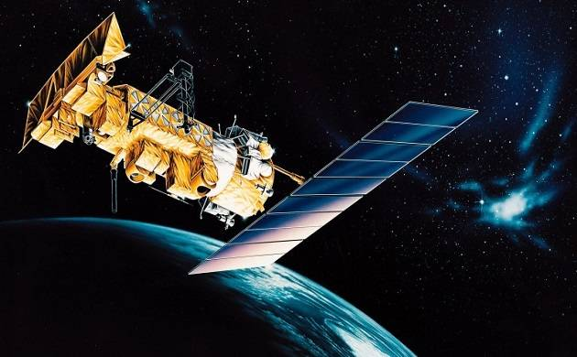
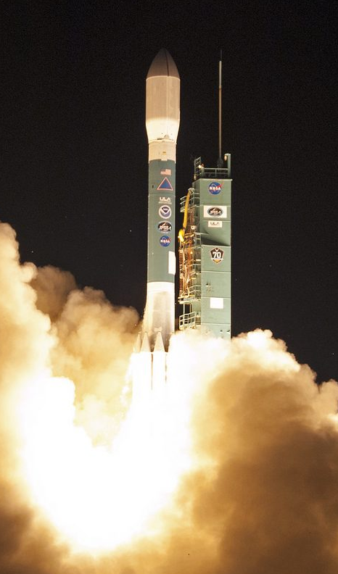
JPSS

Slide 40
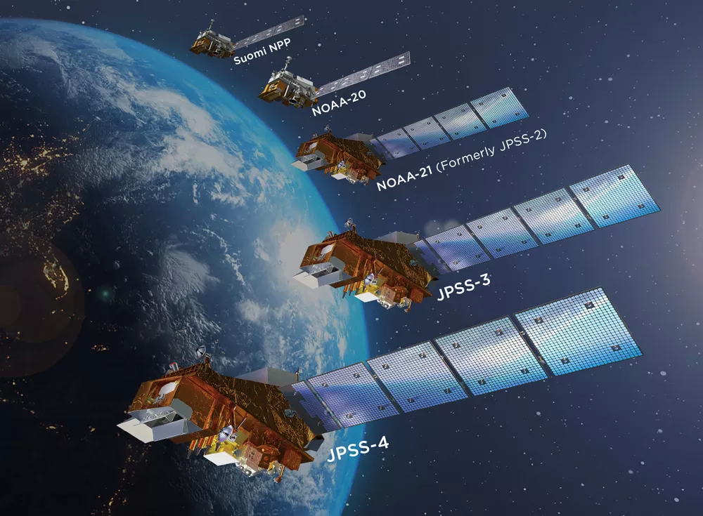
JPSS

Slide 41
JPSS
2011
2017
2022
2026
2031

Slide 42
JPSS
Joint Polar Satellite System
Next generation polar orbiting environmental satellites.
Collaboration between NOAA and NASA.
Replacing NOAA-POES (TIROS) and DMSP programs.
First satellite was launched in 2011 (Suomi NPP).
Second launched in 2017 (JPSS-1 or NOAA-20).
JPSS-2 launched in November 2022

Slide 43
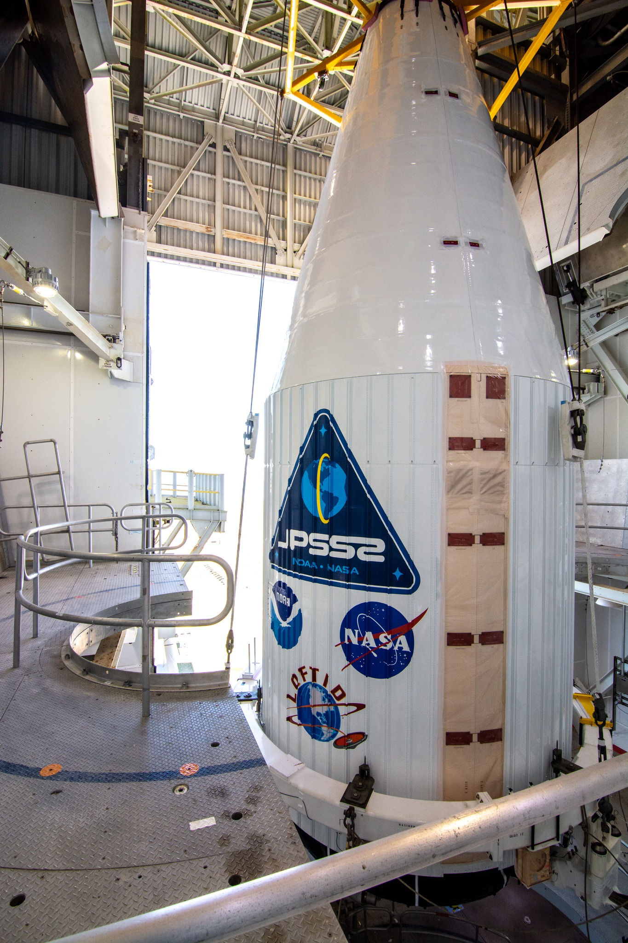
JPSS
Joint Polar Satellite System
Next generation polar orbiting environmental satellites.
Collaboration between NOAA and NASA.
Replacing NOAA-POES (TIROS) and DMSP programs.
First satellite was launched in 2011 (Suomi NPP).
Second launched in 2017 (JPSS-1 or NOAA-20).
JPSS-2 launched in November 2022

Slide 44
JPSS
New instrumentation types:
Advanced Technology Microwave Sounder (ATMS) – Replaces current AMSU-A/B
Cross-track Infrared Sounder (CrIS) – Replaces current HIRS/3
Visible Infrared Imaging Radiometer Suite (VIIRS) – Replaces current AVHRR
Others: Radiation budget, ozone mapper.

Slide 45
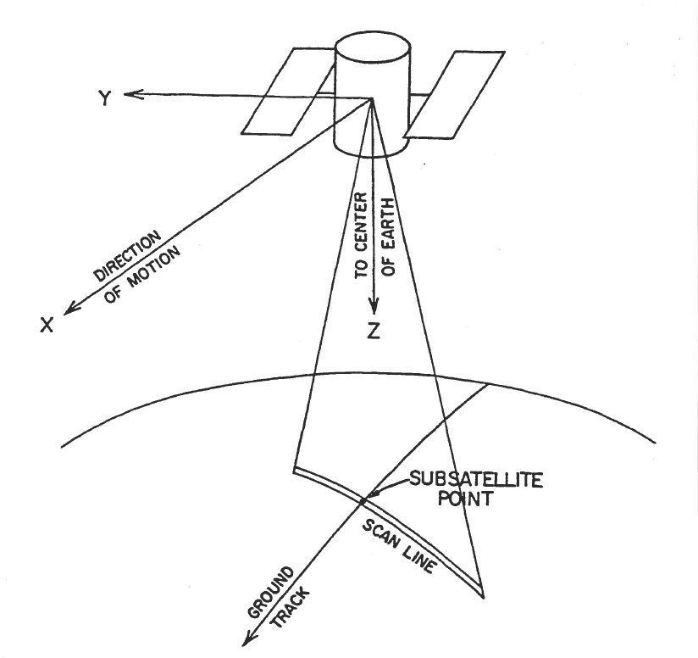
JPSS
SCAN STRATEGY
(Image: Kidder and Vonder Harr, 1995)

Slide 46
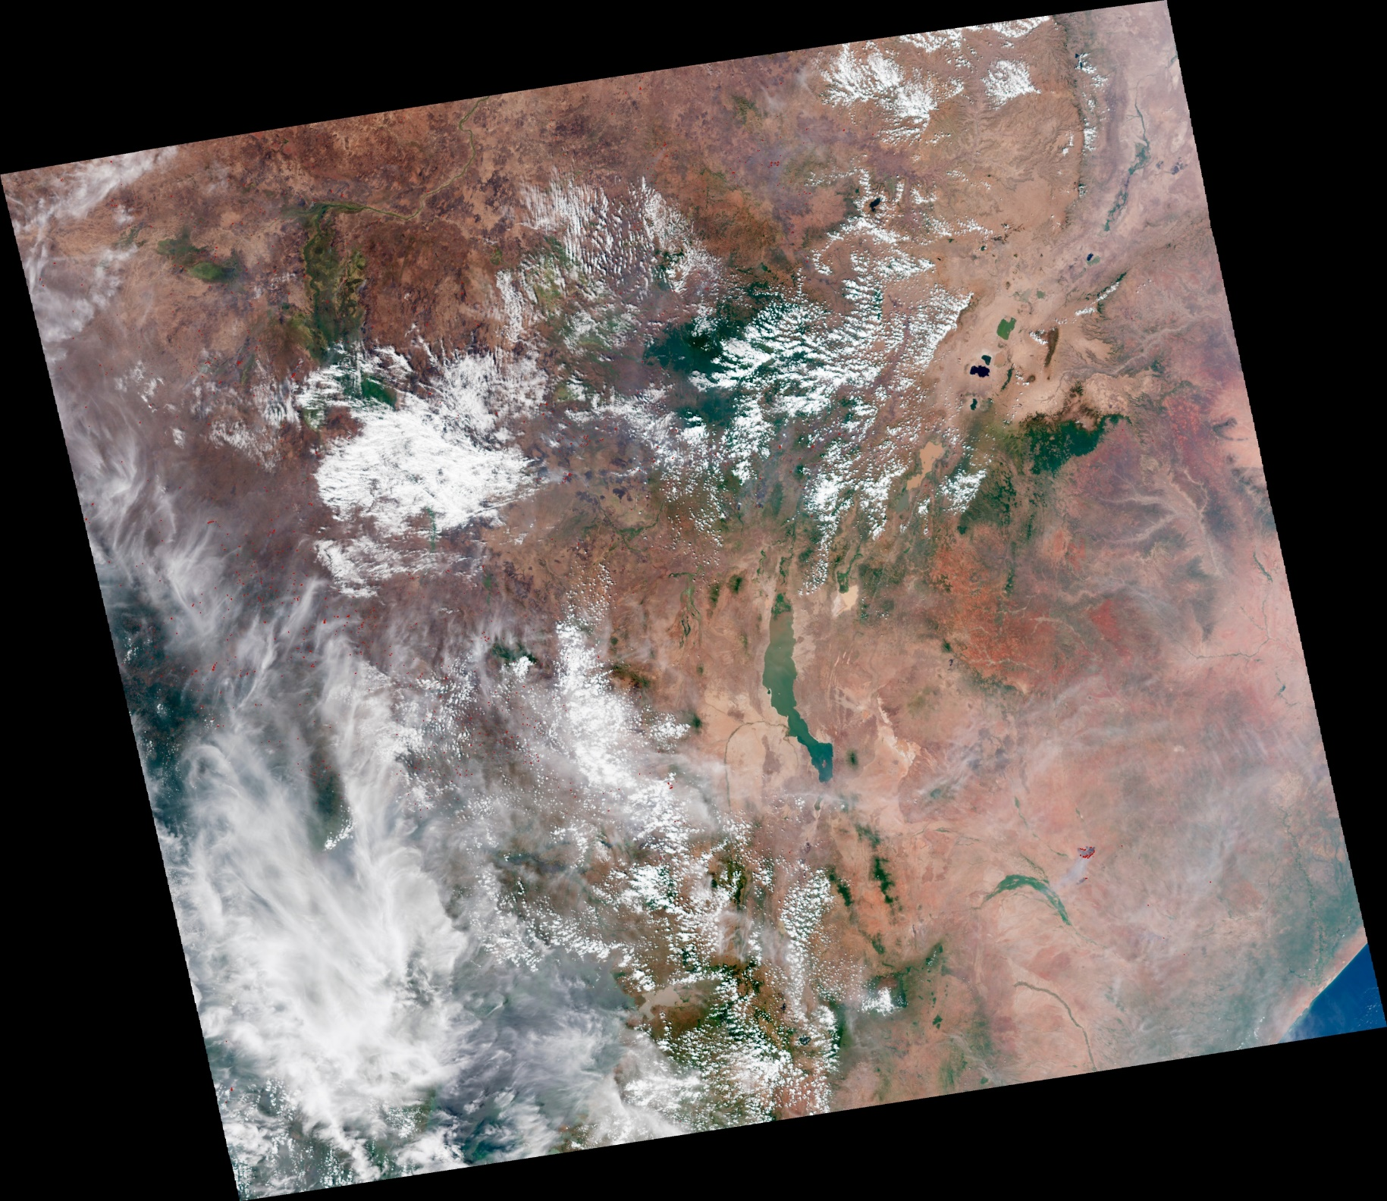

Slide 47


Slide 48
Red dots are fires
Field of cumulus clouds

Slide 49
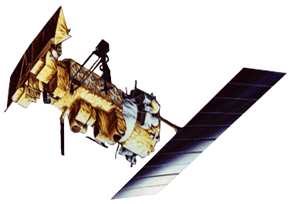
CURRENT CIVIL POLAR ORBITERS

Slide 50
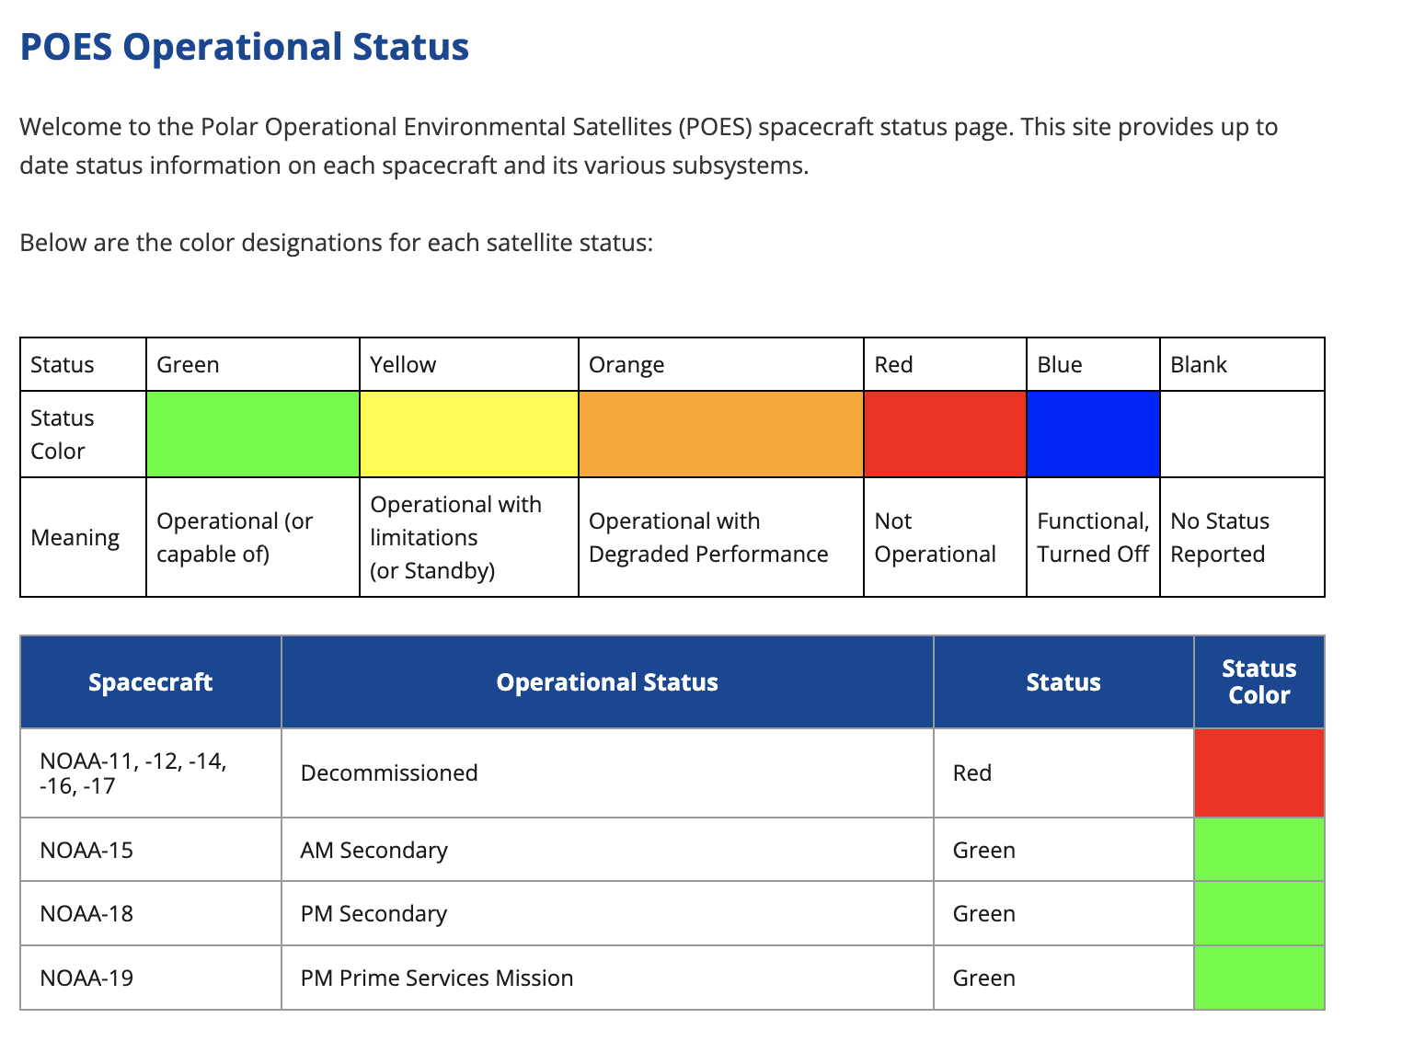
POES Status
As of January, 2024:

Slide 51
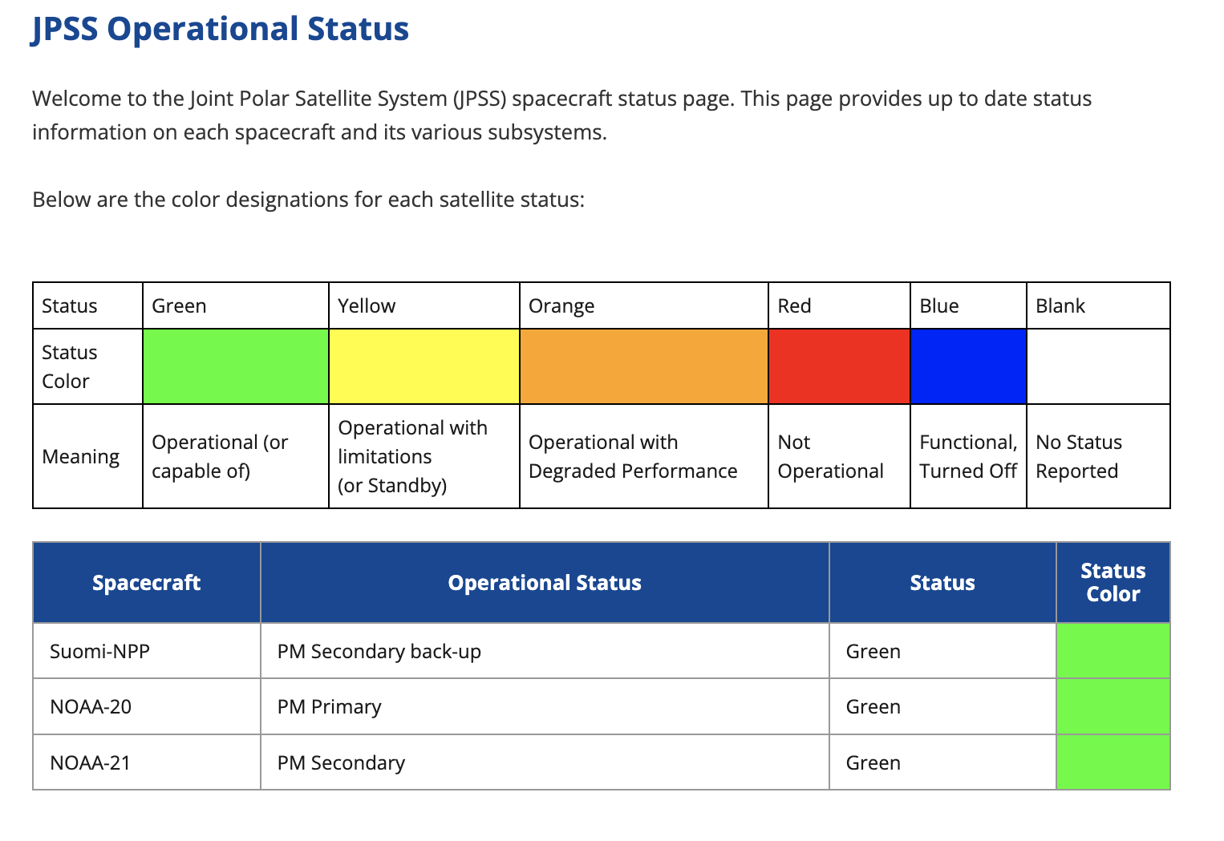
POES Status
As of January, 2024:

Slide 52
Geostationary Orbiters

Slide 53
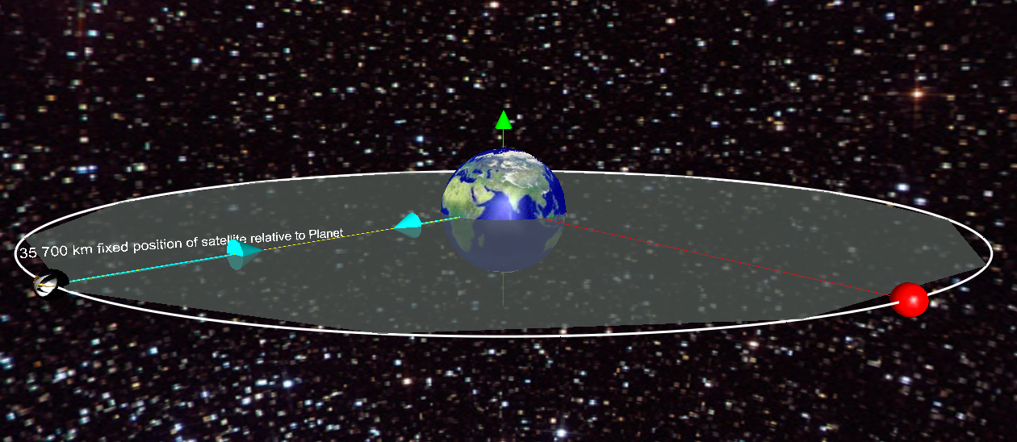
6 Earth radii

Slide 54
ATS
Applications Technology Satellite
First metsat in geostationary orbit.
Placed above Western Hemisphere.
Designed to test meteorological and other types of instrumentation.
ATS 3 launched with equipment for creating color images; launched in 1967; remained active until 2001.

Slide 55
ATS
Total of 6 launched – last one in 1974.

Slide 56
ATS
ATS
Early full-disk image from ATS
Total of 6 launched – last one in 1974.

Slide 57
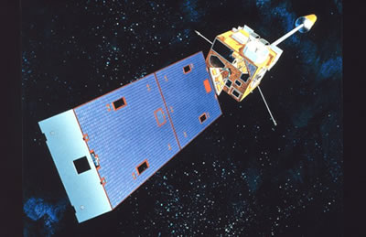
GOES (Mid 1970s to now)

Slide 58
GOES
Geostationary Operational Environmental Satellite
Operational workhorse of day-to-day weather forecasting.
Apogee: 35,804 km
Perigee: 35,797 km
Period: 1436.7 minutes (~1 day)
Equatorial orbiters.

Slide 59
GOES
Geostationary Operational Environmental Satellite
Operational workhorse of day-to-day weather forecasting.
United States has generally maintained at least two geostationary satellites in orbit at all times:
One above 75 west
One above 135 west
On-orbit spare near 105 west
Currently there are more

Slide 60
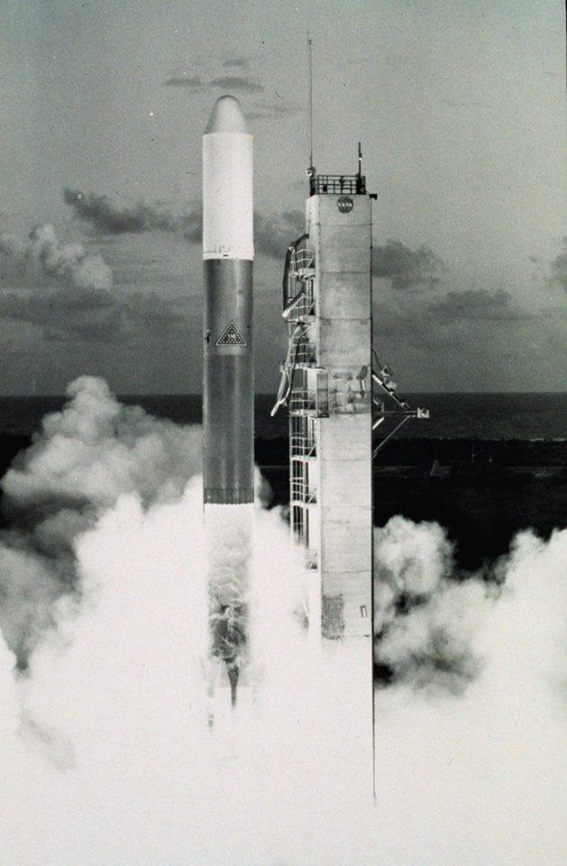
GOES (mid 1970s - now)
Launch of GOES-1 in 1975
Geostationary Operational Environmental Satellite
Operational workhorse of day-to-day weather forecasting.
United States has generally maintained at least two geostationary satellites in orbit at all times:
One above 75 west
One above 135 west
On-orbit spare near 105 west
Currently there are more

Slide 61
GOES-R Series
Next Generation GOES (R through U)
Will extend geostationary satellite service to 2036.
Advanced instrumentation:
Advanced Baseline Imager (ABI) – Replaces GOES imager (16 bands instead of 5; two visible channels; up to 4 times the resolution)
Geostationary Lightning Mapper (GLM)
Also: Several Sun-oriented instruments

Slide 62
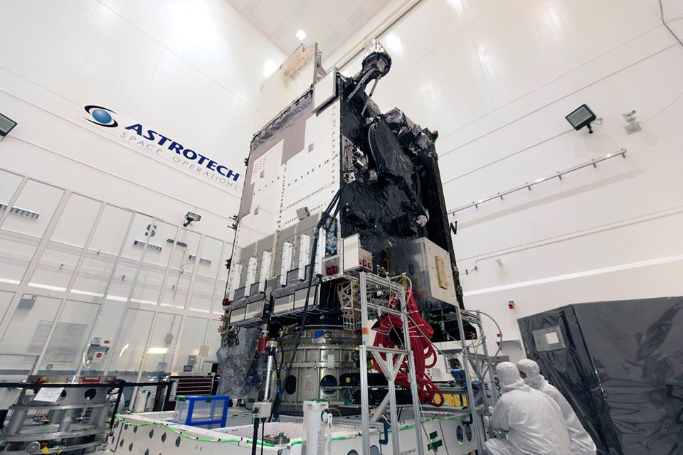
GOES R-Series
Next Generation GOES (R through U)
Will extend geostationary satellite service to 2036.
Advanced instrumentation:
Advanced Baseline Imager (ABI) – Replaces GOES imager (16 bands instead of 5; two visible channels; up to 4 times the resolution)
Geostationary Lightning Mapper (GLM)
Also: Several Sun-oriented instruments
GOES-S/17/W

Slide 63
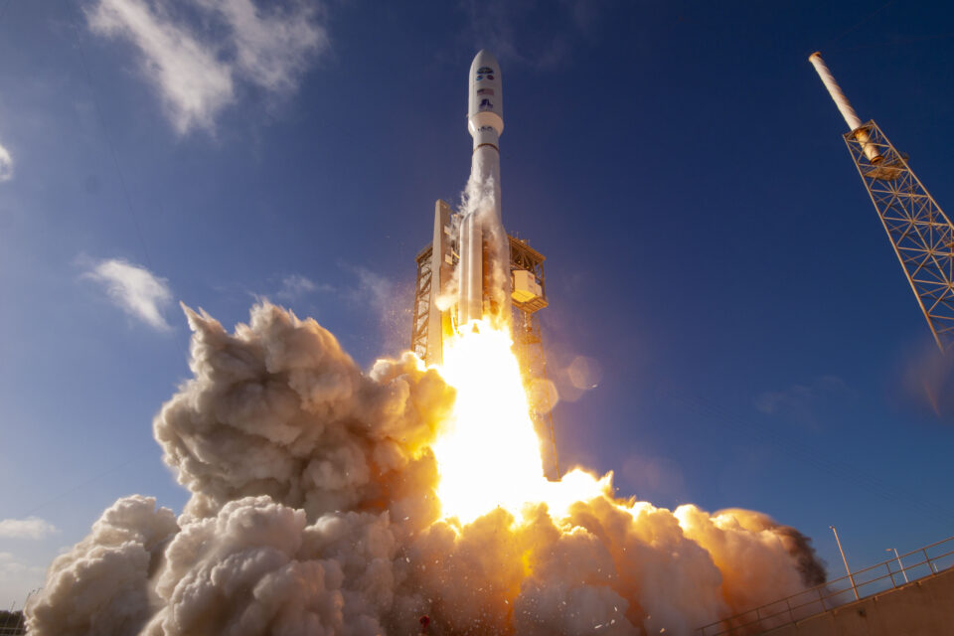
GOES R-Series
Next Generation GOES (R through U)
Will extend geostationary satellite service to 2036.
Advanced instrumentation:
Advanced Baseline Imager (ABI) – Replaces GOES imager (16 bands instead of 5; two visible channels; up to 4 times the resolution)
Geostationary Lightning Mapper (GLM)
Also: Several Sun-oriented instruments
GOES-T/18/W

Slide 64
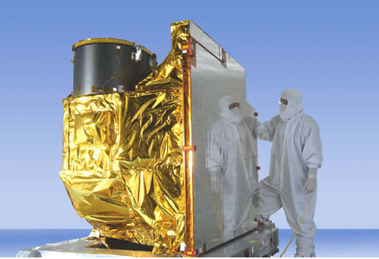
GOES-R SERIES
Next Generation GOES (R through U)
Will extend geostationary satellite service to 2036.
Advanced instrumentation:
Advanced Baseline Imager (ABI) – Replaces GOES imager (16 bands instead of 5; two visible channels; up to 4 times the resolution)
Geostationary Lightning Mapper (GLM)
Also: Several Sun-oriented instruments

Slide 65
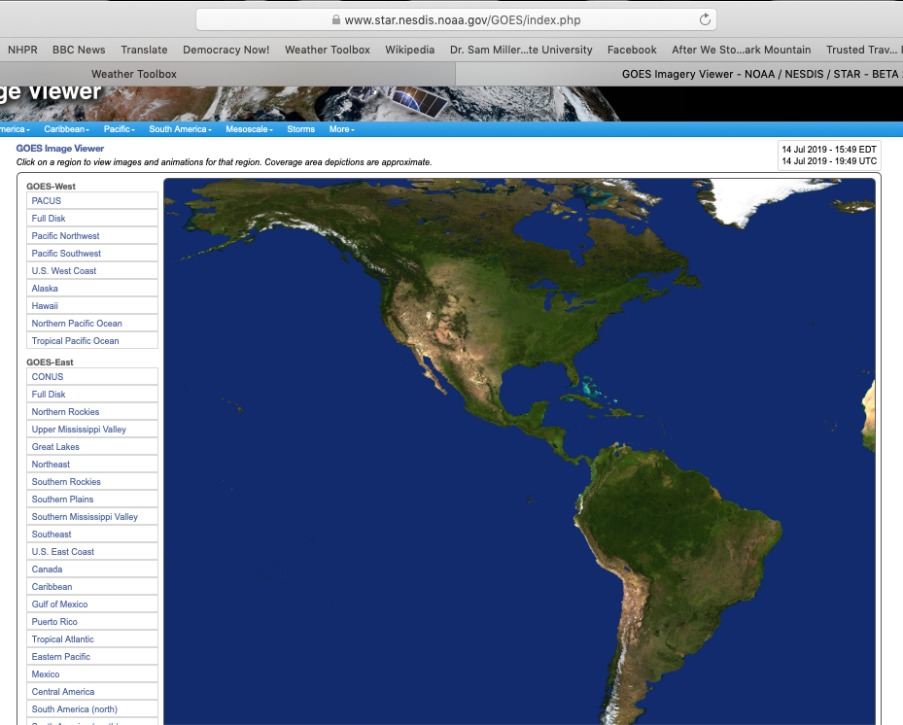

Slide 67
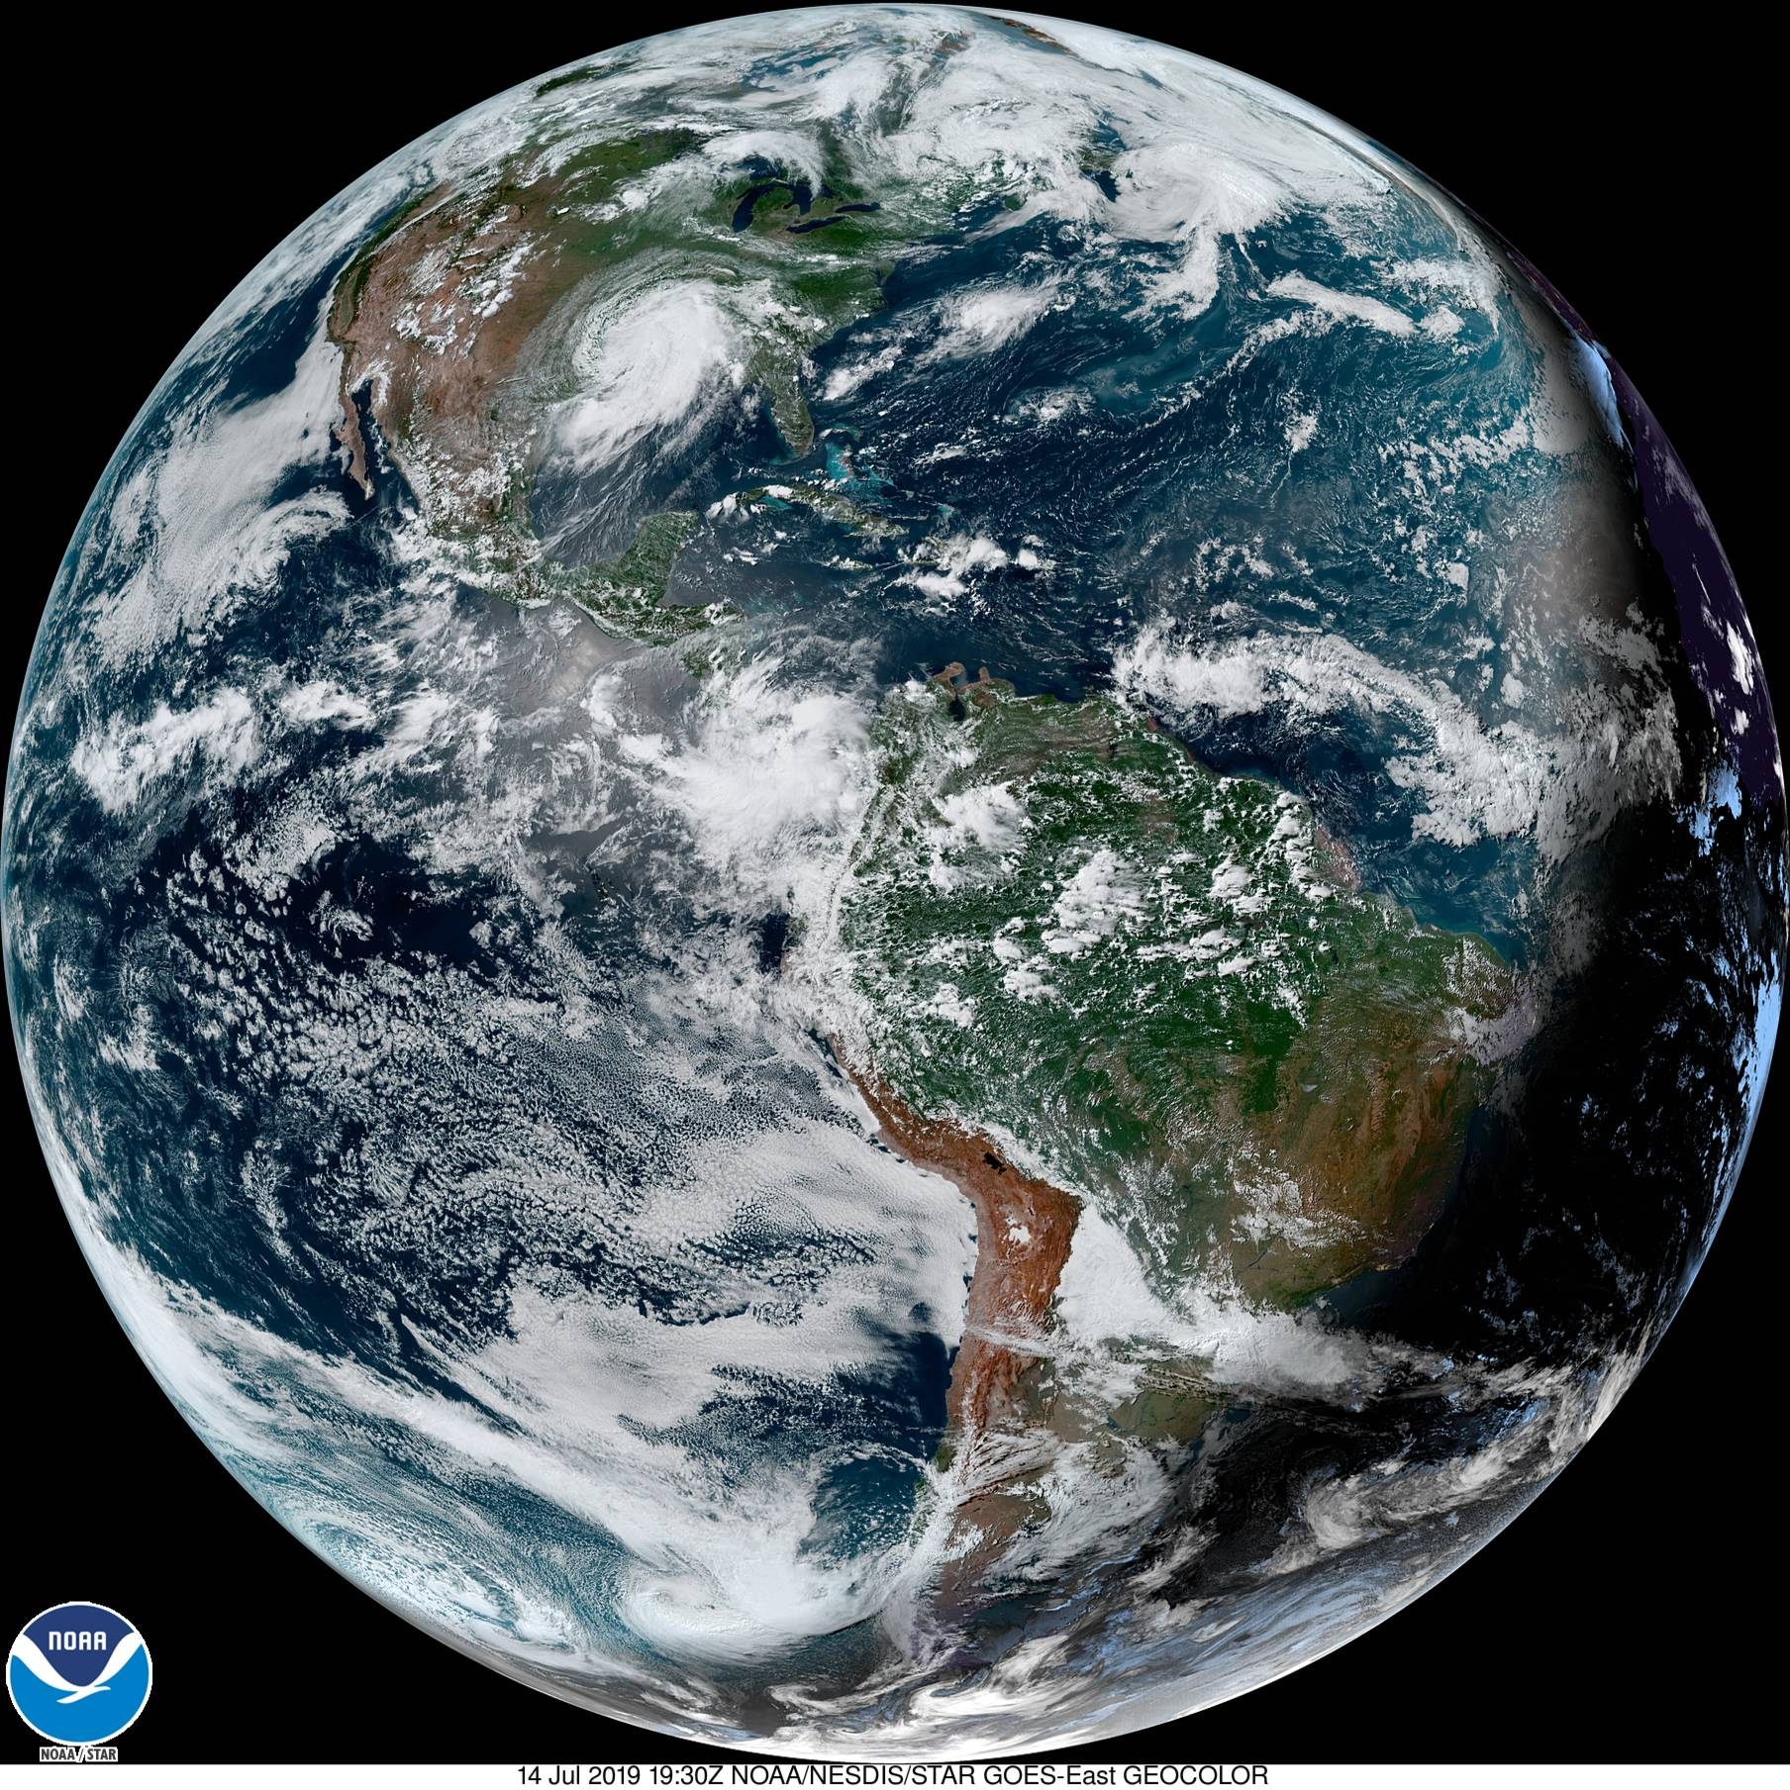

Slide 68
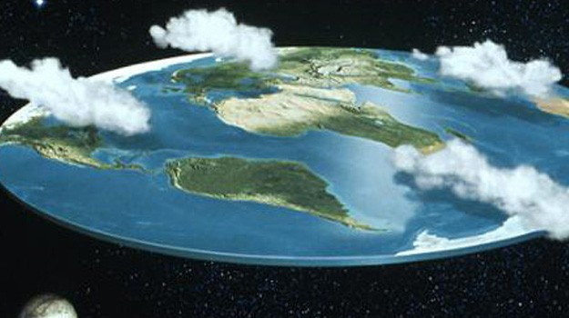
X

Slide 69

ROUND
EARTH
(Marty approves.)

Slide 70
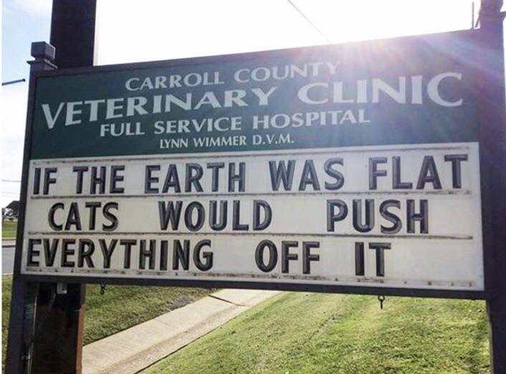

Slide 72
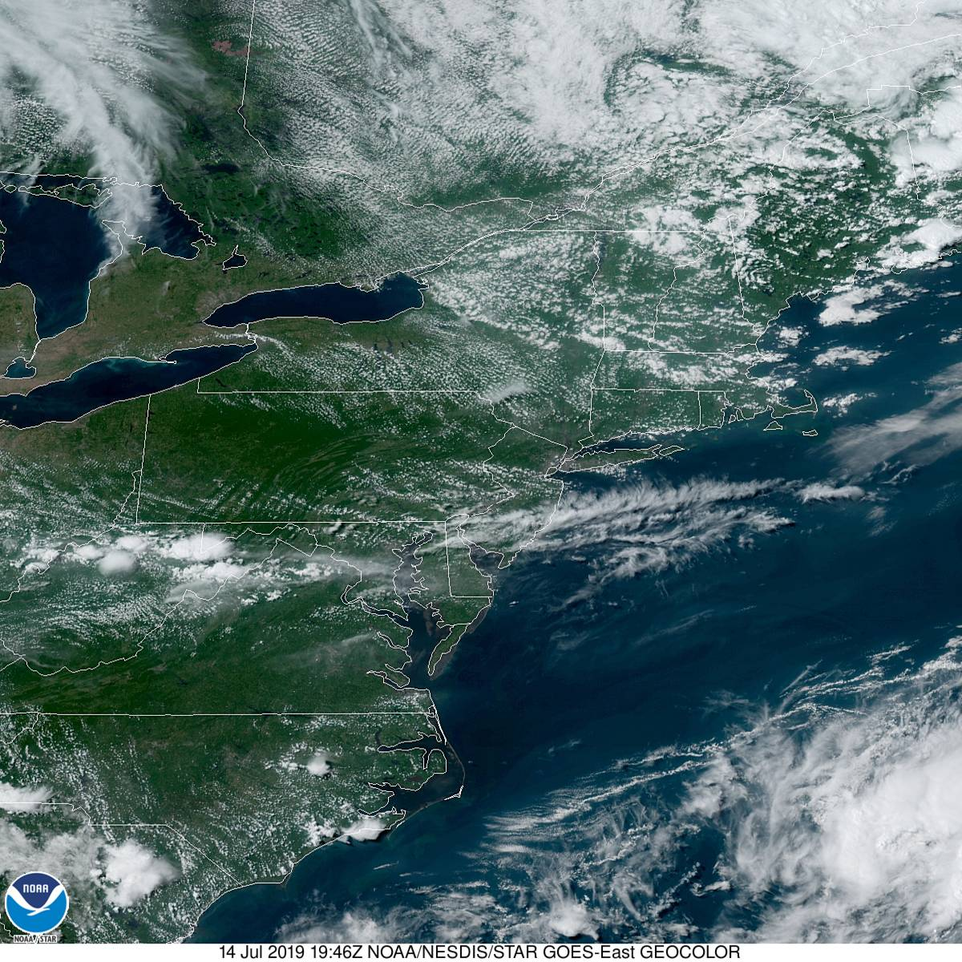

Slide 73
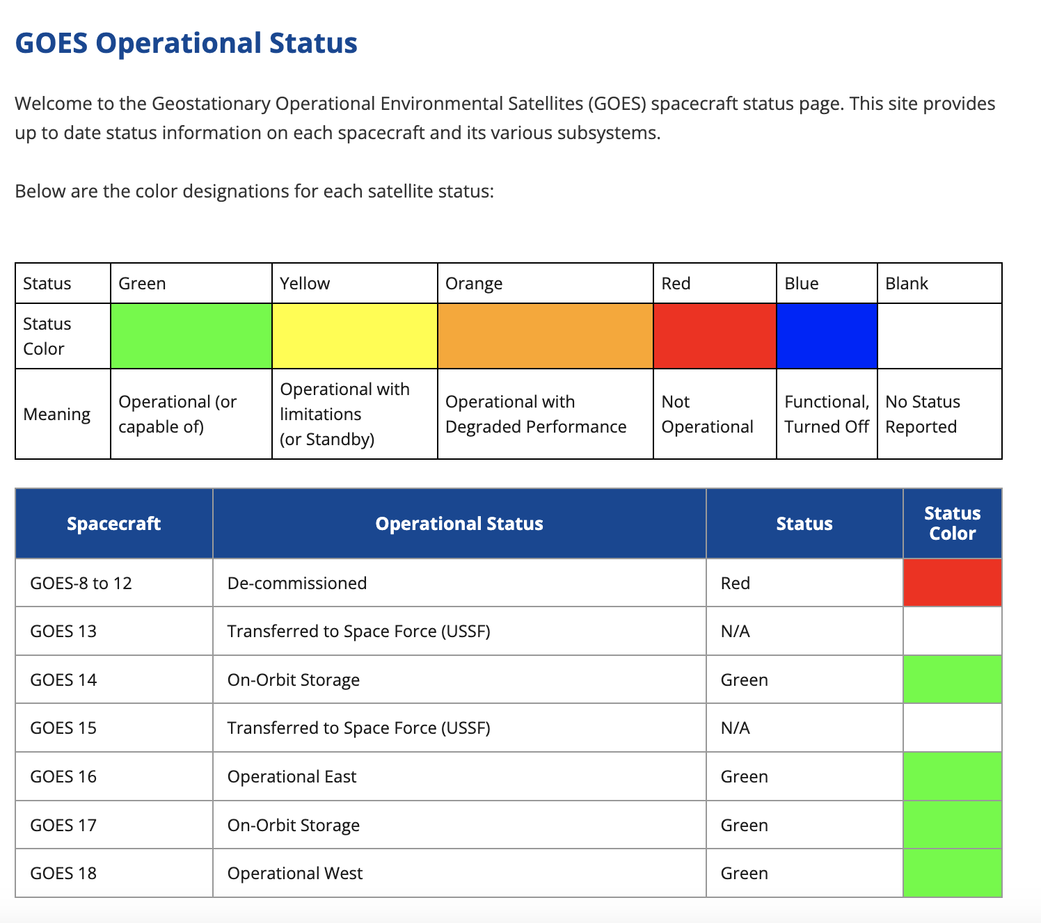
GOES Status
As of January, 2024
R
S
T

Slide 74
GOES Status
As of January, 2024
GOES-U/19 was launched in June, 2024
It became the new GOES-East
This is the last of the GOES-R series
Next generation will be GeoXO, beginning in the 2030s.
R
S
T

Slide 75
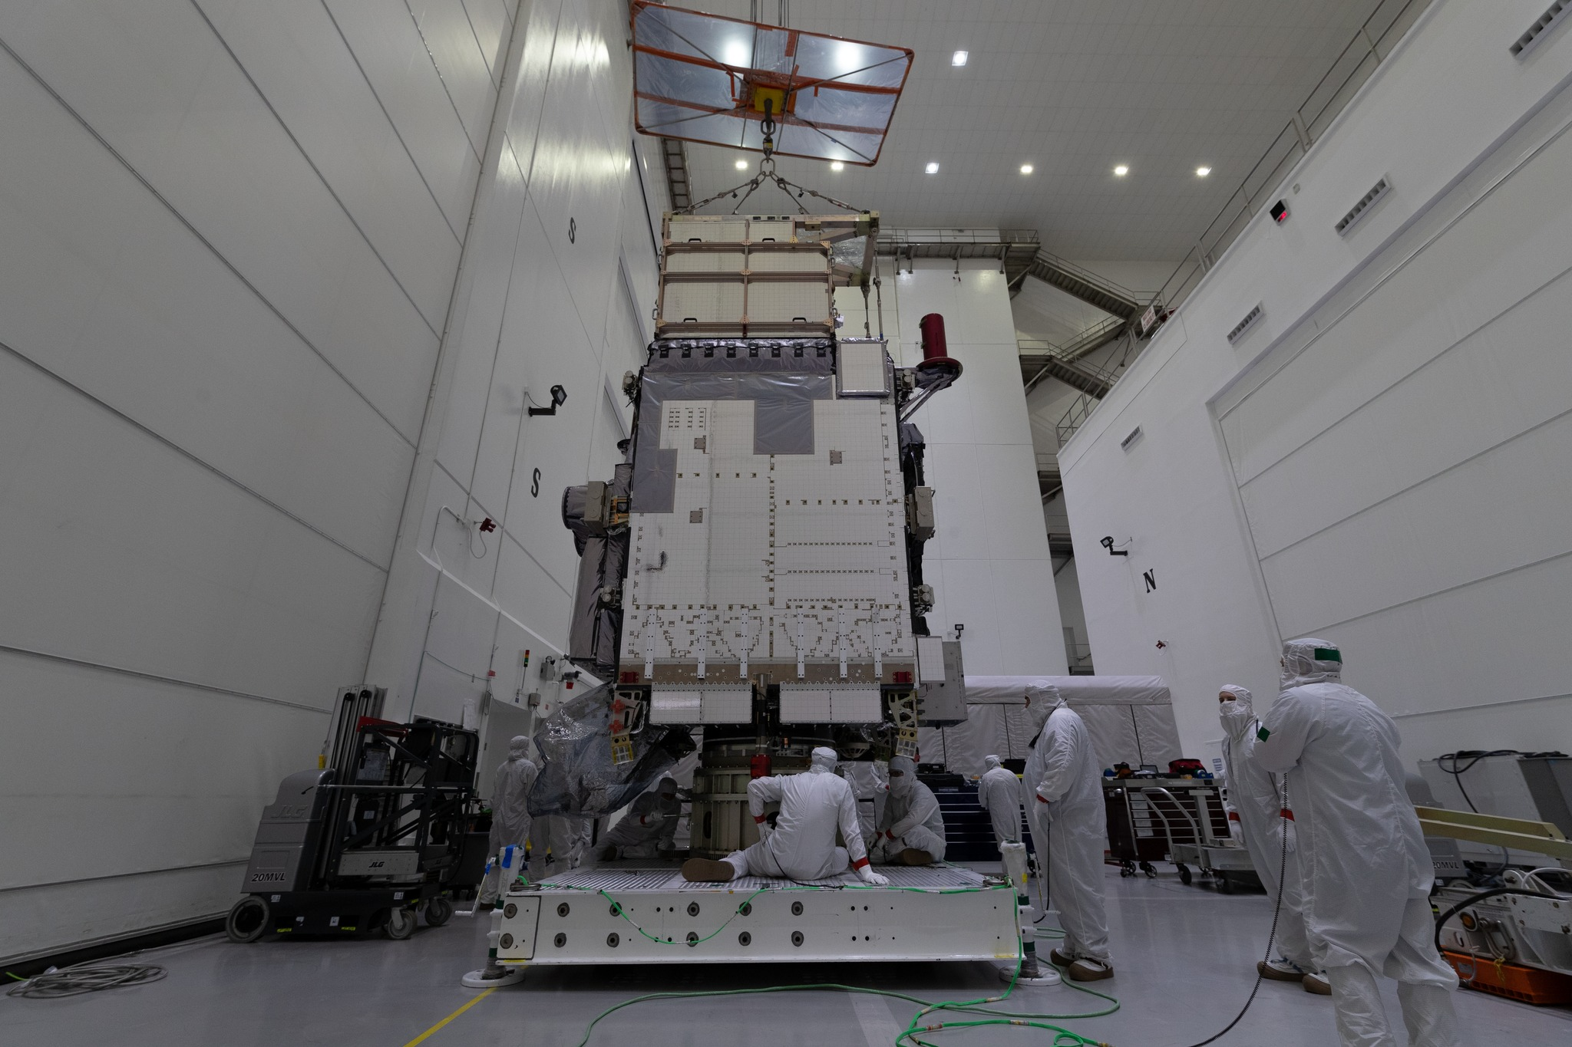
GOES Status
GOES-U/19

Slide 76
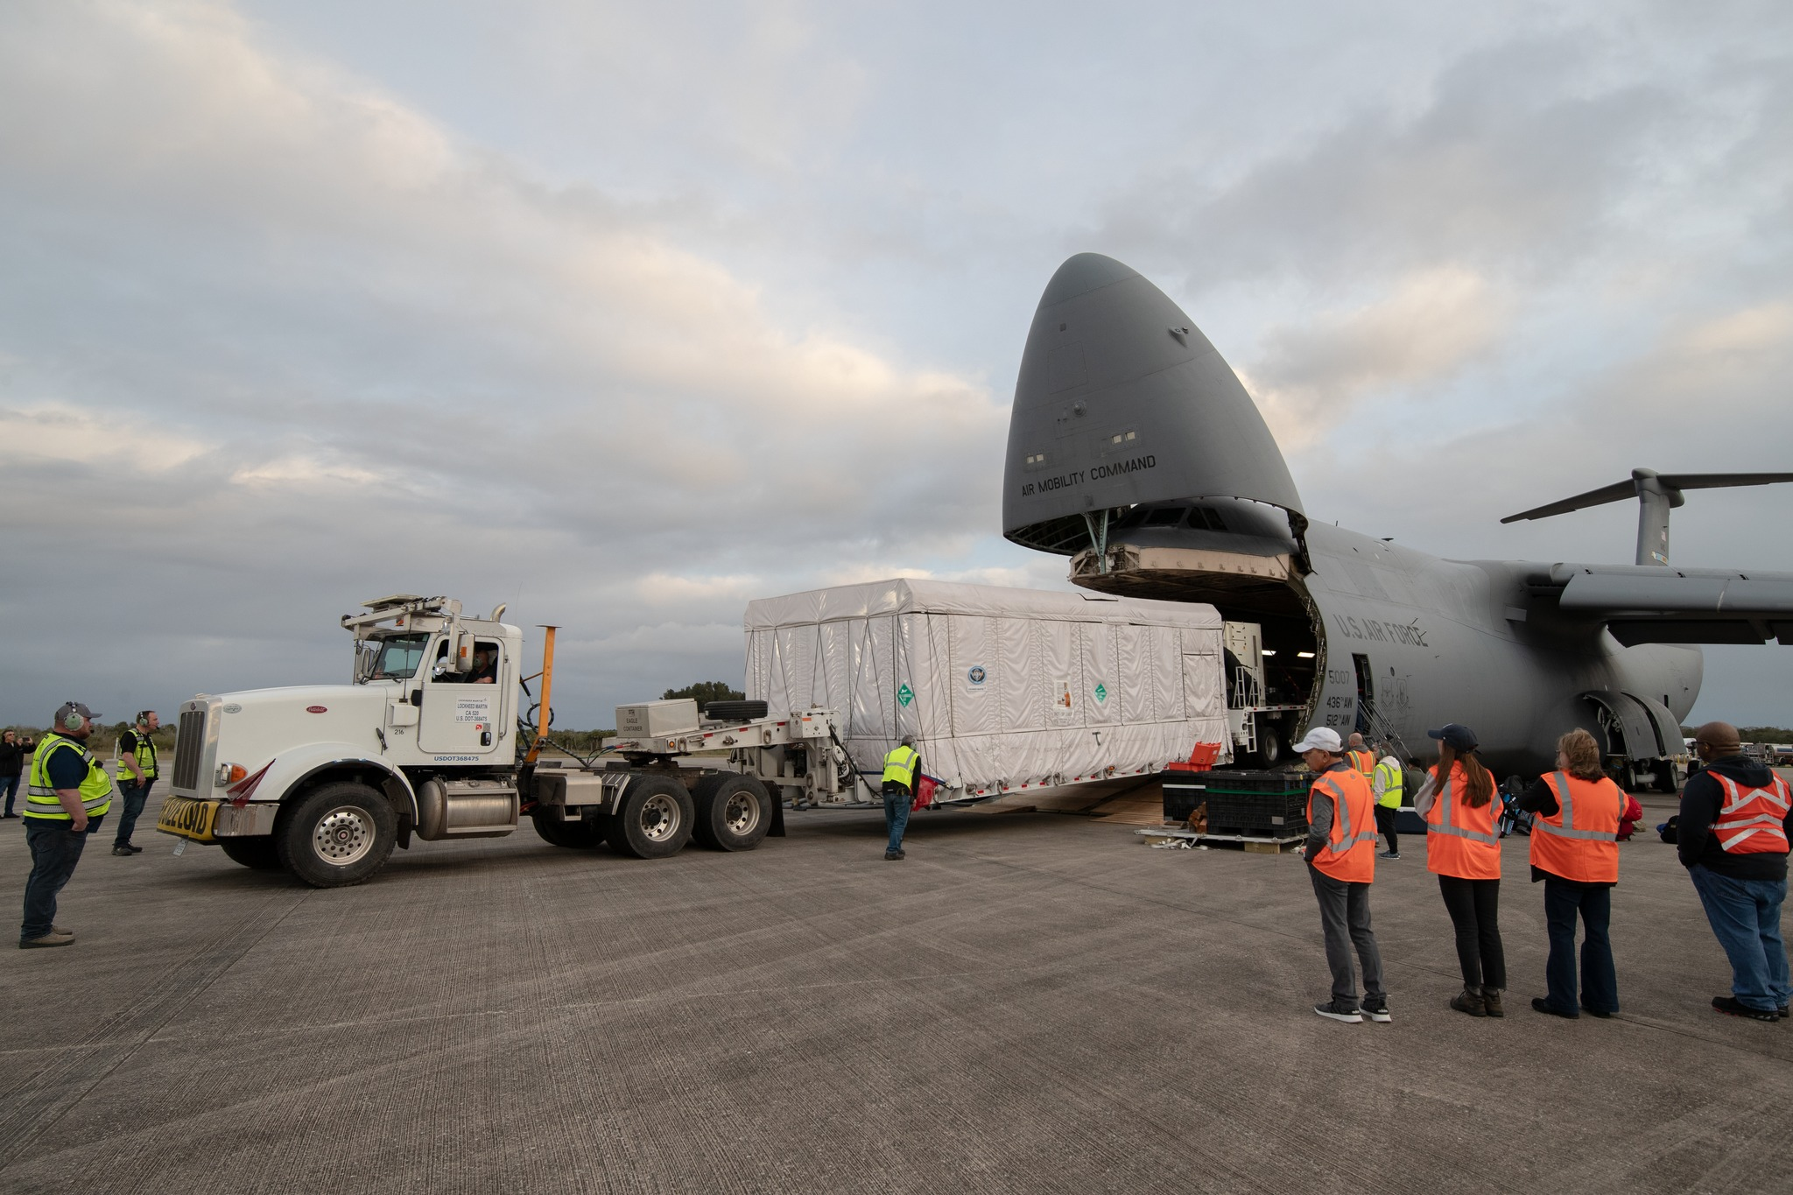
GOES Status
GOES-U/19 arrives at Kennedy Space Center

Slide 77
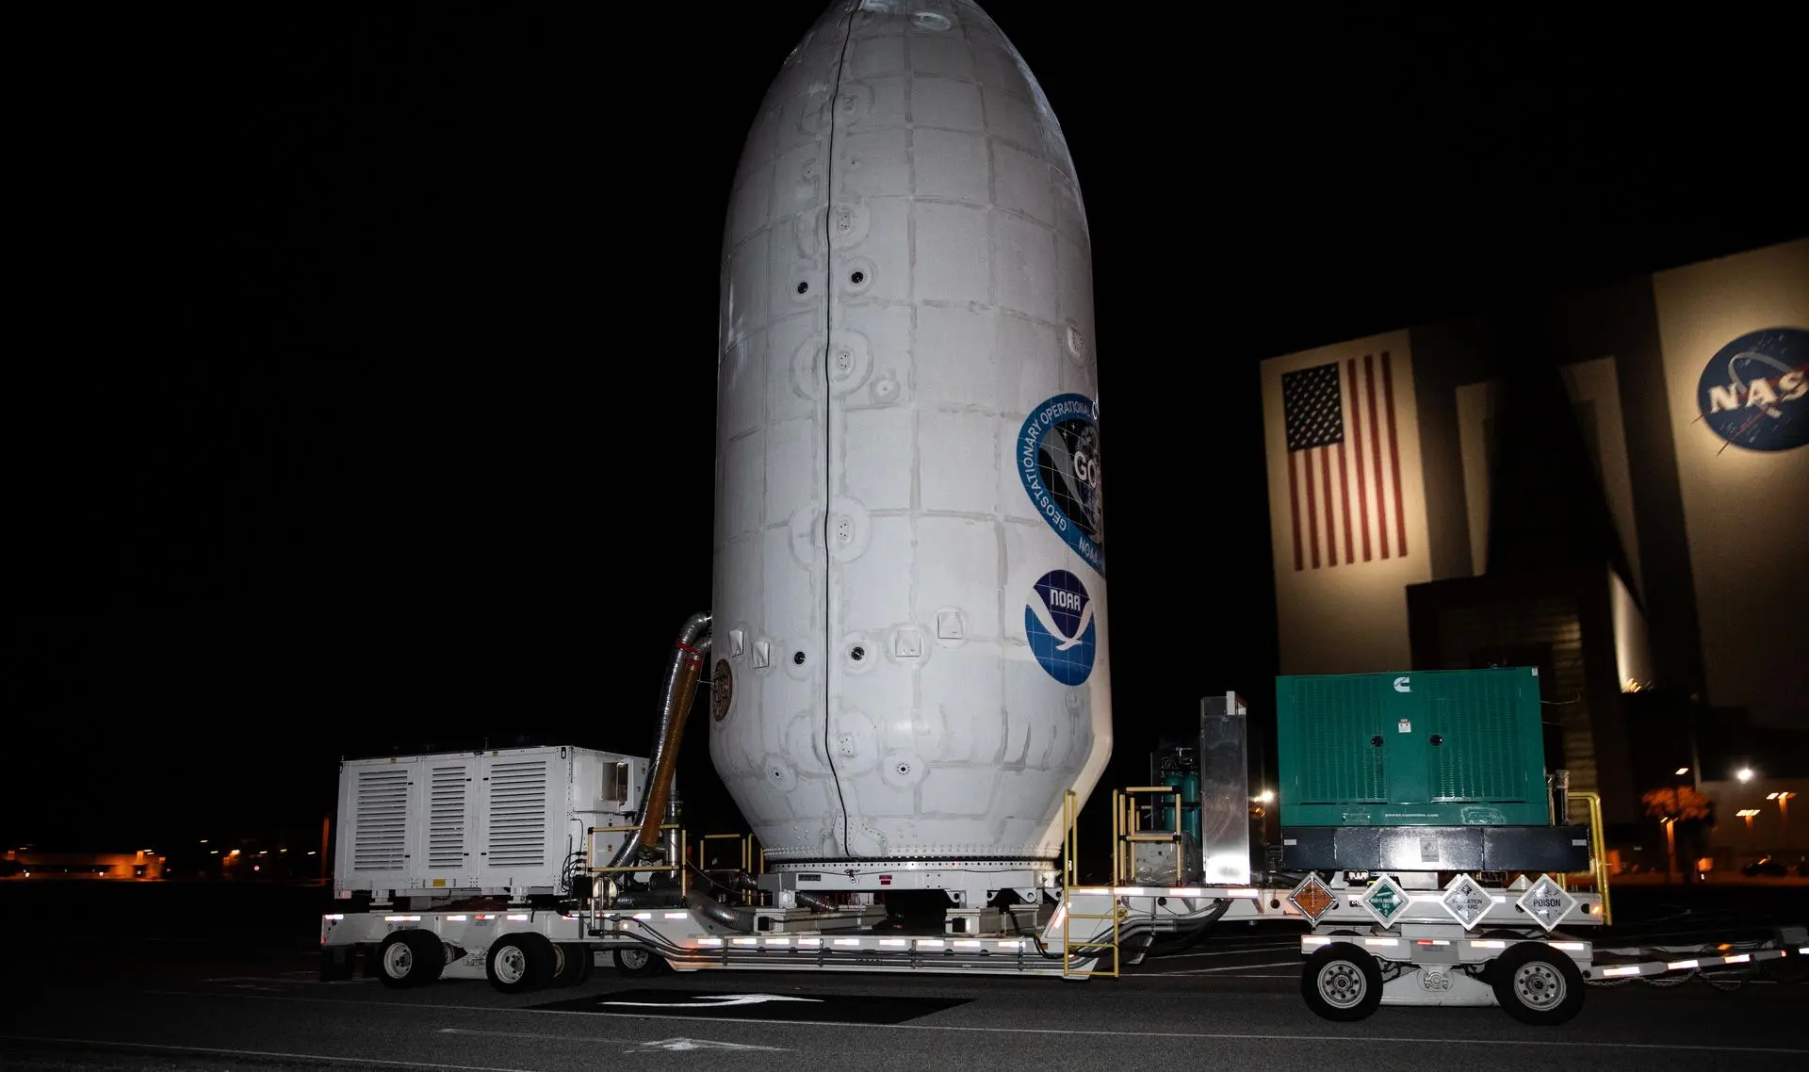
GOES Status
GOES-U/19 installed in payload fairing

Slide 78
FOR CURRENT STATUS OF ALL METSAT SYSTEMS
http://www.ospo.noaa.gov

Slide 79
References
Kidder, S.Q., and T.H. Vonder Harr, 1995: Satellite Meteorology – An Introduction, San Diego: Academic Press, 466 pgs.
Public Domain Sources

