Slide 1
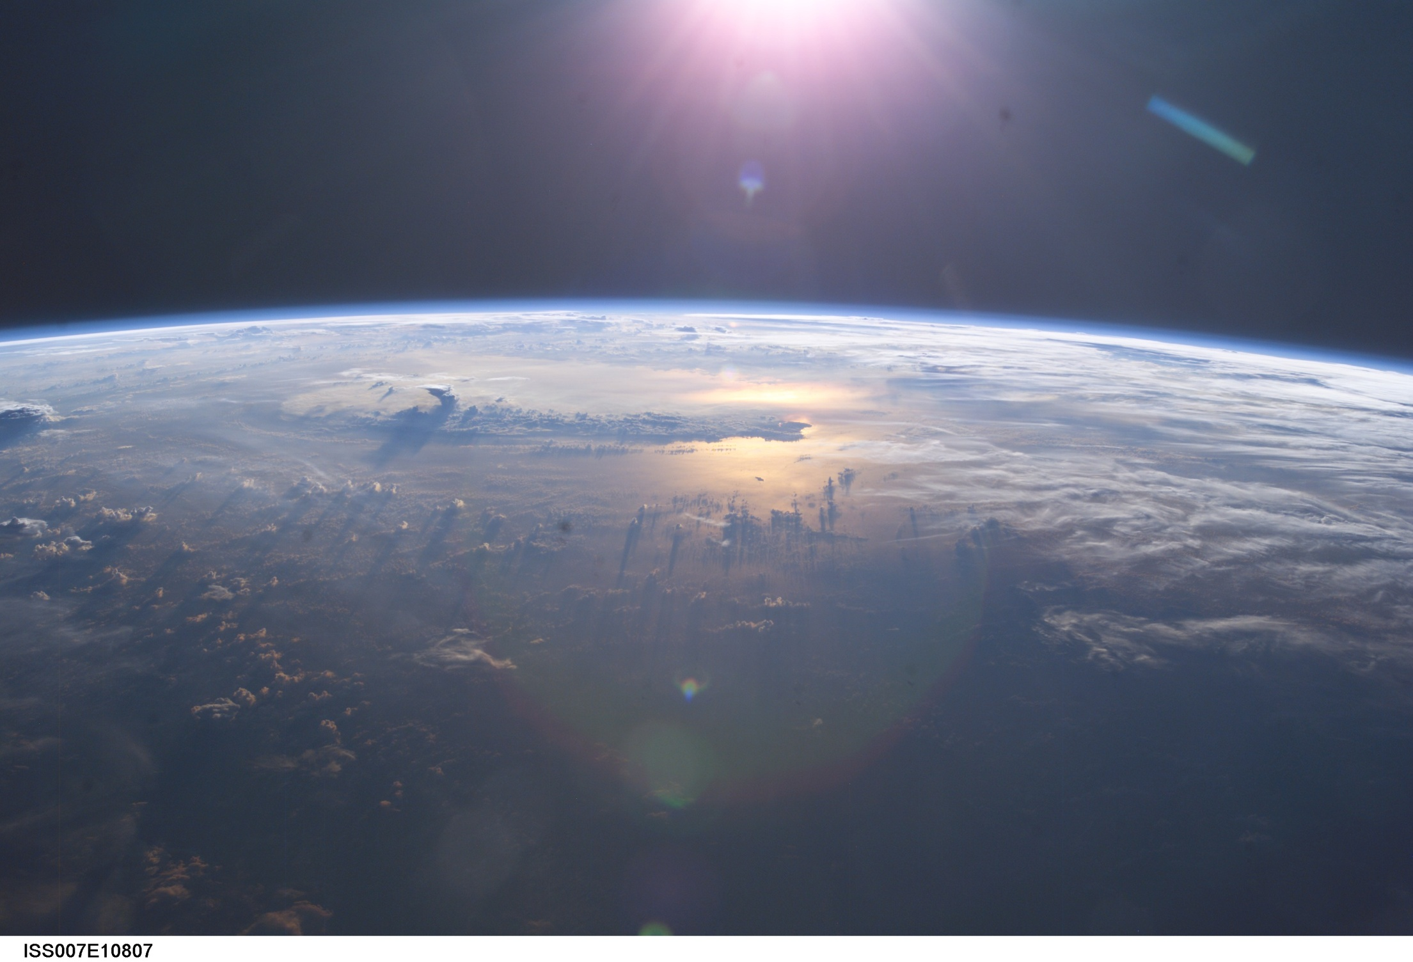


SATELLITE METEOROLOGY
Part 3: EMR and Instrumentation
Dr. Sam Miller
Professor of Meteorology
Plymouth State University
Open Educational Resource

Slide 2
BASICS OF EMR

Slide 3
LIGHT CAN BE DESCRIBED AS A PARTICLE OR A WAVE
Both provide a limited description of light in particular circumstances.
Both are analogies.
Characteristics light manifests depend on the experiment performed.
BASICS OF EMR

Slide 4
WAVE ANALOGY OF EMR
Most of the time, the wave analogy is best for use in remote sensing.
Wave characteristics of light include:
Relationship to electrical and magnetic fields
Speed of propagation in a vacuum (c)
Wavelength (λ)
Period (T) and frequency (f and ω)
Polarization
Phase angle (φ)
Doppler shift (Δf)
Energy carried by light (ΔE)
Black body radiation
BASICS OF EMR

Slide 5
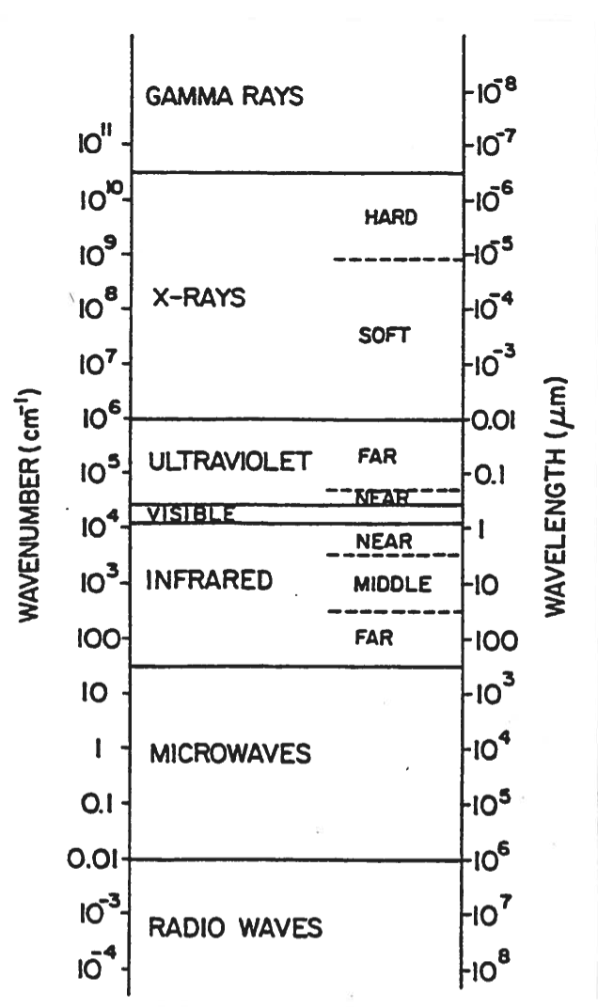
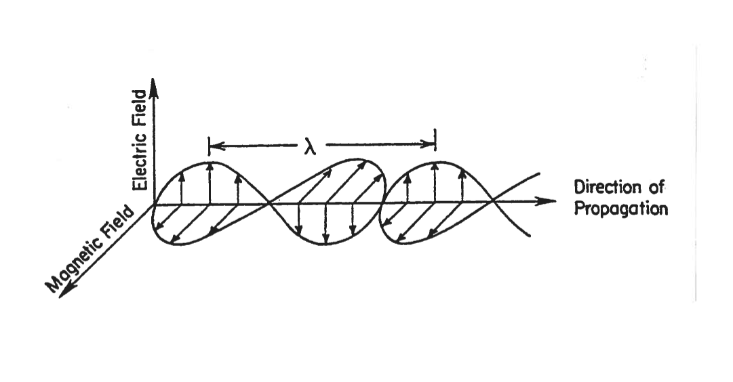
WAVE ANALOGY OF EMR
BASICS OF EMR
(Images: Kidder and Vonder Harr, 1995)

Slide 6
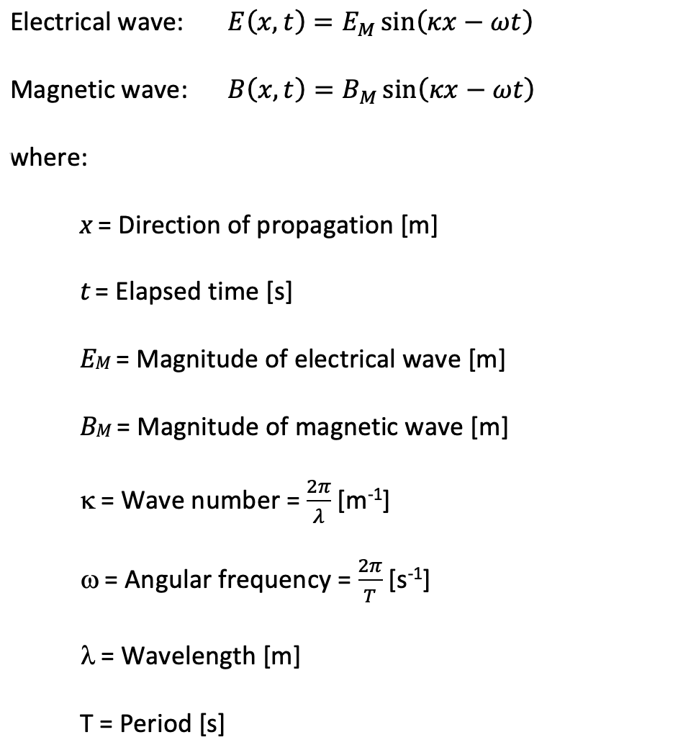
WAVE ANALOGY OF EMR
(Image: Kidder and Vonder Harr, 1995)

Slide 7
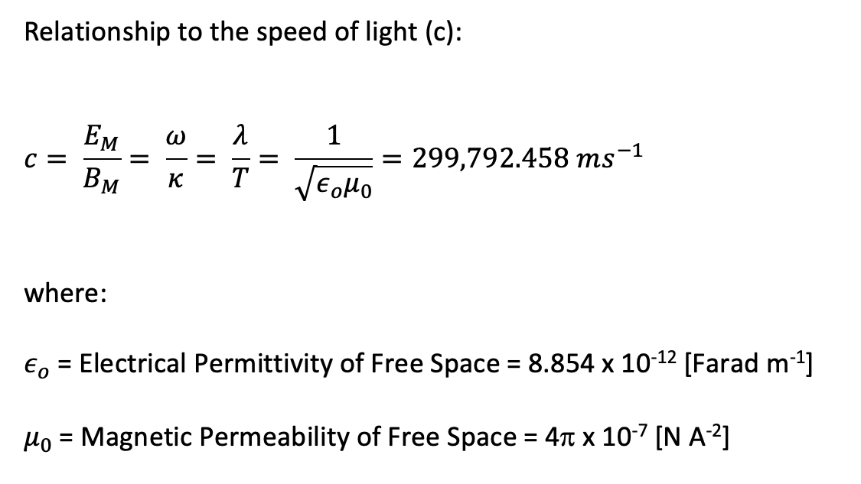
WAVE ANALOGY OF EMR
299,792,458
BASICS OF EMR
(Image: Kidder and Vonder Harr, 1995)

Slide 8
POLARIZATION
Polarization refers to the orientation of the electrical field.
May be linear or circular.
If linear, electrical field remains oriented in a fixed plane.
If circular, electrical field rotates around axis of propagation.
BASICS OF EMR
(Image: Kidder and Vonder Harr, 1995)

Slide 9
POLARIZATION
Polarization refers to the orientation of the electrical field.
May be linear or circular.
If linear, electrical field remains oriented in a fixed plane.
If circular, electrical field rotates around axis of propagation.
BASICS OF EMR

Slide 10
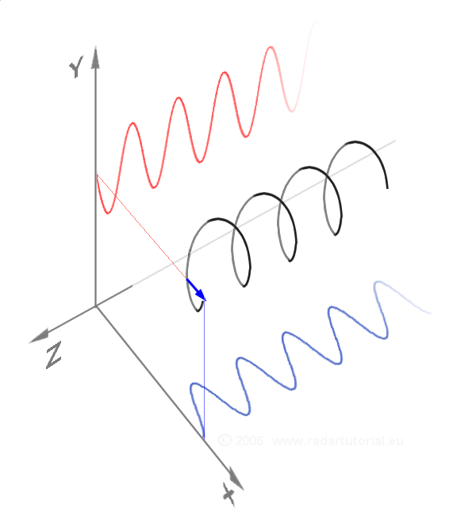
POLARIZATION
BASICS OF EMR

Slide 11
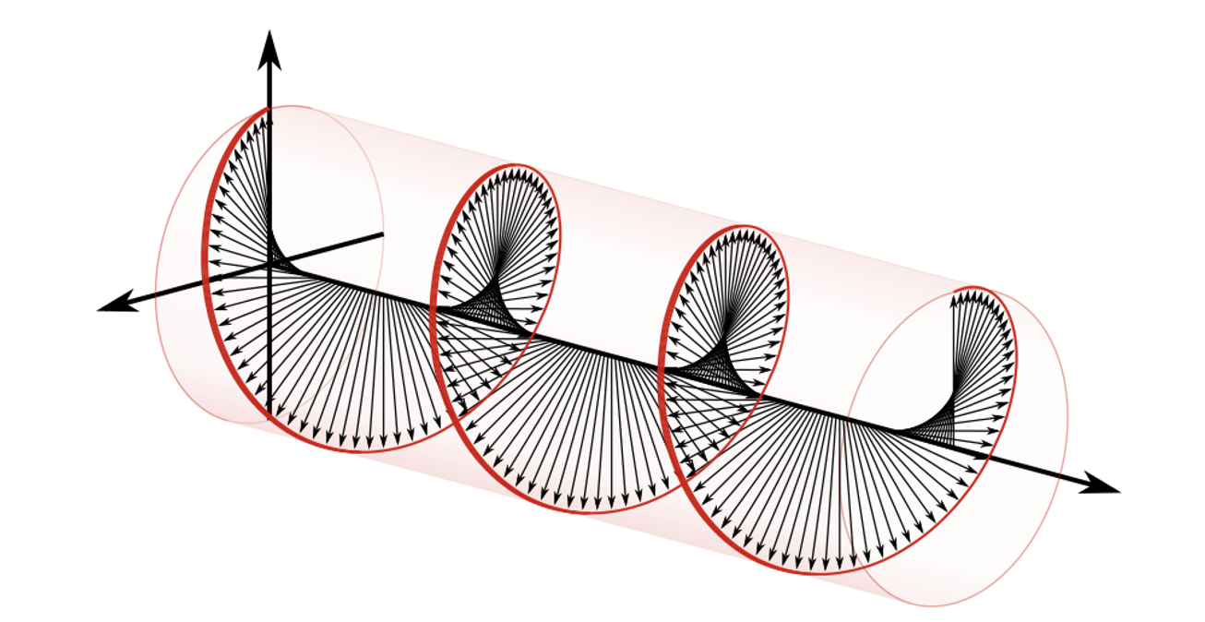
POLARIZATION
Right-handed circular polarization rotates clockwise over time
BASICS OF EMR

Slide 12
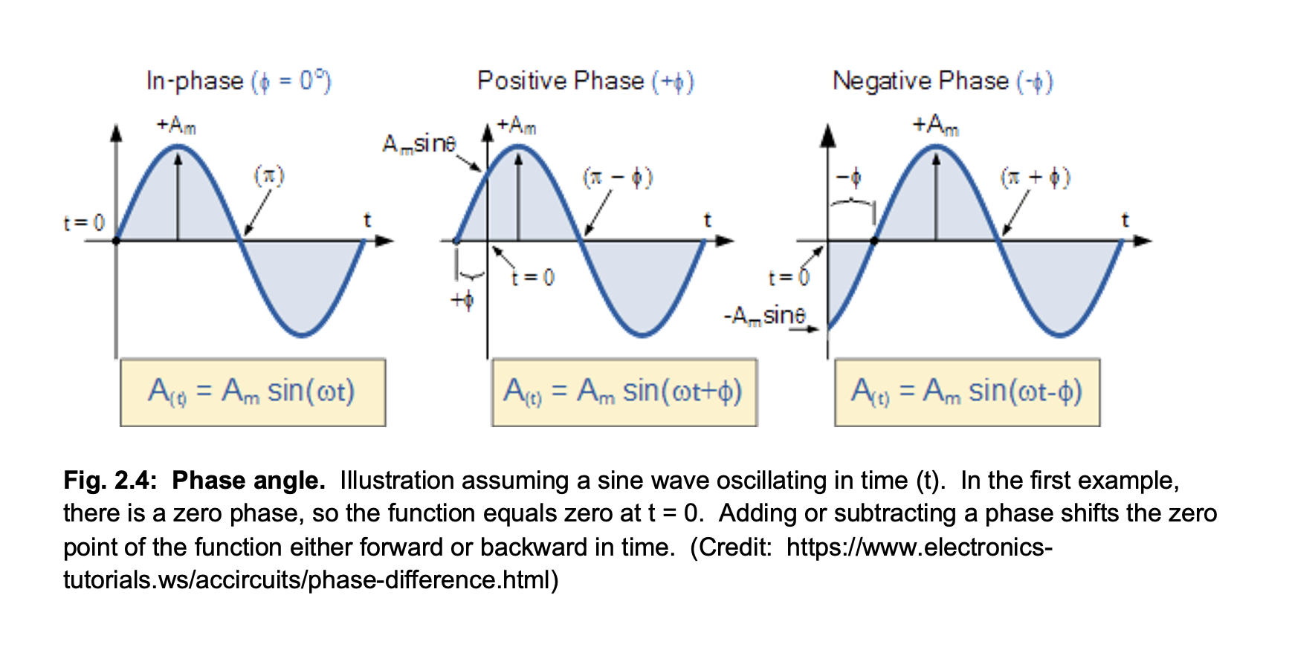
PHASE ANGLE
Zero phase angle occurs when the sine wave has a zero value at t = 0
BASICS OF EMR

Slide 13
PHASE ANGLE
Positive phase angle occurs when the sine wave has a positive value at t = 0
BASICS OF EMR

Slide 14
PHASE ANGLE
Negative phase angle occurs when the sine wave has a negative value at t = 0
BASICS OF EMR

Slide 15
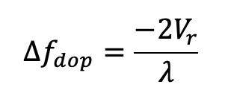
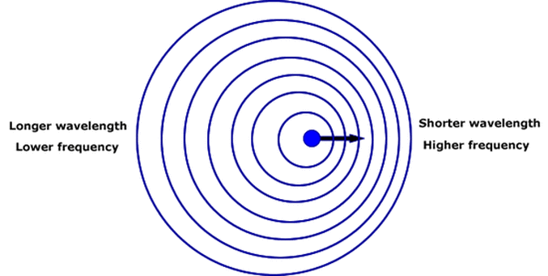
DOPPLER SHIFT
BASICS OF EMR

Slide 16
DOPPLER SHIFT
Frequency shift
Original wavelength of EMR
Velocity of source relative to observer
BASICS OF EMR

Slide 17
DOPPLER SHIFT
If velocity of source is away from the observer, Vr is a positive number.
This implies a lower frequency (Δf < 0).
This also implies a longer observed wavelength: Redshifting
Outbound: Positive Vr
BASICS OF EMR

Slide 18
DOPPLER SHIFT
If velocity of source is toward the observer, Vr is a negative number.
This implies a higher frequency (Δf > 0).
This also implies a shorter observed wavelength: Blueshifting
Inbound: Negative Vr
BASICS OF EMR

Slide 19
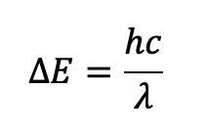
ENERGY CARRIED BY EMR
From Max Planck: Energy carried by a photon as a function of its wavelength
As wavelength decreases, energy carried by photon increases.
BASICS OF EMR

Slide 20
ENERGY CARRIED BY EMR
From Max Planck: Energy carried by a photon as a function of its wavelength
As wavelength decreases, energy carried by photon increases.
Very high energy
Very low energy
BASICS OF EMR
(Image: Kidder and Vonder Harr, 1995)

Slide 21
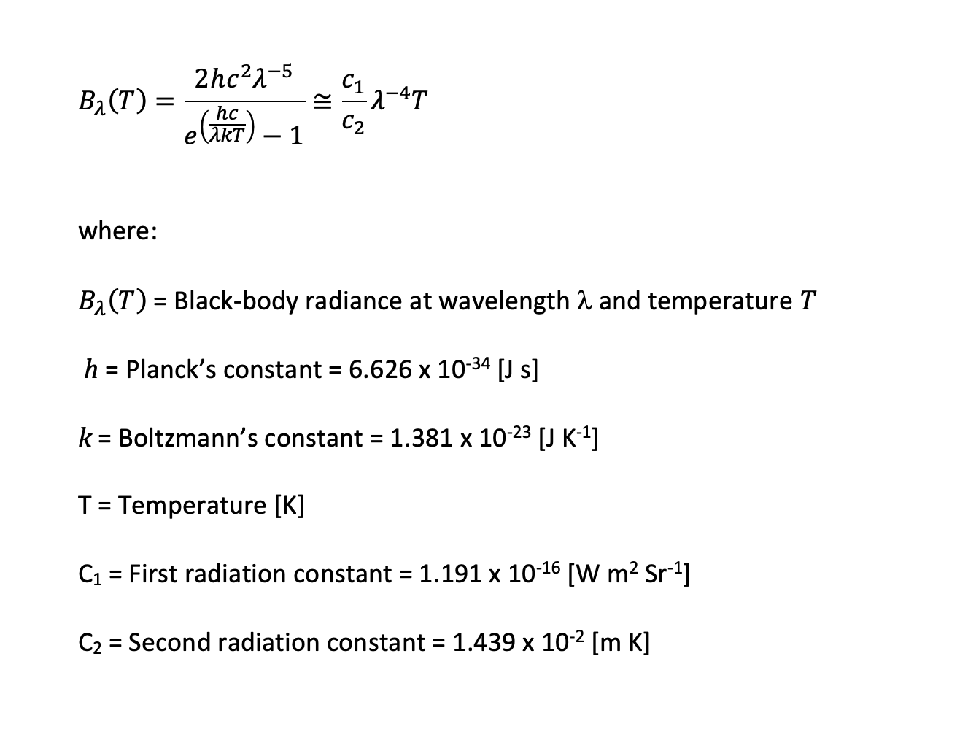
PLANCK’S BLACK BODY EQUATION
Describes shape of the black-body function
BASICS OF EMR

Slide 22
PLANCK’S BLACK BODY EQUATION
Rayleigh-Jeans Approximation
Valid for temperatures and wavelengths in Earth’s atmosphere
BASICS OF EMR

Slide 23
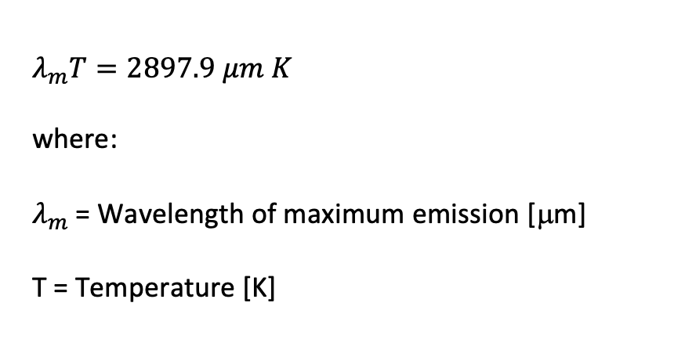
WIEN’S LAW
BASICS OF EMR

Slide 24
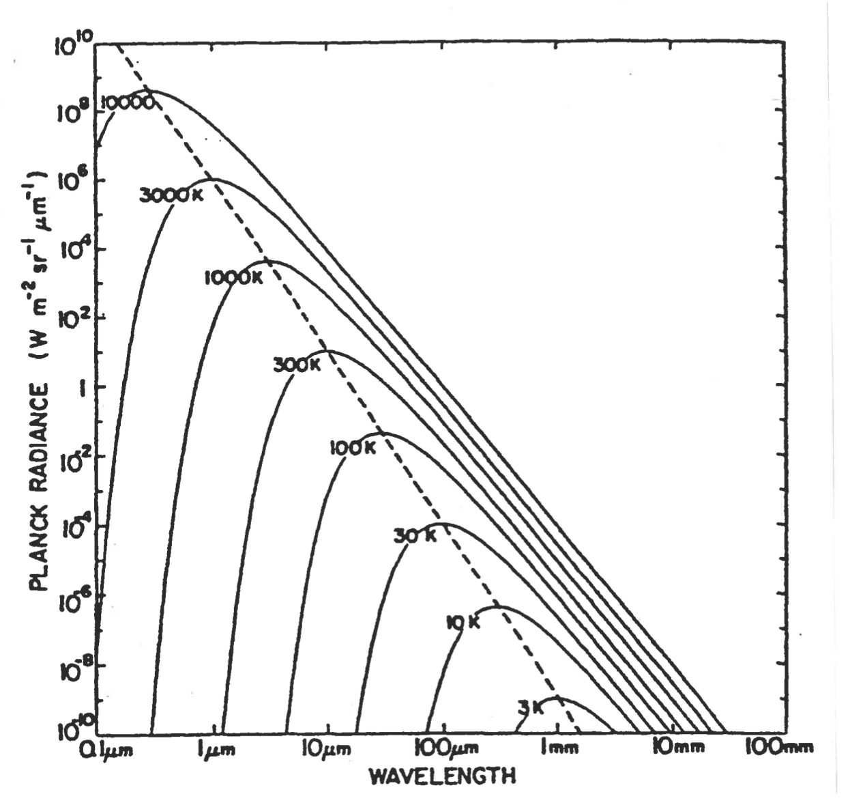
WIEN’S LAW
As temperature goes up, λmax goes down
BASICS OF EMR
(Image: Kidder and Vonder Harr, 1995)

Slide 25
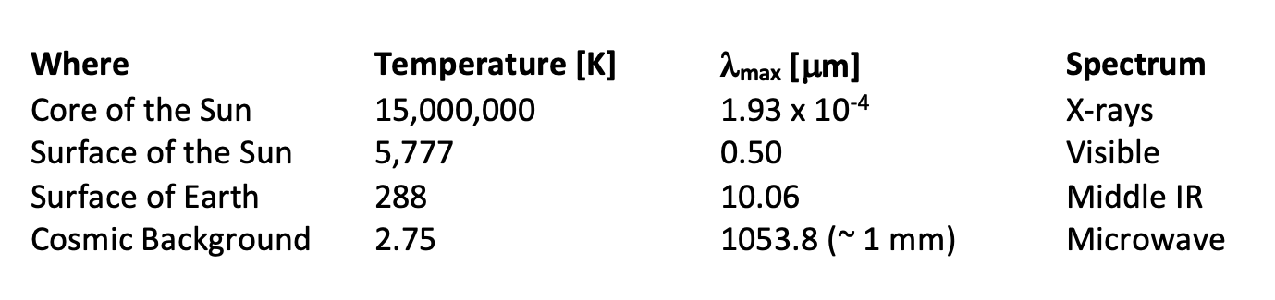
WIEN’S LAW
(Image: Kidder and Vonder Harr, 1995)

Slide 26
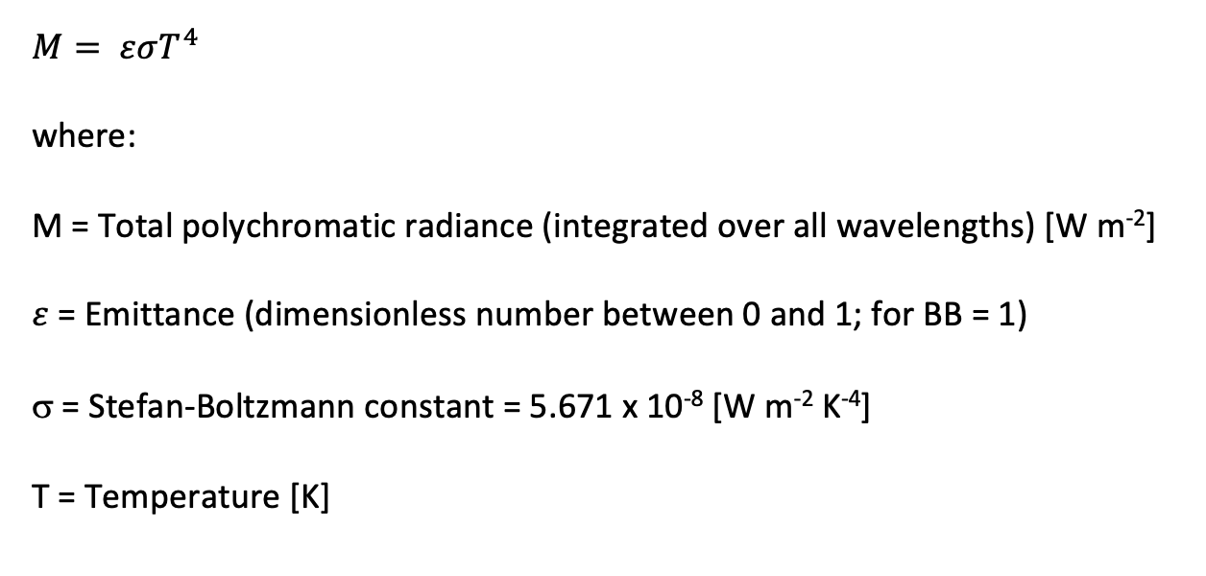
STEFAN-BOLTZMANN LAW
BASICS OF EMR

Slide 27
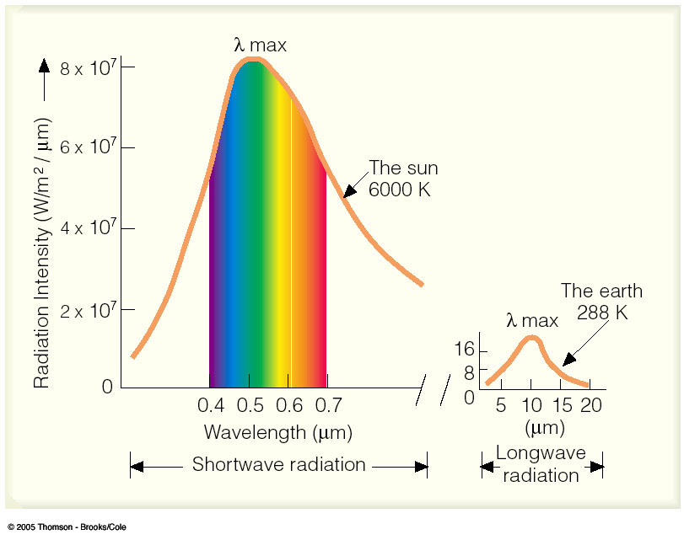
SOLAR AND TERRESTRIAL SPECTRA
BASICS OF EMR

Slide 28
SOLAR AND TERRESTRIAL SPECTRA
Both objects are close approximations of black bodies
BASICS OF EMR

Slide 29
SOLAR AND TERRESTRIAL SPECTRA
Wavelength of maximum emission (brightness) described by Wien’s Law
BASICS OF EMR

Slide 30
SOLAR AND TERRESTRIAL SPECTRA

Slide 31
SOLAR AND TERRESTRIAL SPECTRA
Total amount of energy emitted described by Stefan-Boltzmann Law
BASICS OF EMR

Slide 32
SOLAR AND TERRESTRIAL SPECTRA
Surface of the Sun is about 20 x hotter than the surface of Earth
Stefan-Boltzmann Law states than Sun emits about 160,000 as much energy per unit area as Earth.
BASICS OF EMR

Slide 33
SOLAR AND TERRESTRIAL SPECTRA
Sun: About 63,164,000 W/m^2
Earth: About 390 W/m^2
BASICS OF EMR

Slide 34
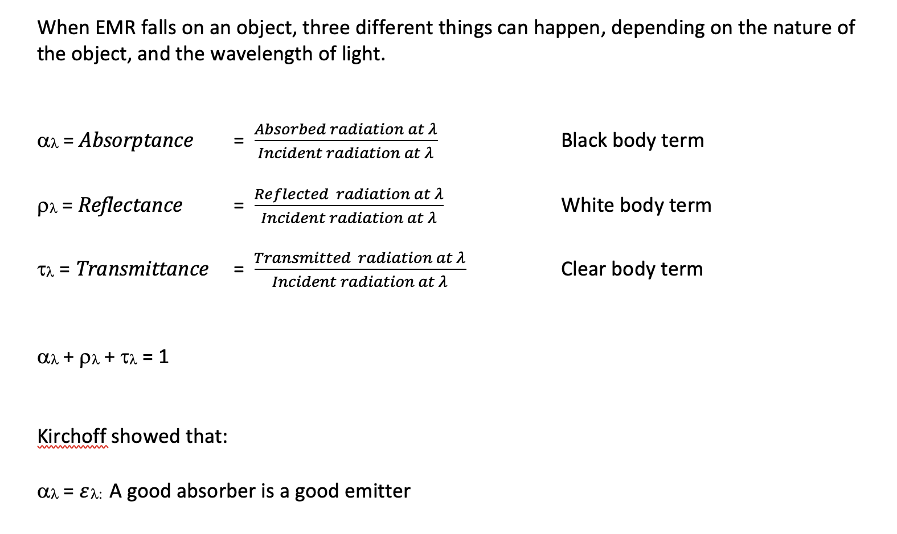
NON-BLACK BODIES: ALL REAL OBJECTS ARE “GRAY”

Slide 35
NON-BLACK BODIES: ALL REAL OBJECTS ARE “GRAY”

Slide 36
NON-BLACK BODIES: ALL REAL OBJECTS ARE “GRAY”
Includes scattering

Slide 37
NON-BLACK BODIES: ALL REAL OBJECTS ARE “GRAY”
Related to Vertical Optical Depth (more later)

Slide 38
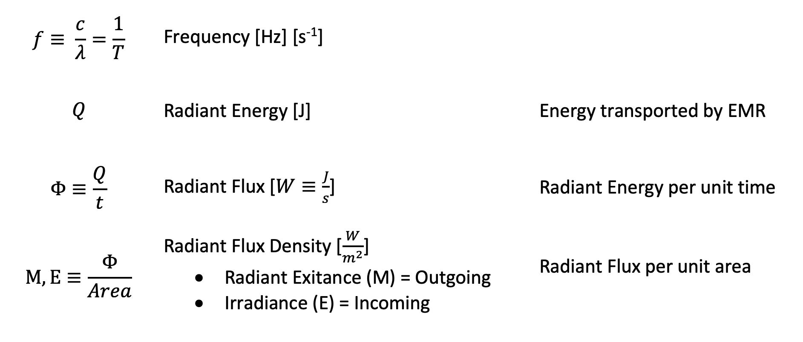
ADDITIONAL QUANTITIES
BASICS OF EMR

Slide 39
APPLICATION TO REMOTE SENSING

Slide 40
ADDITIONAL QUANTITIES
The Stefan-Boltzmann Law states that there is a relationship between M and the temperature of a scan spot.
If we can measure M, we’ll have T.
REMOTE SENSING APPLICATIONS

Slide 41
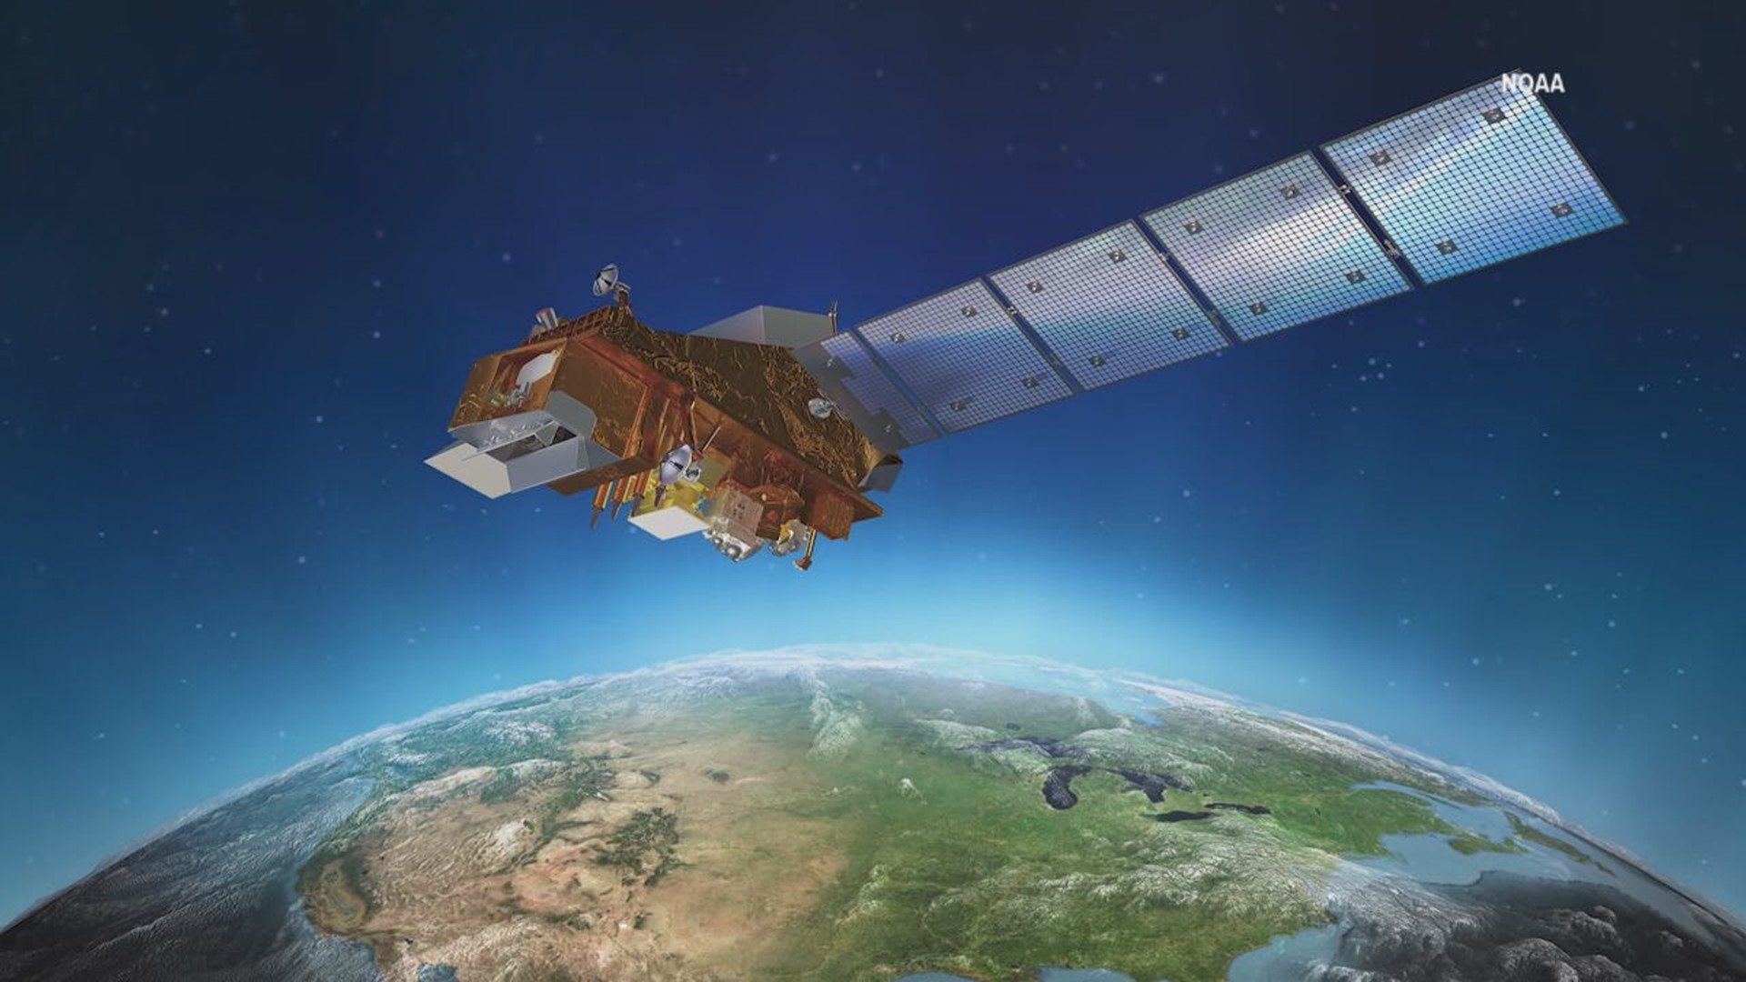
RADIANCE AND RADIANT EXITANCE
The Stefan-Boltzmann Law states that there is a relationship between M and the temperature of a scan spot.
If we can measure M, we’ll have T.
Scan Spot
REMOTE SENSING APPLICATIONS

Slide 42
RADIANCE AND RADIANT EXITANCE
The Stefan-Boltzmann Law states that there is a relationship between M and the temperature of a scan spot.
If we can measure M, we’ll have T.
Scan Spot
REMOTE SENSING APPLICATIONS

Slide 43
RADIANCE AND RADIANT EXITANCE
Scan Spot
Circle around Scan Spot with radius = 1
REMOTE SENSING APPLICATIONS

Slide 44
RADIANCE AND RADIANT EXITANCE
z
Scan Spot
Circle around Scan Spot with radius = 1
Rectangular coordinates centered on Scan Spot
y
REMOTE SENSING APPLICATIONS
x

Slide 45
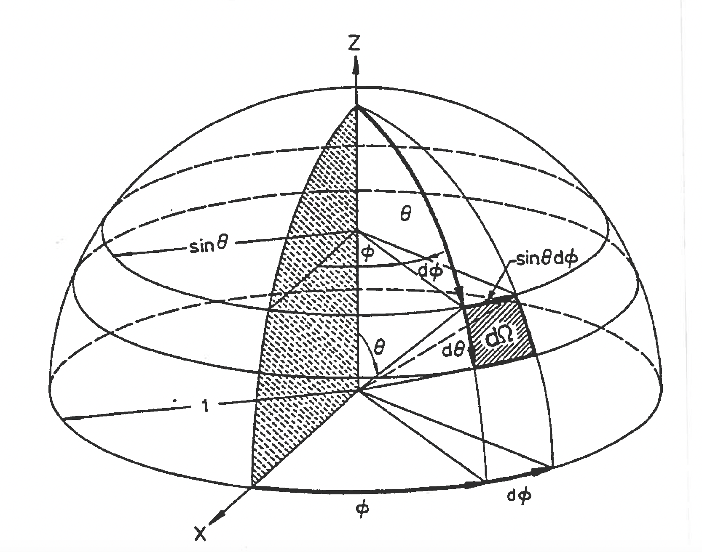
RADIANCE AND RADIANT EXITANCE
z
Scan Spot
Circle around Scan Spot with radius = 1
Rectangular coordinates centered on Scan Spot
y
Unit hemisphere over Scan Spot
REMOTE SENSING APPLICATIONS
x
(Image: Kidder and Vonder Harr, 1995)

Slide 46
RADIANCE AND RADIANT EXITANCE
Angle φ varies from 0 to 2π
(Full circle)
REMOTE SENSING APPLICATIONS
(Image: Kidder and Vonder Harr, 1995)

Slide 47
RADIANCE AND RADIANT EXITANCE
Angle φ varies from 0 to 2π
(Full circle)
Angle θ varies from 0 to π/2
(Quarter circle)
REMOTE SENSING APPLICATIONS
(Image: Kidder and Vonder Harr, 1995)

Slide 48
RADIANCE AND RADIANT EXITANCE
Angle φ varies from 0 to 2π
(Full circle)
Angle θ varies from 0 to π/2
(Quarter circle)
Small area on surface of sphere (dΩ)
REMOTE SENSING APPLICATIONS
(Image: Kidder and Vonder Harr, 1995)

Slide 49
RADIANCE AND RADIANT EXITANCE
Small area on surface of sphere (dΩ)
Arclength in φ direction = Rsinθdφ
REMOTE SENSING APPLICATIONS
(Image: Kidder and Vonder Harr, 1995)

Slide 50
RADIANCE AND RADIANT EXITANCE
Small area on surface of sphere (dΩ)
Arclength in φ direction = Rsinθdφ
Arclength in θ direction = Rdθ
REMOTE SENSING APPLICATIONS
(Image: Kidder and Vonder Harr, 1995)

Slide 51
RADIANCE AND RADIANT EXITANCE
Small area on surface of sphere (dΩ)
Arclength in φ direction = Rsinθdφ
Arclength in θ direction = Rdθ
R=1
REMOTE SENSING APPLICATIONS
(Image: Kidder and Vonder Harr, 1995)

Slide 52
RADIANCE AND RADIANT EXITANCE
Small area on surface of sphere:
dΩ = Rsinθdθdφ
REMOTE SENSING APPLICATIONS
(Image: Kidder and Vonder Harr, 1995)

Slide 53
RADIANCE AND RADIANT EXITANCE
Small area on surface of sphere:
dΩ = Rsinθdθdφ
This is the ”solid angle.”
Units are Steradians
REMOTE SENSING APPLICATIONS
(Image: Kidder and Vonder Harr, 1995)

Slide 54
RADIANCE AND RADIANT EXITANCE
θ Is the zenith angle
REMOTE SENSING APPLICATIONS
(Image: Kidder and Vonder Harr, 1995)

Slide 55
RADIANCE AND RADIANT EXITANCE
If θ is zero, you are looking directly down at the Scan Spot and it is very bright.
REMOTE SENSING APPLICATIONS
(Image: Kidder and Vonder Harr, 1995)

Slide 56
RADIANCE AND RADIANT EXITANCE
If θ is zero, you are looking directly down at the Scan Spot and it is very bright.
As θ increases, the apparent brightness of the Scan Spot decreases.
REMOTE SENSING APPLICATIONS
(Image: Kidder and Vonder Harr, 1995)

Slide 57
RADIANCE AND RADIANT EXITANCE
If θ is zero, you are looking directly down at the Scan Spot and it is very bright.
As θ increases, the apparent brightness of the Scan Spot decreases.
When θ reaches 90 degrees, Scan Spot becomes invisible.
REMOTE SENSING APPLICATIONS
(Image: Kidder and Vonder Harr, 1995)

Slide 58
RADIANCE AND RADIANT EXITANCE
Conclusion:
For a fixed brightness, the apparent brightness varies with cos θ
REMOTE SENSING APPLICATIONS
(Image: Kidder and Vonder Harr, 1995)

Slide 59
RADIANCE AND RADIANT EXITANCE
Satellite usually not directly overhead when receiving EMR from the scan spot (θ > 0).
REMOTE SENSING APPLICATIONS
EMR QUANTITIES

Slide 60
RADIANCE AND RADIANT EXITANCE
EMR enters radiometer through “camera eye” called the “Field of View” that has a known solid angle
REMOTE SENSING APPLICATIONS
(Image: Kidder and Vonder Harr, 1995)

Slide 61
RADIANCE AND RADIANT EXITANCE
Radiometer does not measure the full Radiant Exitance – only the portion that enters through the Field of View
The is called the Radiance (L)
REMOTE SENSING APPLICATIONS

Slide 62
RADIANCE AND RADIANT EXITANCE
If the observed Radiance (L) is summed over the full surface of the unit hemisphere, the total Radiant Exitance (M) can be obtained, and from that, temperature.
REMOTE SENSING APPLICATIONS
(Image: Kidder and Vonder Harr, 1995)

Slide 63
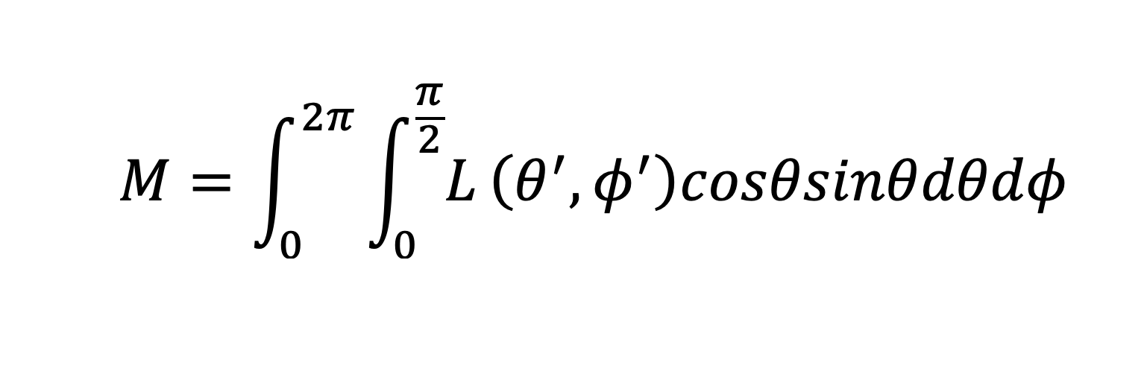
RADIANCE AND RADIANT EXITANCE
REMOTE SENSING APPLICATIONS

Slide 64
RADIANCE AND RADIANT EXITANCE
This is the Radiance observed through the instrument’s FOV (W m^-2 Sr^-1)
REMOTE SENSING APPLICATIONS

Slide 65
RADIANCE AND RADIANT EXITANCE
This term accounts for the variation in apparent brightness with zenith angle
REMOTE SENSING APPLICATIONS

Slide 66
RADIANCE AND RADIANT EXITANCE
Remember the small surface area (solid angle) on the surface of the hemisphere
REMOTE SENSING APPLICATIONS

Slide 67
RADIANCE AND RADIANT EXITANCE
This sums the Radiance through the circumferental angle φ
REMOTE SENSING APPLICATIONS

Slide 68
RADIANCE AND RADIANT EXITANCE
This sums the Radiance through the zenith angle θ
REMOTE SENSING APPLICATIONS

Slide 69
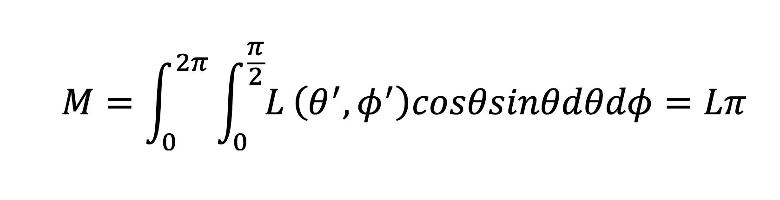
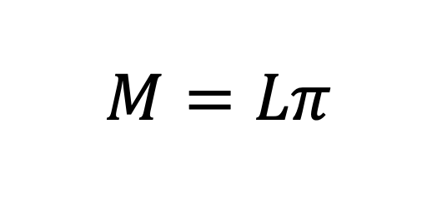
RADIANCE AND RADIANT EXITANCE
Solution:
REMOTE SENSING APPLICATIONS

Slide 70
ABSORPTION AND EMISSION

Slide 71
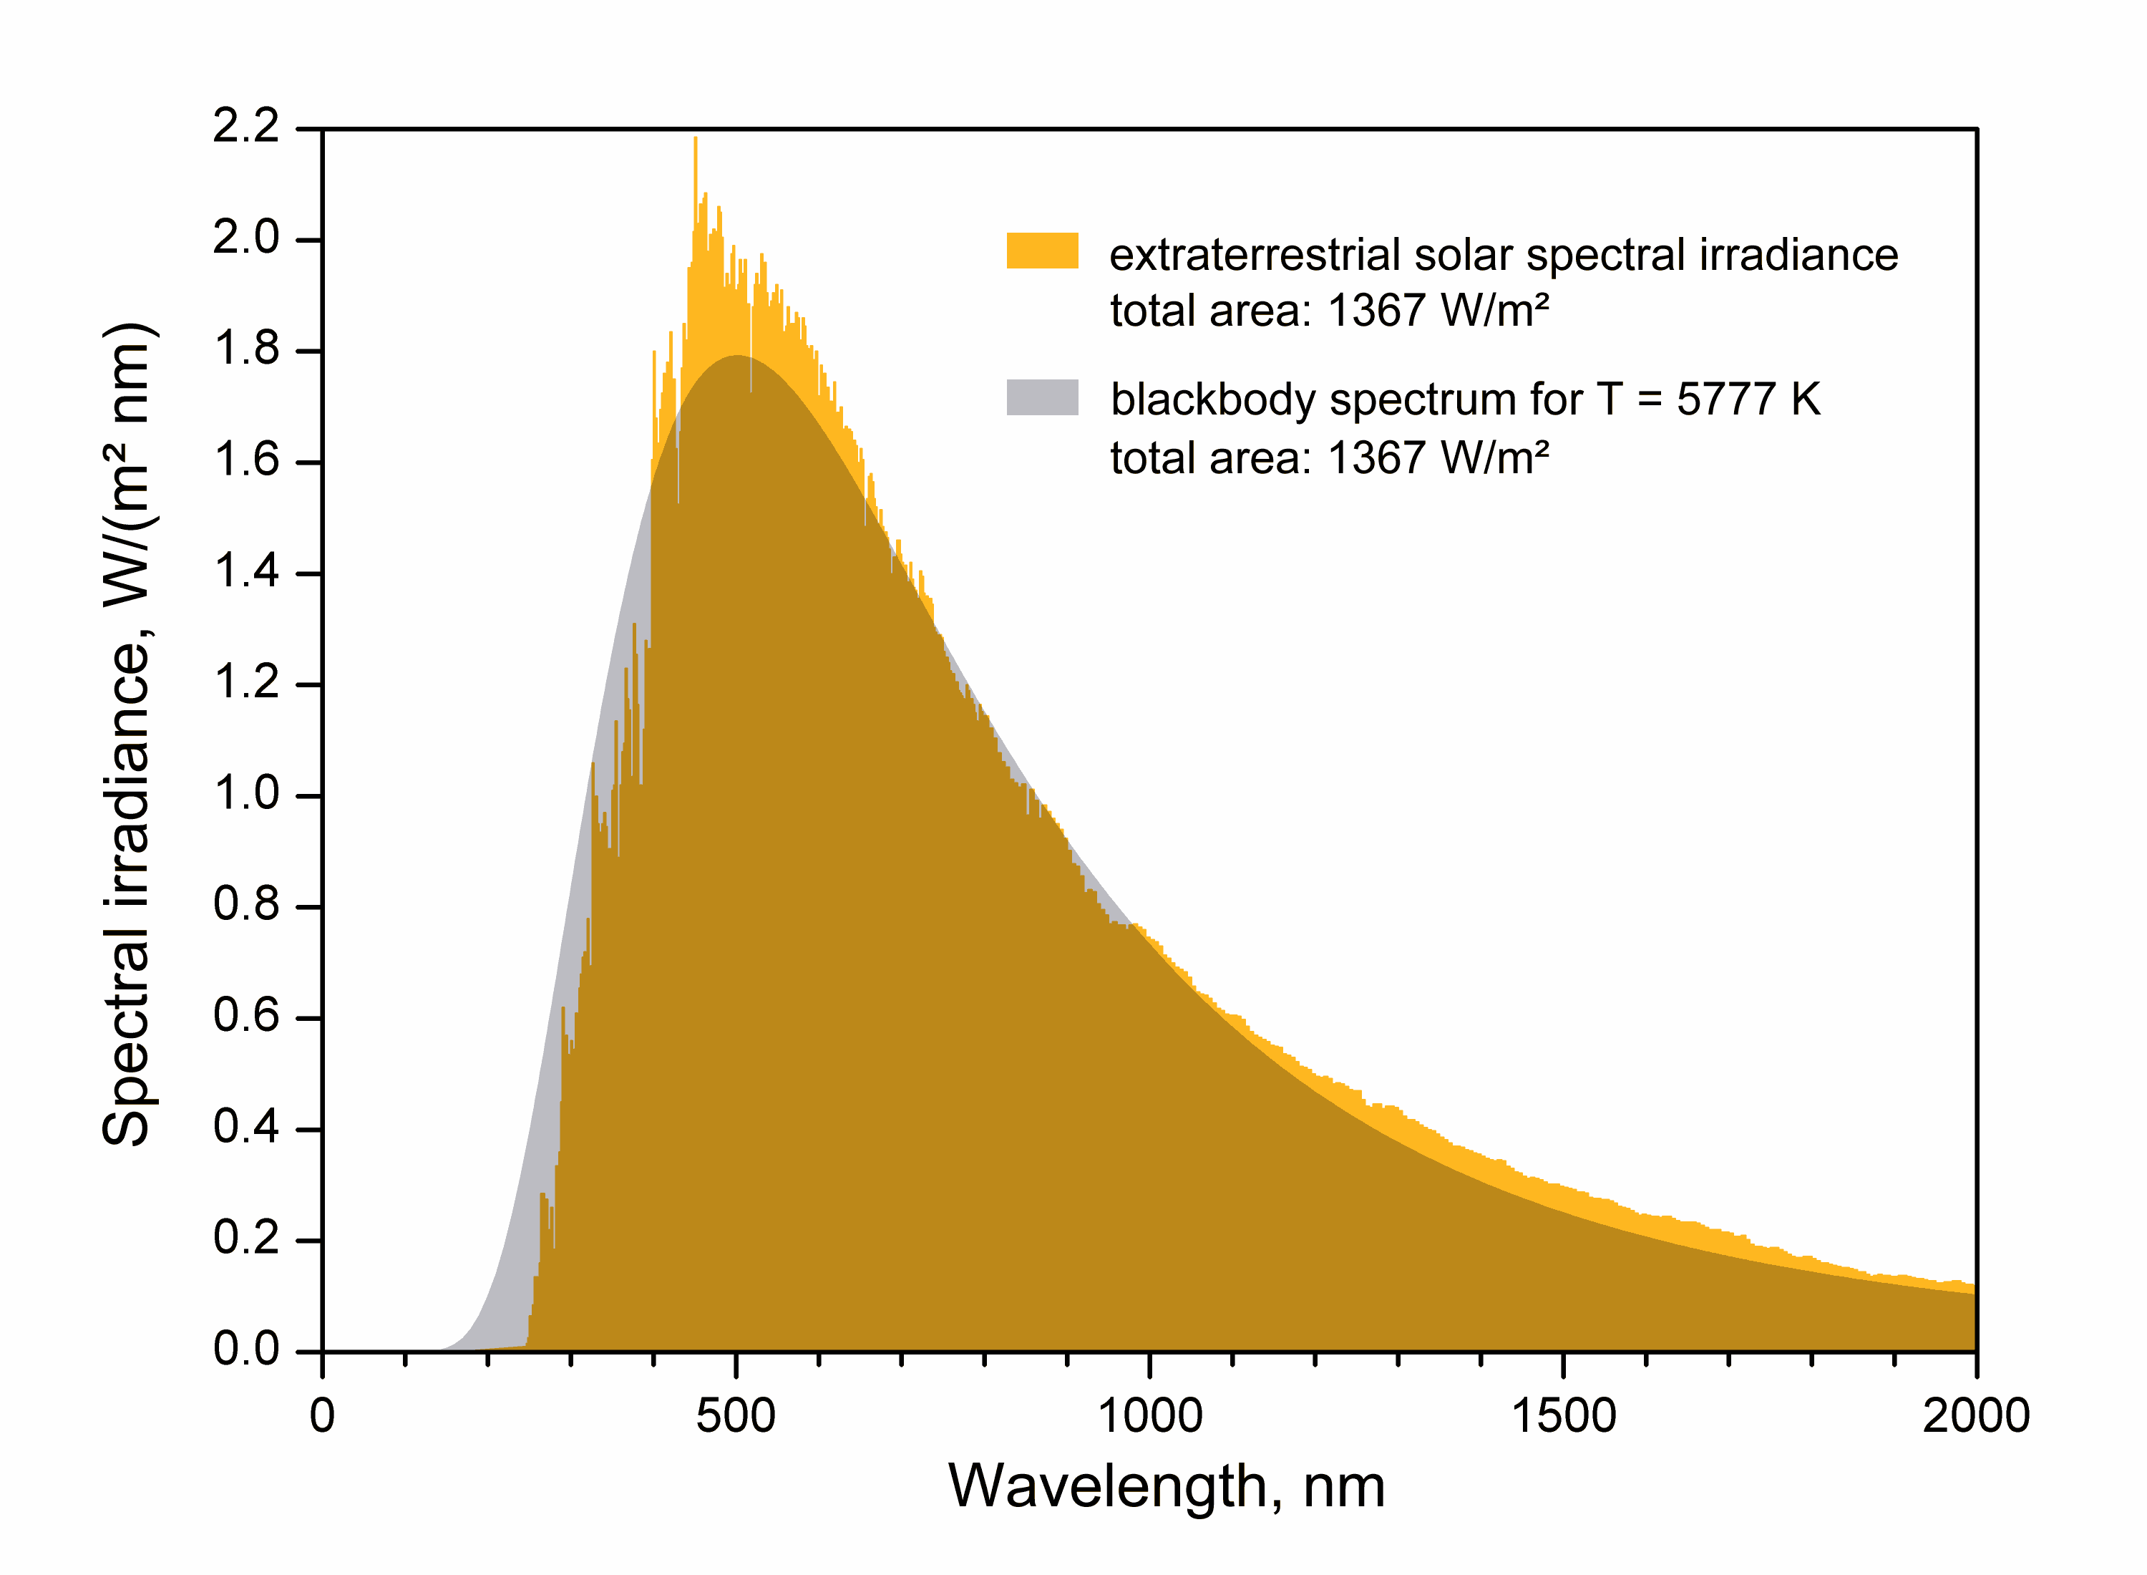
SOLAR SPECTRUM AND EQUIVALENT BLACK BODY

Slide 72
SOLAR SPECTRUM AND EQUIVALENT BLACK BODY
Emission by hot gases

Slide 73
SOLAR SPECTRUM AND EQUIVALENT BLACK BODY
Absorption by cool gases

Slide 74
ABSORPTION IN EARTH’S ATMOSPHERE
Ionization
Electron Orbitals
Forbidden
ATOMIC
Dissociation
Vibrational
Rotational
MOLECULAR
ABSORPTION

Slide 75
ABSORPTION IN EARTH’S ATMOSPHERE
Ionization
Electron Orbitals
Forbidden
ATOMIC
Dissociation
Vibrational
Rotational
MOLECULAR
Degrees of Freedom
ABSORPTION

Slide 76
ABSORPTION IN EARTH’S ATMOSPHERE
e.g. Absorption of UV by O3
Very high energy
(Short wavelength)
Ionization
Electron Orbitals
Forbidden
ATOMIC
Dissociation
Vibrational
Rotational
MOLECULAR
ABSORPTION

Slide 77
ABSORPTION IN EARTH’S ATMOSPHERE
Ionization
Electron Orbitals
Forbidden
ATOMIC
Dissociation
Vibrational
Rotational
MOLECULAR
e.g. Absorption of IR by CO2, H20
Very low energy
(Long wavelength)
ABSORPTION

Slide 78
ABSORPTION IN EARTH’S ATMOSPHERE
Ionization
Electron Orbitals
Forbidden
ATOMIC
e.g. Absorption of Microwave by O2
Lowest energy
Dissociation
Vibrational
Rotational
MOLECULAR
ABSORPTION

Slide 79
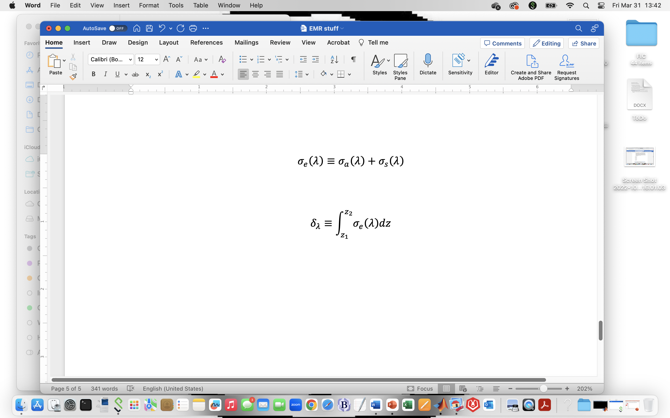
ABSORPTION IN EARTH’S ATMOSPHERE
The amount (or efficiency) of absorption (and emission) is parameterized by the Volume Absorption Coefficient
Depends on wavelength
ABSORPTION

Slide 80
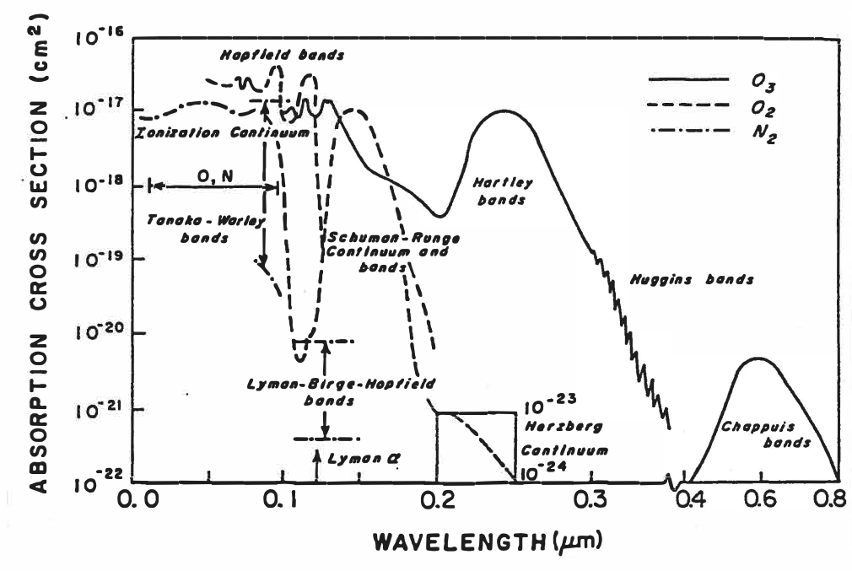
Gamma and X-ray (“0” - 0.1 μm): Ionization Continuum
ABSORPTION
(Image: Kidder and Vonder Harr, 1995)

Slide 81
UVC (0.1 - 0.2 μm): Dissociation of O₂ molecules into O
UVB (0.2 - 0.3 μm): Dissociation of O₃ molecules (Hartley)
UVA (0.3 - 0.4 μm): Quantum interactions in O₃ (Higgins)
ABSORPTION
(Image: Kidder and Vonder Harr, 1995)

Slide 82
Visible (0.4 - 0.7 μm): Dissociation of O₃ (Chappuis)
Atmospheric Window
ABSORPTION
(Image: Kidder and Vonder Harr, 1995)

Slide 83
Visible (0.4 - 0.7 μm): Dissociation of O₃ (Chappuis)
Atmospheric Window
Most Solar EMR enters Earth system here
ABSORPTION
(Image: Kidder and Vonder Harr, 1995)

Slide 84
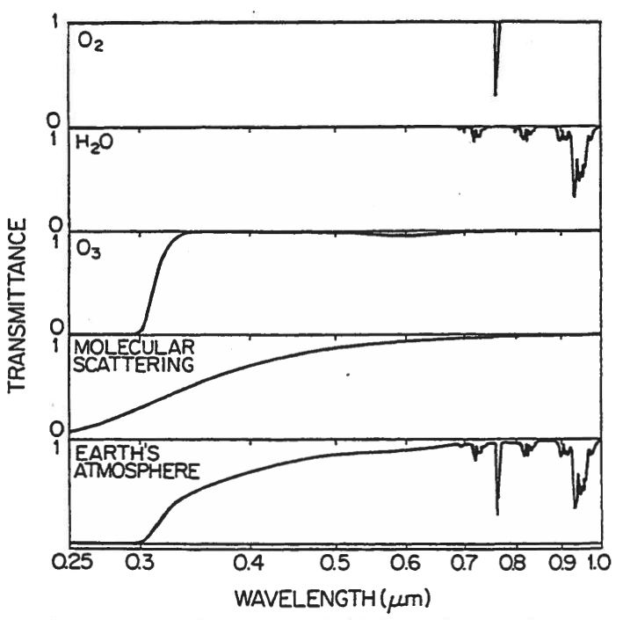
Near IR (0.7 – 1.0 μm): Vibrational degrees of freedom
O₂
H2O
O₃
ABSORPTION
(Image: Kidder and Vonder Harr, 1995)

Slide 85
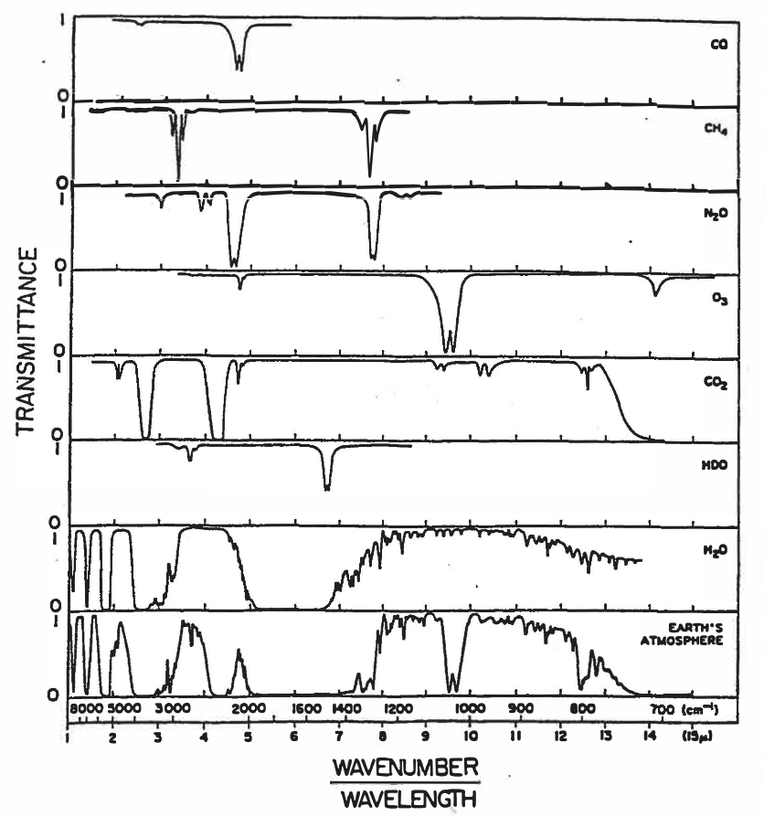
Middle IR (1.0 – 15 μm): Rotational degrees of freedom
CO
CH₄
N₂O
O₃
CO₂
HDO
H₂O
Far IR (15 – 1000 μm [1 mm]): Mostly water vapor
(Not shown)
ABSORPTION
(Image: Kidder and Vonder Harr, 1995)

Slide 86
Middle IR (1.0 – 15 μm): Rotational degrees of freedom
CO
CH₄
N₂O
O₃
CO₂
HDO
H₂O
Far IR (15 – 1000 μm [1 mm]): Mostly water vapor
(Not shown)
ABSORPTION
Water Vapor Channels
(Image: Kidder and Vonder Harr, 1995)

Slide 87
Middle IR (1.0 – 15 μm): Rotational degrees of freedom
CO
CH₄
N₂O
O₃
CO₂
HDO
H₂O
Far IR (15 – 1000 μm [1 mm]): Mostly water vapor
(Not shown)
ABSORPTION
Atmospheric Window
(Image: Kidder and Vonder Harr, 1995)

Slide 88
Middle IR (1.0 – 15 μm): Rotational degrees of freedom
CO
CH₄
N₂O
O₃
CO₂
HDO
H₂O
Far IR (15 – 1000 μm [1 mm]): Mostly water vapor
(Not shown)
Most Terrestrial EMR exits Earth system here
ABSORPTION
Atmospheric Window
(Image: Kidder and Vonder Harr, 1995)

Slide 89
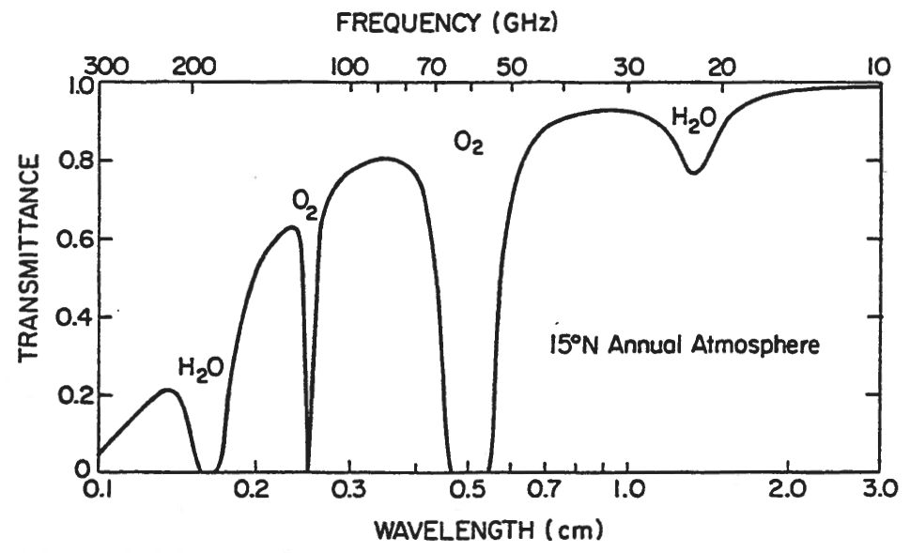
Microwave (1 – 1000 mm): Forbidden reactions
H₂O
O₂
ABSORPTION
(Image: Kidder and Vonder Harr, 1995)

Slide 90
Microwave (1 – 1000 mm): Forbidden reactions
H₂O
O₂
Microwave Sounder
ABSORPTION
(Image: Kidder and Vonder Harr, 1995)

Slide 91
SCATTERING

Slide 92
SCATTERING IN EARTH’S ATMOSPHERE
The amount (or efficiency) of scattering is parameterized by the Volume Scattering Coefficient
Depends on wavelength
SCATTERING

Slide 93
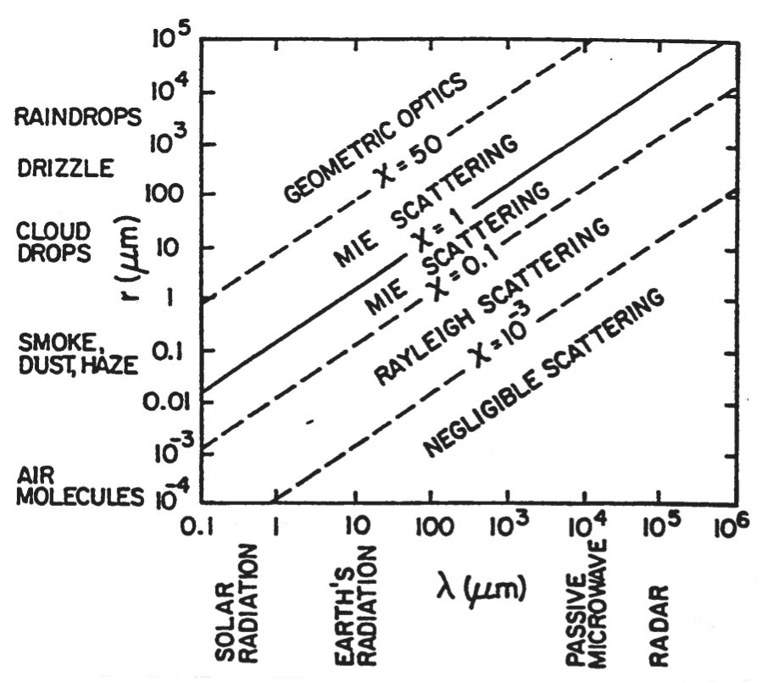
SCATTERING IN EARTH’S ATMOSPHERE
SCATTERING
(Image: Kidder and Vonder Harr, 1995)

Slide 94
SCATTERING IN EARTH’S ATMOSPHERE
Geometric: Particle >> EMR
Mie: Particle ~= EMR
Rayleigh: Particle << EMR
SCATTERING
(Image: Kidder and Vonder Harr, 1995)

Slide 95
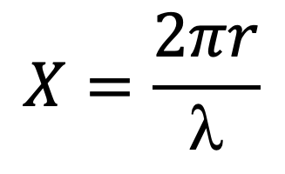
SCATTERING IN EARTH’S ATMOSPHERE
$$X=\frac{2πr}{\text{l}}$$
Size parameter describes relationship between size of scattering particle and the EMR wavelength
SCATTERING
(Image: Kidder and Vonder Harr, 1995)

Slide 96
SCATTERING IN EARTH’S ATMOSPHERE
$$X=\frac{2πr}{\text{l}}$$
Rainbows
SCATTERING
(Image: Kidder and Vonder Harr, 1995)

Slide 97
SCATTERING IN EARTH’S ATMOSPHERE
$$X=\frac{2πr}{\text{l}}$$
Blue Sky
SCATTERING
(Image: Kidder and Vonder Harr, 1995)

Slide 98
SCATTERING IN EARTH’S ATMOSPHERE
$$X=\frac{2πr}{\text{l}}$$
Scattering of IR by clouds
SCATTERING
(Image: Kidder and Vonder Harr, 1995)

Slide 99
SCATTERING IN EARTH’S ATMOSPHERE
Basis of Radar Reflectivity
X-Band: 2.5 – 3.7 cm
C-Band: 3.7 – 7.5 cm
S-Band: 7.5 – 15 cm
SCATTERING
(Image: Kidder and Vonder Harr, 1995)

Slide 100
TRANSMITTANCE

Slide 101
TRANSMITTANCE IN EARTH’S ATMOSPHERE
Transmittance is parameterized by the Volume Extinction Coefficient and Vertical Optical Depth
Extinction coefficient is the linear sum of the volume absorption coefficient and the volume scattering coefficient
Depends on wavelength
TRANSMITTANCE

Slide 102
TRANSMITTANCE IN EARTH’S ATMOSPHERE
Transmittance is parameterized by the Volume Extinction Coefficient and Vertical Optical Depth
Vertical Optical Depth is the vertical integral of the extinction coefficient
Also depends on wavelength
TRANSMITTANCE

Slide 103
TRANSMITTANCE IN EARTH’S ATMOSPHERE
Transmittance is parameterized by the Volume Extinction Coefficient and Vertical Optical Depth
Greater extinction (absorption, scattering, or both) implies a greater vertical optical depth
Vertical Optical Depth is the vertical integral of the extinction coefficient
Also depends on wavelength
TRANSMITTANCE

Slide 104
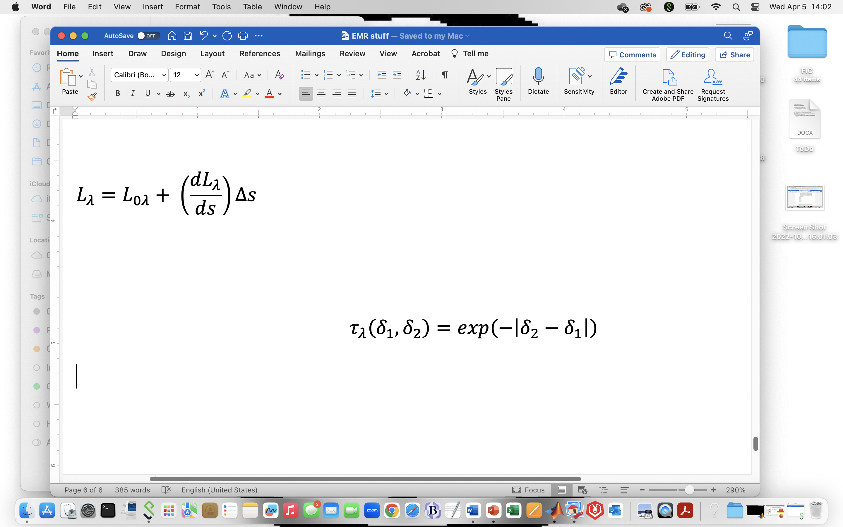
TRANSMITTANCE IN EARTH’S ATMOSPHERE
Transmittance is parameterized by the Volume Extinction Coefficient and Vertical Optical Depth
Relationship of transmittance to vertical optical depth at two levels
Also depends on wavelength
TRANSMITTANCE

Slide 105
TRANSMITTANCE IN EARTH’S ATMOSPHERE
Transmittance is parameterized by the Volume Extinction Coefficient and Vertical Optical Depth
As difference between two Vertical Optical Depths increases, transmittance between those levels decreases
Relationship of transmittance to vertical optical depth at two levels
Also depends on wavelength
TRANSMITTANCE

Slide 106
RADIANCE TRANSFER FUNCTION

Slide 107
RADIANCE TRANSFER FUNCTION (RTF)
A model of absorption, emission, and scattering in Earth’s atmosphere

Slide 108
RADIANCE TRANSFER FUNCTION (RTF)
Spacecraft

Slide 109
RADIANCE TRANSFER FUNCTION (RTF)
SMV
Spacecraft
SGT
SSP

Slide 110
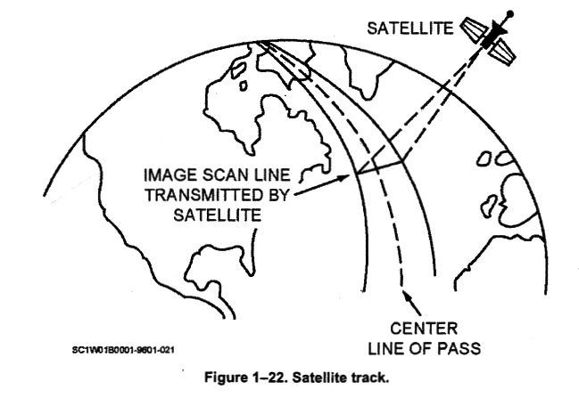
RADIANCE TRANSFER FUNCTION (RTF)
SMV
Spacecraft
SGT
SSP

Slide 111
RADIANCE TRANSFER FUNCTION (RTF)
SMV
Spacecraft
SGT
SSP

Slide 112
RADIANCE TRANSFER FUNCTION (RTF)
Spacecraft
Scan line

Slide 113
RADIANCE TRANSFER FUNCTION (RTF)
Spacecraft
Scan spot

Slide 114
RADIANCE TRANSFER FUNCTION (RTF)
Spacecraft
Polychromatic radiance

Slide 115
RADIANCE TRANSFER FUNCTION (RTF)
Spacecraft
Upwelling radiance

Slide 116
RADIANCE TRANSFER FUNCTION (RTF)
Spacecraft
Radiance reaching spacecraft
Top of atmosphere
Column of atmosphere
Original radiance

Slide 117
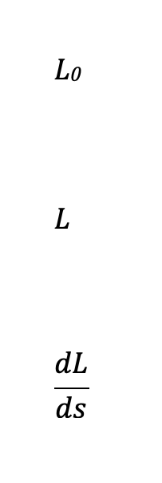
RADIANCE TRANSFER FUNCTION (RTF)
RTF describes what’s happening here

Slide 118
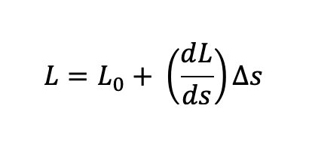
RADIANCE TRANSFER FUNCTION (RTF)
y = b + m x
Slope describes processes in a small control volume, which are then integrated through the depth of the atmosphere (Δs) to find total change in radiance

Slide 119
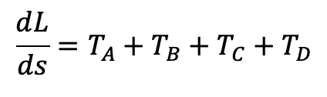
RADIANCE TRANSFER FUNCTION (RTF)
y = b + m x
Slope includes four terms

Slide 120
RADIANCE TRANSFER FUNCTION (RTF)
Loss
y = b + m x
Slope includes four terms
Gain

Slide 121
RADIANCE TRANSFER FUNCTION (RTF)
y = b + m x
Slope includes four terms
Absorption
Emission
Scattering

Slide 122
RADIANCE TRANSFER FUNCTION (RTF)
y = b + m x
Because both absorption/emission and scattering depend on wavelength, all four terms must be evaluated for narrow, monochromatic channels
Absorption
Emission
Scattering

Slide 123
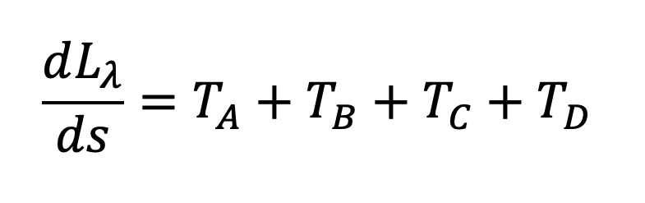
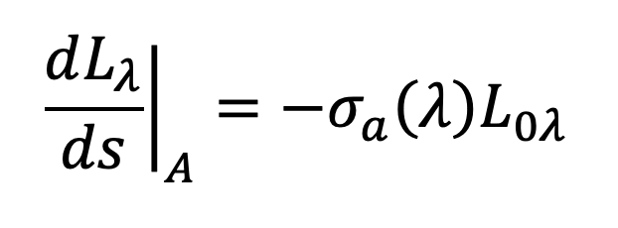
RADIANCE TRANSFER FUNCTION (RTF)
This is a black body term:
The volume absorption coefficient is related to the absorptance (α) at wavelength λ
Absorption
(Loss)
Volume absorption coefficient
Initial radiance from scan spot entering control volume at wavelength λ

Slide 124
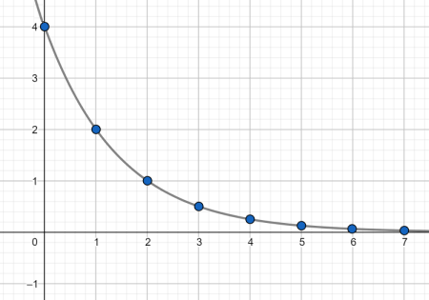
RADIANCE TRANSFER FUNCTION (RTF)
This is a black body term:
The volume absorption coefficient is related to the absorptance (α) at wavelength λ
Absorption
(Loss)
Volume absorption coefficient
Initial radiance from scan spot entering control volume at wavelength λ
When integrated, this is exponential decay

Slide 125
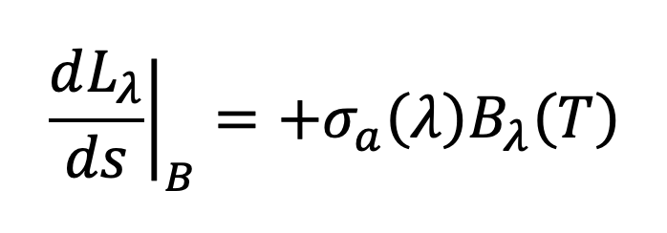
RADIANCE TRANSFER FUNCTION (RTF)
This is a black body term:
The volume absorption coefficient is related to the emittance (ε) at
wavelength λ
Emission
(Gain)
Volume absorption coefficient
Black body emission within the control volume at wavelength λ

Slide 126
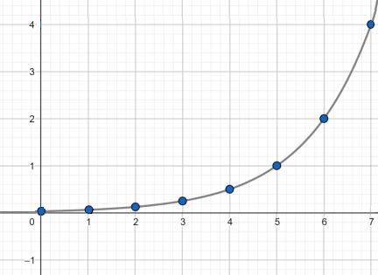
RADIANCE TRANSFER FUNCTION (RTF)
This is a black body term:
The volume absorption coefficient is related to the emittance (ε) at
wavelength λ
Emission
(Gain)
Volume absorption coefficient
Black body emission within the control volume at wavelength λ
When integrated, this is exponential growth

Slide 127
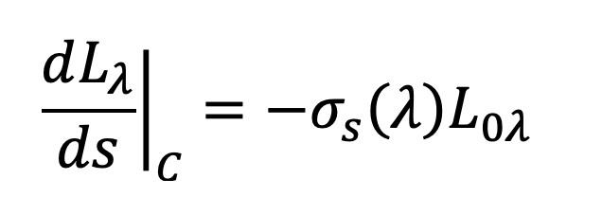
RADIANCE TRANSFER FUNCTION (RTF)
This is a white body term:
The volume scattering coefficient is related to the reflectance (ρ) at
wavelength λ
Exponential decay again
Scattering out
(Loss)
Radi
Volume scattering coefficient
Initial radiance from scan spot entering control volume at wavelength λ

Slide 128
RADIANCE TRANSFER FUNCTION (RTF)
Scattering in
(Gain)
Scattering particle

Slide 129
RADIANCE TRANSFER FUNCTION (RTF)
Scattering in
(Gain)
Scattering particle

Slide 130
RADIANCE TRANSFER FUNCTION (RTF)
Scattering in
(Gain)
Initial radiance from scan spot entering control volume at wavelength λ
(Lλ)

Slide 131
RADIANCE TRANSFER FUNCTION (RTF)
Scattering in
(Gain)
Radiance from somewhere else entering control volume at wavelength λ
(L’λ)

Slide 132
RADIANCE TRANSFER FUNCTION (RTF)
Scattering in
(Gain)
Encounters scattering particle

Slide 133
RADIANCE TRANSFER FUNCTION (RTF)
Scattering in
(Gain)
Scattered into same direction as initial radiance from scan spot

Slide 134
RADIANCE TRANSFER FUNCTION (RTF)
Scattering in
(Gain)
Imaginary sphere around scattering particle

Slide 135
RADIANCE TRANSFER FUNCTION (RTF)
Scattering in
(Gain)
Imaginary sphere around scattering particle

Slide 136
RADIANCE TRANSFER FUNCTION (RTF)
Scattering in
(Gain)
Radiance from somewhere else (L’λ) enters sphere at scattering angle ψ
Smaller scattering angles more likely to bend L’λ into same direction as Lλ
ψ

Slide 137
RADIANCE TRANSFER FUNCTION (RTF)
Scattering in
(Gain)
To account for all possible scattering angles, must integrate around the entire sphere
ψ

Slide 138
RADIANCE TRANSFER FUNCTION (RTF)
Scattering in
(Gain)
(x,y,z) dimensions
ψ

Slide 139
RADIANCE TRANSFER FUNCTION (RTF)
Scattering in
(Gain)
φ’ is circumferential angle (0 – 2π) Full circle
ψ

Slide 140
RADIANCE TRANSFER FUNCTION (RTF)
Scattering in
(Gain)
θ’ is polar angle (0 – π)
Half circle
ψ

Slide 141
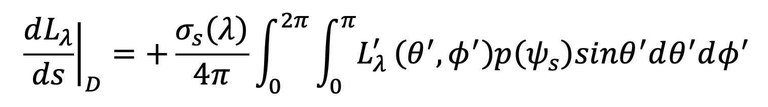
RADIANCE TRANSFER FUNCTION (RTF)
Scattering in
(Gain)
Volume scattering coefficient

Slide 142
RADIANCE TRANSFER FUNCTION (RTF)
Scattering in
(Gain)
Circumferential angle

Slide 143
RADIANCE TRANSFER FUNCTION (RTF)
Scattering in
(Gain)
Polar angle

Slide 144
RADIANCE TRANSFER FUNCTION (RTF)
Radiance from somewhere else entering sphere at wavelength λ as a function of circumferential and polar angle
Scattering in
(Gain)

Slide 145
RADIANCE TRANSFER FUNCTION (RTF)
Scattering in
(Gain)
Weighting function dependent on scattering angle ψ

Slide 146
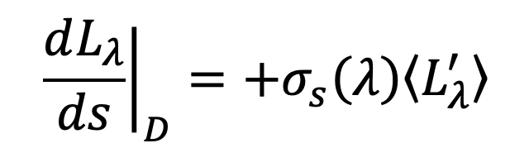
RADIANCE TRANSFER FUNCTION (RTF)
This is a white body term:
The volume scattering coefficient is related to the reflectance (ρ) at
wavelength λ
Exponential growth again
Scattering in
(Gain)
After completing integral on RHS

Slide 147
RADIANCE TRANSFER FUNCTION (RTF)
Now substitute explicit identities into slope term and narrow scope to monochromatic channels
y = b + m x
Black body
terms
White body
terms

Slide 148
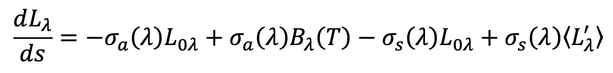
RADIANCE TRANSFER FUNCTION (RTF)
Expression becomes:
Black body
terms
White body
terms

Slide 149
RADIANCE TRANSFER FUNCTION (RTF)
Expression becomes:
Loss
Black body
terms
White body
terms

Slide 150
RADIANCE TRANSFER FUNCTION (RTF)
Expression becomes:
Gain
Black body
terms
White body
terms

Slide 151
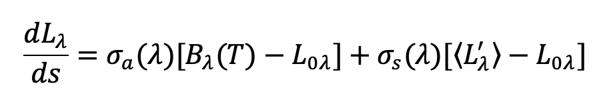
RADIANCE TRANSFER FUNCTION (RTF)
Or:
Black body
terms
White body
terms

Slide 152
RADIANCE TRANSFER FUNCTION (RTF)
If no scattering present:
If black body emission within control volume is greater than initial radiance, the radiance reaching satellite is increased
If black body emission within control volume is less than initial radiance, the radiance reaching satellite is decreased
Black body
terms
White body
terms

Slide 153
RADIANCE TRANSFER FUNCTION (RTF)
If no absorption or emission present:
If radiance from somewhere else scattered into same direction as initial radiance else is greater than initial radiance, the radiance reaching satellite is increased
If radiance from somewhere else scattered into same direction as initial radiance else is less than initial radiance, the radiance reaching satellite is decreased
Black body
terms
White body
terms

Slide 154
PASSIVE SENSORS

Slide 155
SATELLITE RADIOMETERS
Most satellite instruments are passive sensors
No emission of EMR from instrument
Utilizes environmentally available EMR
Radiometer = quantitative camera
PASSIVE SENSORS

Slide 156
SATELLITE RADIOMETERS
Most satellite instruments are passive sensors
No emission of EMR from instrument
Utilizes environmentally available EMR
Radiometer = quantitative camera
Specialization of radiometer
IMAGERS
SOUNDERS
PASSIVE SENSORS

Slide 157
SATELLITE IMAGERS
Designed to create pictures in narrow range of wavelengths (called channels), one pixel at a time
Specialization of radiometer
IMAGERS
IMAGERS

Slide 158
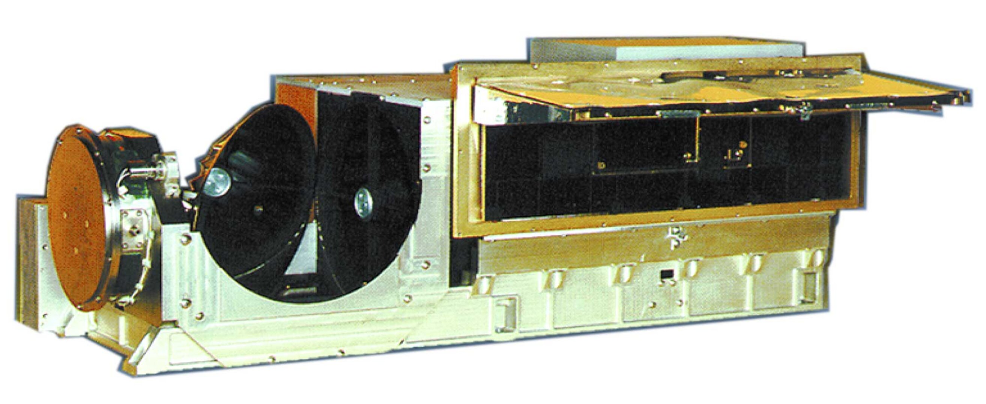
SATELLITE IMAGERS
Designed to create pictures in narrow range of wavelengths (called channels), one pixel at a time
Examples:
Advanced Very-High Resolution Radiometer (AVHRR)
[NOAA Polar Orbiters]
IMAGERS

Slide 159
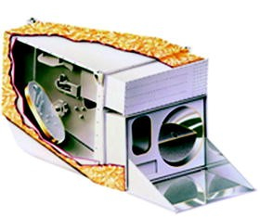
SATELLITE IMAGERS
Designed to create pictures in narrow range of wavelengths (called channels), one pixel at a time
Examples:
Moderate Resolution Imaging Spectroradiometer (MODIS)
[TERRA/AQUA]
IMAGERS

Slide 160
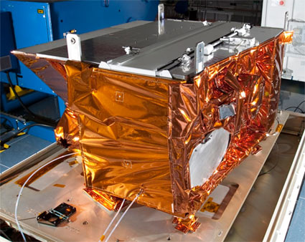
SATELLITE IMAGERS
Designed to create pictures in narrow range of wavelengths (called channels), one pixel at a time
Examples:
Visible Infrared Imaging Radiometer Suite (VIIRS)
[JPSS]
IMAGERS

Slide 161

SATELLITE IMAGERS
JPSS
Designed to create pictures in narrow range of wavelengths (called channels), one pixel at a time
Examples:
Visible Infrared Imaging Radiometer Suite (VIIRS)
[JPSS]
IMAGERS

Slide 162

SATELLITE IMAGERS
Designed to create pictures in narrow range of wavelengths (called channels), one pixel at a time
Examples:
Advanced Baseline Imager (ABI)
[GOES-R Series]
IMAGERS

Slide 163

SATELLITE IMAGERS
GOES-R
Designed to create pictures in narrow range of wavelengths (called channels), one pixel at a time
Examples:
Advanced Baseline Imager (ABI)
[GOES-R Series]
IMAGERS

Slide 164
AVHRR
IMAGERS

Slide 165
AVHRR
SMV
Limb
L
Upwelling polychromatic radiance (L)
From scan spot
SGT
SSP
Scan Line
IMAGERS

Slide 166
AVHRR
Upwelling polychromatic (L) radiance enters instrument through the Field of View (FOV)
Field of View (FOV)
L
IMAGERS

Slide 167
AVHRR
Upwelling polychromatic (L) radiance enters instrument through the Field of View (FOV)
FOV has width of 1300 μradians
Field of View (FOV)
L
IMAGERS

Slide 168
AVHRR
SMV
Limb
FOV projected to SSP from 850 km creates a scan spot 1.1 km in diameter
SGT
Scan Line
IMAGERS

Slide 169
AVHRR
Scan Mirror rotates six times per second
Scan Mirror
Field of View (FOV)
L
IMAGERS

Slide 170
AVHRR
SMV
SMV carries spacecraft across landscape at 392 km/min, or 6.5 km/sec
Limb
SGT
Scan Line
IMAGERS

Slide 171
AVHRR
SMV
SMV carries spacecraft across landscape at 392 km/min, or 6.5 km/sec
Limb
Scan mirror rotates six times in one second, so successive scan lines are 1.1 km apart
SGT
Scan Line
IMAGERS

Slide 172
AVHRR
Maximum scan (zenith) angle (θ) is 55.3 degrees
Scan Mirror
Field of View (FOV)
L
IMAGERS

Slide 173
AVHRR
SMV
Scan angle of 55.3 degrees, combined with satellite elevation of 850 km, gives a half-length for scan line of 1230 km
Limb
θ
SGT
Scan Line
IMAGERS

Slide 174
AVHRR
SMV
Scan angle of 55.3 degrees, combined with satellite elevation of 850 km, gives a half-length for scan line of 1230 km
Limb
θ
SGT
2460 km
Full length for scan line is 2460 km
Scan Line
IMAGERS

Slide 175
AVHRR
SMV
FOV projected to end of scan line creates scan spot 2.3 km wide in the along-track direction and 6.4 km long in the cross-track direction
Limb
SGT
IMAGERS

Slide 176
AVHRR
Telescope
Scan Mirror directs polychromatic radiance into telescope
Scan Mirror
L
IMAGERS

Slide 177
AVHRR
Types of telescopes?
IMAGERS

Slide 178

AVHRR
Types of telescopes?
Ahoy, etc.
REFRACTING
Polly
Wooden leg
(not shown)
IMAGERS
Note: I tried to find a picture of a monkey holding this telescope

Slide 179
AVHRR
Types of telescopes?
REFRACTING
Magnification depends on focal length
IMAGERS

Slide 180

AVHRR
Types of telescopes?
REFLECTING
Isaac Newton’s reflecting telescope
IMAGERS

Slide 181

AVHRR
Types of telescopes?
REFLECTING
Hale Telescope on Mount Palomar
IMAGERS

Slide 182

AVHRR
Types of telescopes?
REFLECTING
Hubble Space Telescope
IMAGERS

Slide 183

AVHRR
Types of telescopes?
REFLECTING
James Webb Space Telescope
IMAGERS

Slide 184
AVHRR
Types of telescopes?
REFLECTING
Magnification depends on diameter of primary mirror
IMAGERS

Slide 185
AVHRR
Telescope
Primary Mirror
Scan Mirror
AVHRR uses a reflecting telescope
(No pirates needed)
L
IMAGERS

Slide 186
AVHRR
Telescope
Primary Mirror
Scan Mirror
Secondary Mirror
Primary mirror magnifies radiance from FOV and reflects it to secondary mirror
L
IMAGERS

Slide 187
AVHRR
Telescope
Primary Mirror
Scan Mirror
Secondary Mirror
Secondary mirror focuses radiance through small opening in center of primary mirror
L
L
IMAGERS

Slide 188
AVHRR
Telescope
Primary Mirror
Scan Mirror
Secondary Mirror
L
SPLT
Polychromatic radiance enters splitter that creates six identical beams
L
IMAGERS

Slide 189
AVHRR
Telescope
Lλ
Channel 1: 0.58 – 0.68 μm (Visible)
Primary Mirror
FILT
Scan Mirror
Lλ
Channel 2: 0.725 – 1.0 μm (IR)
FILT
Secondary Mirror
Lλ
FILT
Channel 3a: 1.58 – 1.64 μm (IR)
L
SPLT
Lλ
Channel 3b: 3.55 – 3.93 μm (IR)
FILT
FILT
Lλ
Channel 4: 10.3 – 11.3 μm (IR)
Lλ
Channel 5: 11.5 – 12.5 μm (IR)
FILT
Polychromatic radiance beams enter color filters
This creates separate monochromatic channels
L
IMAGERS

Slide 190
AVHRR
Telescope
Absorption/emission processes in these channels
Lλ
Channel 1: 0.58 – 0.68 μm (Visible)
FILT
Weak O3 dissociation (atmospheric window)
Primary Mirror
Scan Mirror
Vibrational transitions of O3 and H2O
Lλ
Channel 2: 0.725 – 1.0 μm (IR)
FILT
Secondary Mirror
Lλ
FILT
Channel 3a: 1.58 – 1.64 μm (IR)
Rotational transitions of H2O
L
SPLT
Lλ
Channel 3b: 3.55 – 3.93 μm (IR)
FILT
Rotational transitions of HDO
FILT
Weak rotational transitions of CO2 (atmospheric window)
Lλ
Channel 4: 10.3 – 11.3 μm (IR)
Weak rotational transitions of CO2 and H2O
Lλ
Channel 5: 11.5 – 12.5 μm (IR)
FILT
Polychromatic radiance beams enter color filters
This creates separate monochromatic channels
L
IMAGERS

Slide 191
AVHRR
Telescope
~
PV
Lλ
Primary Mirror
FILT
Scan Mirror
Lλ
PV
FILT
~
Secondary Mirror
Lλ
~
FILT
PV
L
SPLT
Lλ
~
FILT
PV
FILT
Lλ
PV
~
PV
Lλ
~
FILT
Monochromatic radiance beams enter photo-cells that generate a continuous electric signal proportional to the brightness in the channel
L
IMAGERS

Slide 192
AVHRR
Telescope
~
PV
A2D
Lλ
Primary Mirror
FILT
Scan Mirror
Lλ
PV
FILT
~
A2D
Secondary Mirror
Lλ
~
FILT
PV
A2D
L
SPLT
Lλ
~
FILT
PV
A2D
FILT
Lλ
A2D
PV
~
PV
Lλ
~
FILT
A2D
Analog-to-Digital (A2D) sampling of each channel occurs once each 25 μsec
L
IMAGERS

Slide 193
AVHRR
SMV
In 25 μsec, the scan mirror rotates through 942 μradians of arc
Limb
SGT
IMAGERS

Slide 194
AVHRR
SMV
In 25 μsec, the scan mirror rotates through 942 μradians of arc
Limb
Combined with the satellite elevation of 850 km, this puts the centroids of the scan spots 800 meters apart near the subsatellite point
SGT
IMAGERS

Slide 195
AVHRR
Telescope
~
PV
A2D
Lλ
Primary Mirror
FILT
Scan Mirror
Lλ
PV
FILT
~
A2D
Secondary Mirror
Lλ
~
FILT
PV
A2D
L
SPLT
Lλ
~
FILT
PV
A2D
FILT
Lλ
A2D
PV
~
PV
Lλ
~
FILT
A2D
Digital voltages are encoded as 10-bit binary
L
IMAGERS

Slide 196

AVHRR
Telescope
~
PV
A2D
Lλ
Primary Mirror
FILT
Scan Mirror
Lλ
PV
FILT
~
A2D
Secondary Mirror
Lλ
~
FILT
PV
A2D
There are 1024 possible different brightness levels (0 – 1023)
L
SPLT
Lλ
~
FILT
PV
A2D
FILT
Lλ
A2D
PV
~
PV
Lλ
~
FILT
A2D
Digital voltages are encoded as 10-bit binary
L
IMAGERS

Slide 197
AVHRR
Telescope
~
PV
A2D
Lλ
Primary Mirror
FILT
Scan Mirror
Lλ
PV
FILT
~
A2D
Secondary Mirror
Lλ
~
FILT
PV
A2D
L
SPLT
Memory
Lλ
~
FILT
PV
A2D
FILT
Lλ
A2D
PV
~
PV
Lλ
~
FILT
A2D
Binary brightness values are stored to flash memory
L
IMAGERS

Slide 198
AVHRR
SMV
There are 2048 scan spots in each scan line
Limb
SGT
IMAGERS

Slide 199
AVHRR
SMV
There are 2048 scan spots in each scan line
Limb
AVHRR completes six scan lines every second
SGT
IMAGERS

Slide 200
AVHRR
SMV
There are 2048 scan spots in each scan line
Limb
AVHRR completes six scan lines every second
SGT
Each scan spot radiance is recorded by six channels
IMAGERS

Slide 201
AVHRR
SMV
There are 2048 scan spots in each scan line
Limb
AVHRR completes six scan lines every second
SGT
Each scan spot radiance is recorded by six channels
Total number of radiances recorded = 73,728 per second
IMAGERS

Slide 202
AVHRR
Factors limiting resolution of instrument
Mirror rotation rate and SMV: Sets along-track distance between adjacent scan lines = 1.09 km
Mirror rotation rate and A2D conversion rate: Sets cross-track distance between scan spot centroids = 800 meters at SSP
FOV and satellite elevation: Sets minimum size of each scan spot = 1.1 km circle at SSP
Result: Best resolution is about 1.1 km at SSP
IMAGERS

Slide 203
AVHRR
Data downloading
High-Resolution Picture Transmission (HRPT): Full resolution, all channels. 5.25 W transmitter on spacecraft.
Automatic Picture Transmission (APT): Reduced resolution, channels 1 and 4 only. 5 W transmitter on spacecraft.
IMAGERS

Slide 204
AVHRR
Data downloading
High-Resolution Picture Transmission (HRPT): Full resolution, all channels. 5.25 W transmitter on spacecraft.
Automatic Picture Transmission (APT): Reduced resolution, channels 1 and 4 only. 5 W transmitter on spacecraft.
Three ground stations for receiving HRPT:
NOAA Command and Data Acquisition (CDA) stations at Gilmore Creek, Alaska and Wallops Island, Virginia
European Centre d’Etudes Spatiales (CNES) in France
All data then transferred to NOAA Satellite Operations Center (NSOC) in Suitland, Maryland
IMAGERS

Slide 205

MODIS CHANNELS
NASA TERRA & AQUA
IMAGERS

Slide 206
MODIS CHANNELS
NASA TERRA & AQUA
36 Channels
Visible
IMAGERS

Slide 207
MODIS CHANNELS
NASA TERRA & AQUA
36 Channels
IR
IMAGERS

Slide 208

VIIRS CHANNELS
NOAA JPSS
IMAGERS

Slide 209
VIIRS CHANNELS
NOAA JPSS
22 Channels
Visible
IMAGERS

Slide 210
VIIRS CHANNELS
NOAA JPSS
22 Channels
IR
IMAGERS

Slide 211

ABI CHANNELS
NOAA GOES
IMAGERS
(Schmit et al., 2017)

Slide 212
ABI CHANNELS
NOAA GOES
16 Channels
Visible
IMAGERS
(Schmit et al., 2017)

Slide 213
ABI CHANNELS
NOAA GOES
16 Channels
IR
IMAGERS
(Schmit et al., 2017)

Slide 214
ABI CHANNELS
NOAA GOES
16 Channels
IR - WV
IMAGERS
(Schmit et al., 2017)

Slide 215
ENHANCEMENT CURVES
Polychromatic (all channels)
IMAGERS

Slide 216

ENHANCEMENT CURVES
Polychromatic (all channels)
Monochromatic (one channel)
IMAGERS

Slide 217
ENHANCEMENT CURVES
Polychromatic (all channels)
Monochromatic (one channel)
For AVHRR, Radiance reported in each channel is encoded in 10-bit binary (1024 possible brightness levels)
Reduced to 256 brightness levels, and for IR is inverted: Bright white = cold; black = warm
IMAGERS

Slide 218

ENHANCEMENT CURVES
Unenhanced radiances and corresponding temperatures
IMAGERS
(Image: Kidder and Vonder Harr, 1995)

Slide 219
ENHANCEMENT CURVES
Unenhanced radiances and corresponding temperatures
Brightness levels
IMAGERS
(Image: Kidder and Vonder Harr, 1995)

Slide 220
ENHANCEMENT CURVES
Unenhanced radiances and corresponding temperatures
Temperature scale
IMAGERS
(Image: Kidder and Vonder Harr, 1995)

Slide 221
ENHANCEMENT CURVES
Unenhanced radiances and corresponding temperatures
Black = Warm
White = Cold
IMAGERS
(Image: Kidder and Vonder Harr, 1995)

Slide 222
ENHANCEMENT CURVES
Unenhanced radiances and corresponding temperatures
These temperatures outside meteorologically meaningful range
IMAGERS
(Image: Kidder and Vonder Harr, 1995)

Slide 223

ENHANCEMENT CURVES
General purpose enhancement curve
“Zeroes out” unnecessary gray-scale; uses remaining brightness level to increase resolution at low and high-end temperatures
Greater slope = better resolution
IMAGERS
(Image: Kidder and Vonder Harr, 1995)

Slide 224

ENHANCEMENT CURVES
General purpose enhancement curve
ZA Curve
IMAGERS

Slide 225
ENHANCEMENT CURVES
Other enhancement curves (legacy)
MB Curve for cold thunderstorms tops
IMAGERS
(Image: Kidder and Vonder Harr, 1995)

Slide 226
ENHANCEMENT CURVES
Other enhancement curves (legacy)
BD Curve for hurricanes
IMAGERS
(Image: Kidder and Vonder Harr, 1995)

Slide 227

ENHANCEMENT CURVES
Other enhancement curves (legacy)
MB Curve
IMAGERS

Slide 228

ENHANCEMENT CURVES
Other enhancement curves (legacy)
BD Curve
IMAGERS

Slide 229



ENHANCEMENT CURVES
Other enhancement curves
IMAGERS

Slide 230

ENHANCEMENT CURVES
Other enhancement curves (modern)
National Hurricane Center (NHC) enhancement of IR image
Colors are coded by cloud-top temperature
IMAGERS

Slide 231

ENHANCEMENT CURVES
Other enhancement curves (modern)
Enhanced water vapor image
Curve emphasizes dry and moist areas
IMAGERS

Slide 232
ATMOSPHERIC SOUNDERS
Specialization of radiometer
SOUNDERS
SOUNDERS

Slide 233
ATMOSPHERIC SOUNDERS
Key Idea (1959): “If the atmosphere is observed at carefully chosen wavelengths, it is possible to retrieve the Planck Radiance, and therefore the temperature, as a function of height.”
Specialization of radiometer
SOUNDERS
SOUNDERS

Slide 234
ATMOSPHERIC SOUNDERS
Key Idea (1959): “If the atmosphere is observed at carefully chosen wavelengths, it is possible to retrieve the Planck Radiance, and therefore the temperature, as a function of height.”
Two broad classes of sounders:
Active: LIDAR and Radar
Passive: Environmental radiance is used
SOUNDERS

Slide 235
ATMOSPHERIC SOUNDERS
Key Idea (1959): “If the atmosphere is observed at carefully chosen wavelengths, it is possible to retrieve the Planck Radiance, and therefore the temperature, as a function of height.”
Two broad classes of sounders:
Active: LIDAR and Radar
Passive: Environmental radiance is used
Vertical: Radiance coming from atmosphere below satellite is sensed.
Limb: Radiance from limb of atmosphere is sensed.
SOUNDERS

Slide 236
ATMOSPHERIC SOUNDERS
Key Idea (1959): “If the atmosphere is observed at carefully chosen wavelengths, it is possible to retrieve the Planck Radiance, and therefore the temperature, as a function of height.”
Two broad classes of sounders:
Active: LIDAR and Radar
Passive: Environmental radiance is used
Vertical: Radiance coming from atmosphere below satellite is sensed.
Limb: Radiance from limb of atmosphere is sensed.
SOUNDERS

Slide 237
SLANT RANGE OPTICAL DEPTH
Recall definition of Vertical Optical Depth:
SOUNDERS

Slide 238
SLANT RANGE OPTICAL DEPTH
Spacecraft
Upwelling radiance
SSP
SOUNDERS

Slide 239
SLANT RANGE OPTICAL DEPTH
Spacecraft
Upwelling radiance
SSP
SOUNDERS

Slide 240
SLANT RANGE OPTICAL DEPTH
Spacecraft
SOUNDERS

Slide 241
SLANT RANGE OPTICAL DEPTH
Spacecraft
z2
Integral limits of Vertical Optical Depth
z1
Okay when looking at the SSP
SOUNDERS

Slide 242
SLANT RANGE OPTICAL DEPTH
Spacecraft
z2
Integral limits of Vertical Optical Depth
z1
When viewing down the scan line, need Slant Range Optical Depth
SOUNDERS

Slide 243
SLANT RANGE OPTICAL DEPTH
Spacecraft
sl2
Integral limits of Slant Range Optical Depth
sl1
SOUNDERS

Slide 244
SLANT RANGE OPTICAL DEPTH
Let μ = cos θ
Spacecraft
sl2
θ
Zenith angle
sl1
SOUNDERS

Slide 245

SLANT RANGE OPTICAL DEPTH
Relationship between Vertical Optical Depth and Slant Range Optical Depth:
Spacecraft
sl2
θ
Zenith angle
sl1
SOUNDERS

Slide 246

IMPROVED RADIANCE TRANSFER FUNCTION (RTF)
Definitions: Absorption Number and Single-Scatter Albedo
SOUNDERS

Slide 247

IMPROVED RADIANCE TRANSFER FUNCTION (RTF)
RTF Becomes:
SOUNDERS

Slide 248
IMPROVED RADIANCE TRANSFER FUNCTION (RTF)
RTF Becomes:
Initial Radiance from Scan Spot
SOUNDERS

Slide 249
IMPROVED RADIANCE TRANSFER FUNCTION (RTF)
RTF Becomes:
Gain from emission within atmosphere
SOUNDERS

Slide 250
IMPROVED RADIANCE TRANSFER FUNCTION (RTF)
RTF Becomes:
Gain from scattering into same direction as initial radiance
SOUNDERS

Slide 251
IMPROVED RADIANCE TRANSFER FUNCTION (RTF)
If no scattering:
Schwarzchild Equation:
Basis of Atmospheric Sounders
SOUNDERS

Slide 252

IMPROVED RADIANCE TRANSFER FUNCTION (RTF)
Schwarzchild Equation:
Basis of Atmospheric Sounders
(This is the RTF with no scattering.)
SOUNDERS

Slide 253

IMPROVED RADIANCE TRANSFER FUNCTION (RTF)
After solving for radiance reaching the satellite:
SOUNDERS

Slide 254
IMPROVED RADIANCE TRANSFER FUNCTION (RTF)
After solving for radiance reaching the satellite:
Surface Term (Noise)
SOUNDERS

Slide 255
IMPROVED RADIANCE TRANSFER FUNCTION (RTF)
After solving for radiance reaching the satellite:
Sky Term (Noise)
SOUNDERS

Slide 256
IMPROVED RADIANCE TRANSFER FUNCTION (RTF)
After solving for radiance reaching the satellite:
Atmospheric Term
This is the contribution to the total radiance from emission within the column of air between the surface and the satellite.
If we can determine the black-body radiance between h0 and hT (base and top of a layer), we can determine the temperature.
SOUNDERS

Slide 257
IMPROVED RADIANCE TRANSFER FUNCTION (RTF)
After solving for radiance reaching the satellite:
Atmospheric Term
Weighting functions determine where the radiance is coming from.
SOUNDERS

Slide 258

IMPROVED RADIANCE TRANSFER FUNCTION (RTF)
Solving for weighting function between h0 (surface) and hT (centroid of weight):
SOUNDERS

Slide 259
IMPROVED RADIANCE TRANSFER FUNCTION (RTF)
Solving for weighting function between h0 (surface) and hT (centroid of weight):
Weight is dependent on zenith angle
Weight is dependent on elevation
SOUNDERS

Slide 260
IMPROVED RADIANCE TRANSFER FUNCTION (RTF)
Solving for weighting function between h0 (surface) and hT (centroid of weight):
Sky Term (Noise) = f(transmittance)
Surface Term (Noise) = f(transmittance)
Atmospheric Component
SOUNDERS

Slide 261
IMPROVED RADIANCE TRANSFER FUNCTION (RTF)
Solving for weighting function between h0 (surface) and hT (centroid of weight):
Conclusion: Choose transmittance, and you choose the shape of the weight and therefore where (at what depth in the atmosphere) most of the radiance comes from.
Sky Term (Noise) = f(transmittance)
Surface Term (Noise) = f(transmittance)
Atmospheric Component
SOUNDERS

Slide 262
IMPROVED RADIANCE TRANSFER FUNCTION (RTF)
Chain of logic linking wavelength to the shape of the weighting function:
1. Weights are a function of transmittance;
SOUNDERS

Slide 263
IMPROVED RADIANCE TRANSFER FUNCTION (RTF)
Chain of logic linking wavelength to the shape of the weighting function:
Weights are a function of transmittance;
Transmittance is a function of Vertical Optical Depth;
SOUNDERS

Slide 264
IMPROVED RADIANCE TRANSFER FUNCTION (RTF)
Chain of logic linking wavelength to the shape of the weighting function:
Weights are a function of transmittance;
Transmittance is a function of Vertical Optical Depth;
Vertical Optical Depth is a function of the extinction coefficient;
SOUNDERS

Slide 265
IMPROVED RADIANCE TRANSFER FUNCTION (RTF)
Chain of logic linking wavelength to the shape of the weighting function:
Weights are a function of transmittance;
Transmittance is a function of Vertical Optical Depth;
Vertical Optical Depth is a function of the extinction coefficient;
Extinction coefficient is a function of the volume
absorption coefficient and the volume scattering
coefficient;
SOUNDERS

Slide 266
IMPROVED RADIANCE TRANSFER FUNCTION (RTF)
Chain of logic linking wavelength to the shape of the weighting function:
Weights are a function of transmittance;
Transmittance is a function of Vertical Optical Depth;
Vertical Optical Depth is a function of the extinction coefficient;
Extinction coefficient is a function of the volume
absorption coefficient and the volume scattering
coefficient;
Volume absorption and scattering coefficients are
both functions of wavelength.
SOUNDERS

Slide 267
IMPROVED RADIANCE TRANSFER FUNCTION (RTF)
Chain of logic linking wavelength to the shape of the weighting function:
Weights are a function of transmittance;
Transmittance is a function of Vertical Optical Depth;
Vertical Optical Depth is a function of the extinction coefficient;
Extinction coefficient is a function of the volume
absorption coefficient and the volume scattering
coefficient;
Volume absorption and scattering coefficients are
both functions of wavelength.
Choose the wavelength and you choose the weights.
SOUNDERS

Slide 268
IMPROVED RADIANCE TRANSFER FUNCTION (RTF)
RECALL:
Microwave (1 – 1000 mm): Forbidden reactions
H₂O
O₂
SOUNDERS
Microwave Sounder
(Image: Kidder and Vonder Harr, 1995)

Slide 269

IMPROVED RADIANCE TRANSFER FUNCTION (RTF)
SOUNDERS
(Image: Kidder and Vonder Harr, 1995)

Slide 270
IMPROVED RADIANCE TRANSFER FUNCTION (RTF)
Very small difference in wavelength within this absorption peak results in large difference in height of weight centroid
SOUNDERS
(Image: Kidder and Vonder Harr, 1995)

Slide 271

IMPROVED RADIANCE TRANSFER FUNCTION (RTF)
Variation of weights with wavelength and zenith angle
SOUNDERS
(Image: Kidder and Vonder Harr, 1995)

Slide 272
IMPROVED RADIANCE TRANSFER FUNCTION (RTF)
Variation of weights with wavelength and zenith angle
Vertical Scales
SOUNDERS
(Image: Kidder and Vonder Harr, 1995)

Slide 273
IMPROVED RADIANCE TRANSFER FUNCTION (RTF)
Variation of weights with wavelength and zenith angle
Magnitude of Weights
SOUNDERS
(Image: Kidder and Vonder Harr, 1995)

Slide 274
IMPROVED RADIANCE TRANSFER FUNCTION (RTF)
Variation of weights with wavelength and zenith angle
Channels
SOUNDERS
(Image: Kidder and Vonder Harr, 1995)

Slide 275
IMPROVED RADIANCE TRANSFER FUNCTION (RTF)
Variation of weights with wavelength and zenith angle
Sample height of weight centroid (hT)
SOUNDERS
(Image: Kidder and Vonder Harr, 1995)

Slide 276
IMPROVED RADIANCE TRANSFER FUNCTION (RTF)
Variation of weights with wavelength and zenith angle
Wavelength dependency:
As λ increases, hT decreases
55.45 GHz (0.541 cm)
53.85 GHz (0.557 cm)
52.85 GHz (0.5676 cm)
SOUNDERS
(Image: Kidder and Vonder Harr, 1995)

Slide 277
IMPROVED RADIANCE TRANSFER FUNCTION (RTF)
Variation of weights with wavelength and zenith angle
Zenith angle dependency:
As θ increases, hT increases
55.45 GHz (0.541 cm)
53.85 GHz (0.557 cm)
52.85 GHz (0.5676 cm)
SOUNDERS
(Image: Kidder and Vonder Harr, 1995)

Slide 278
ATMOSPHERIC SOUNDERS
Designed to generate vertical profiles of temperature and water vapor mixing ratio. Also used to generate either profiles or vertically-integrated values of other variables, such as O3 concentration.
SOUNDERS

Slide 279

ATMOSPHERIC SOUNDERS
Designed to generate vertical profiles of temperature and water vapor mixing ratio. Also used to generate either profiles or vertically-integrated values of other variables, such as O3 concentration.
Examples:
High-Resolution Infra-Red Sounder (HIRS)
[NOAA Polar Orbiters]
SOUNDERS

Slide 280

ATMOSPHERIC SOUNDERS
Designed to generate vertical profiles of temperature and water vapor mixing ratio. Also used to generate either profiles or vertically-integrated values of other variables, such as O3 concentration.
Examples:
Advanced Microwave Sounding Unit – A1 (AMSU-A1)
[NOAA Polar Orbiters]
SOUNDERS

Slide 281

ATMOSPHERIC SOUNDERS
Designed to generate vertical profiles of temperature and water vapor mixing ratio. Also used to generate either profiles or vertically-integrated values of other variables, such as O3 concentration.
Examples:
Cross-Track Infrared Sounder (CrIS)
[JPSS]
SOUNDERS

Slide 282
ATMOSPHERIC SOUNDERS
JPSS
Designed to generate vertical profiles of temperature and water vapor mixing ratio. Also used to generate either profiles or vertically-integrated values of other variables, such as O3 concentration.
Examples:
Cross-Track Infrared Sounder (CrIS)
[JPSS]
SOUNDERS

Slide 283

ATMOSPHERIC SOUNDERS
Designed to generate vertical profiles of temperature and water vapor mixing ratio. Also used to generate either profiles or vertically-integrated values of other variables, such as O3 concentration.
Examples:
Advanced Technology Microwave Sounder (ATMS)
[JPSS]
SOUNDERS

Slide 284
ATMOSPHERIC SOUNDERS
JPSS
Designed to generate vertical profiles of temperature and water vapor mixing ratio. Also used to generate either profiles or vertically-integrated values of other variables, such as O3 concentration.
Examples:
Advanced Technology Microwave Sounder (ATMS)
[JPSS]
SOUNDERS

Slide 285
ATMOSPHERIC SOUNDERS
Operation similar to imagers
SOUNDERS

Slide 286
ATMOSPHERIC SOUNDERS
Operation similar to imagers
Uses a scan mirror to direct telescope to several scan spots along a scan line
SOUNDERS

Slide 287
ATMOSPHERIC SOUNDERS
Operation similar to imagers
Uses a scan mirror to direct telescope to several scan spots along a scan line
More channels than an imager
SOUNDERS

Slide 288

ATMOSPHERIC SOUNDERS
Channels are selected using a color wheel
Color wheel from James Webb Space Telescope
Instead of multiple sensors, a single sensor looks at a scan spot while the color wheel is rotated to obtain radiances in different channels
SOUNDERS

Slide 289
ATMOSPHERIC SOUNDERS
Channels are selected using a color wheel
Scan spots are larger and there are fewer of them in each scan line
SOUNDERS

Slide 290
ATMOSPHERIC SOUNDERS
Channels are selected using a color wheel
Scan spots are larger and there are fewer of them in each scan line
There are fewer scan lines completed each second
SOUNDERS

Slide 291

HIRS CHANNELS
NASA POES
20 Channels
SOUNDERS

Slide 292

HIRS CHANNELS
NASA POES
20 Channels
SOUNDERS

Slide 293

AMSU CHANNELS
NASA POES
15 Channels
SOUNDERS

Slide 294

AMSU CHANNELS
NASA POES
15 Channels
SOUNDERS

Slide 295

CrIS CHANNELS
JPSS
2,211 Channels
SOUNDERS

Slide 296

ATMS CHANNELS
JPSS
22 Channels
SOUNDERS

Slide 297

ATMS CHANNELS
JPSS
22 Channels
SOUNDERS

Slide 298
MODIS CHANNELS
NASA TERRA & AQUA
With 36 channels, MODIS functions as both an imager and a sounder
SOUNDERS

Slide 299
THE GOES ABI IS ALSO A SOUNDER
SOUNDERS
(Schmit et al., 2017)

Slide 300

THE GOES ABI IS ALSO A SOUNDER
SOUNDERS
(Schmit et al., 2017)

Slide 301
THE GOES ABI IS ALSO A SOUNDER
ABI LEGACY VERTICAL TEMPERATURE DATA CAN BE OBTAINED AT:
https://www.ncei.noaa.gov/access/metadata/landing-page/bin/iso?id=gov.noaa.ncdc:C01513
SOUNDERS
(Schmit et al., 2017)

Slide 302
SOUNDING RETRIEVALS
Question to be answered: What portion of the radiance in each of the sounder’s channels came from the black-body temperature of the atmosphere, and what portion came from trace gas emission?
SOUNDERS

Slide 303
SOUNDING RETRIEVALS
Question to be answered: What portion of the radiance in each of the sounder’s channels came from the black-body temperature of the atmosphere, and what portion came from trace gas emission?
Water vapor is one of the trace gases.
SOUNDERS

Slide 304
SOUNDING RETRIEVALS
Question to be answered: What portion of the radiance in each of the sounder’s channels came from the black-body temperature of the atmosphere, and what portion came from trace gas emission?
Water vapor is one of the trace gases.
Idea: Use channels that are free of trace gas emission to determine the temperature. Remainder of the radiance should be due to trace gas emission.
SOUNDERS

Slide 305
SOUNDING RETRIEVALS
Question to be answered: What portion of the radiance in each of the sounder’s channels came from the black-body temperature of the atmosphere, and what portion came from trace gas emission?
Water vapor is one of the trace gases.
Idea: Use channels that are free of trace gas emission to determine the temperature. Remainder of the radiance should be due to trace gas emission.
Problem: There are no channels free of trace gas emission.
SOUNDERS

Slide 306
SOUNDING RETRIEVALS
Question to be answered: What portion of the radiance in each of the sounder’s channels came from the black-body temperature of the atmosphere, and what portion came from trace gas emission?
Water vapor is one of the trace gases.
Idea: Use channels that are free of trace gas emission to determine the temperature. Remainder of the radiance should be due to trace gas emission.
Problem: There are no channels free of trace gas emission.
So, we are left with the original problem.
SOUNDERS

Slide 307
SOUNDING RETRIEVALS
Question to be answered: What portion of the radiance in each of the sounder’s channels came from the black-body temperature of the atmosphere, and what portion came from trace gas emission?
Problem is further compounded by the fact that satellite radiance measurements are not discrete (the weighting functions of the channels overlap).
SOUNDERS

Slide 308
SOUNDING RETRIEVALS
Question to be answered: What portion of the radiance in each of the sounder’s channels came from the black-body temperature of the atmosphere, and what portion came from trace gas emission?
This is why we need “retrieval methods.”
Problem is further compounded by the fact that satellite radiance measurements are not discrete (the weighting functions of the channels overlap).
SOUNDERS

Slide 309
SOUNDING RETRIEVALS
Question to be answered: What portion of the radiance in each of the sounder’s channels came from the black-body temperature of the atmosphere, and what portion came from trace gas emission?
RETRIEVAL METHODS
PHYSICAL
HYBRID
STATISTICAL
SOUNDERS

Slide 310
SOUNDING RETRIEVALS
PHYSICAL RETRIEVALS
Can be used for either temperature or water vapor mixing ratio
SOUNDERS

Slide 311
SOUNDING RETRIEVALS
PHYSICAL RETRIEVALS
Black-Body Temperature
Possible sources of First Guess Profile:
Climatology
Nearby radiosonde
Forecast sounding from models
CALCULATE FIRST-GUESS CURRENT TEMPERATURE PROFILE
SOUNDERS

Slide 312
SOUNDING RETRIEVALS
PHYSICAL RETRIEVALS
Black-Body Temperature
These are black-body radiances computed by using the RTF
Requires knowledge of transmittance (τ)
CALCULATE FIRST-GUESS CURRENT TEMPERATURE PROFILE
CALCULATE RADIANCES EXPECTED IN EACH CHANNEL FROM CURRENT PROFILE
SOUNDERS

Slide 313
SOUNDING RETRIEVALS
PHYSICAL RETRIEVALS
This is where the observed radiances from the satellite sounder come into the process
Black-Body Temperature
CALCULATE FIRST-GUESS CURRENT TEMPERATURE PROFILE
CALCULATE RADIANCES EXPECTED IN EACH CHANNEL FROM CURRENT PROFILE
COMPARE OBSERVED RADIANCES TO COMPUTED RADIANCES
SOUNDERS

Slide 314
SOUNDING RETRIEVALS
PHYSICAL RETRIEVALS
The amount of precision required determines the number of cycles through the loop
Black-Body Temperature
CALCULATE FIRST-GUESS CURRENT TEMPERATURE PROFILE
CALCULATE RADIANCES EXPECTED IN EACH CHANNEL FROM CURRENT PROFILE
COMPARE OBSERVED RADIANCES TO COMPUTED RADIANCES
WITHIN ΔE?
SOUNDERS

Slide 315
SOUNDING RETRIEVALS
PHYSICAL RETRIEVALS
Black-Body Temperature
CALCULATE FIRST-GUESS CURRENT TEMPERATURE PROFILE
CALCULATE RADIANCES EXPECTED IN EACH CHANNEL FROM CURRENT PROFILE
COMPARE OBSERVED RADIANCES TO COMPUTED RADIANCES
WITHIN ΔE?
NO
ADJUST CURRENT TEMPERATURE PROFILE
Cycle back if not within tolerance.
Repeat as many times as necessary.
SOUNDERS

Slide 316
SOUNDING RETRIEVALS
PHYSICAL RETRIEVALS
ACCEPT PROFILE
Black-Body Temperature
YES
CALCULATE FIRST-GUESS CURRENT TEMPERATURE PROFILE
CALCULATE RADIANCES EXPECTED IN EACH CHANNEL FROM CURRENT PROFILE
COMPARE OBSERVED RADIANCES TO COMPUTED RADIANCES
WITHIN ΔE?
Stop when error is acceptable.
SOUNDERS

Slide 317
SOUNDING RETRIEVALS
PHYSICAL RETRIEVALS
Advantages:
Physical processes clearly evident at each stage
No large database of coincident radiosonde data is necessary
Disadvantages:
Computationally intensive
Requires knowledge of transmittance (τ)
Does not utilize known statistical properties of atmosphere
SOUNDERS

Slide 318
SOUNDING RETRIEVALS
STATISTICAL RETRIEVALS
ASSUME THAT SOUNDER CHANNELS CORRECTLY SAMPLE THE ATMOSPHERE AT DIFFERENT LEVELS
SOUNDERS

Slide 319
SOUNDING RETRIEVALS
Training Data Set consists of large number of observed temperature and moisture profiles.
STATISTICAL RETRIEVALS
ASSUME THAT SOUNDER CHANNELS CORRECTLY SAMPLE THE ATMOSPHERE AT DIFFERENT LEVELS
CORRELATE CHANNEL RADIANCES TO NEARBY SOUNDING IN TRAINING DATA SET
SOUNDERS

Slide 320
SOUNDING RETRIEVALS
Training Data Set consists of large number of observed temperature and moisture profiles.
STATISTICAL RETRIEVALS
Must be large to assure mathematical stability, and should contain soundings over varied surface types and latitude zones.
ASSUME THAT SOUNDER CHANNELS CORRECTLY SAMPLE THE ATMOSPHERE AT DIFFERENT LEVELS
CORRELATE CHANNEL RADIANCES TO NEARBY SOUNDING IN TRAINING DATA SET
SOUNDERS

Slide 321
SOUNDING RETRIEVALS
Training Data Set consists of large number of observed temperature and moisture profiles.
STATISTICAL RETRIEVALS
Must be large to assure mathematical stability, and should contain soundings over varied surface types and latitude zones.
ASSUME THAT SOUNDER CHANNELS CORRECTLY SAMPLE THE ATMOSPHERE AT DIFFERENT LEVELS
CORRELATE CHANNEL RADIANCES TO NEARBY SOUNDING IN TRAINING DATA SET
Must be recent and updated frequently.
SOUNDERS

Slide 322
SOUNDING RETRIEVALS
Training Data Set consists of large number of observed temperature and moisture profiles.
STATISTICAL RETRIEVALS
Must be large to assure mathematical stability, and should contain soundings over varied surface types and latitude zones.
ASSUME THAT SOUNDER CHANNELS CORRECTLY SAMPLE THE ATMOSPHERE AT DIFFERENT LEVELS
CORRELATE CHANNEL RADIANCES TO NEARBY SOUNDING IN TRAINING DATA SET
Must be recent and updated frequently.
Correlations must be done separately for each satellite to account for small differences in instrument calibration.
SOUNDERS

Slide 323
SOUNDING RETRIEVALS
Training Data Set consists of large number of observed temperature and moisture profiles.
STATISTICAL RETRIEVALS
Must be large to assure mathematical stability, and should contain soundings over varied surface types and latitude zones.
ASSUME THAT SOUNDER CHANNELS CORRECTLY SAMPLE THE ATMOSPHERE AT DIFFERENT LEVELS
CORRELATE CHANNEL RADIANCES TO NEARBY SOUNDING IN TRAINING DATA SET
Must be recent and updated frequently.
Correlations must be done separately for each satellite to account for small differences in instrument calibration.
RTF is not used. Does not require knowledge of transmittance (τ)
SOUNDERS

Slide 324
SOUNDING RETRIEVALS
STATISTICAL RETRIEVALS
ASSUME THAT SOUNDER CHANNELS CORRECTLY SAMPLE THE ATMOSPHERE AT DIFFERENT LEVELS
CORRELATE CHANNEL RADIANCES TO NEARBY SOUNDING IN TRAINING DATA SET
APPLY STATISTICAL RELATIONSHIP TO LOCATIONS WITHOUT IN SITU DATA
SOUNDERS

Slide 325
SOUNDING RETRIEVALS
STATISTICAL RETRIEVALS
Advantages:
Much less computationally intensive than physical retrievals
Does not require knowledge of transmittance or use of the RTF
Extensively utilizes known statistical properties of the atmosphere
Disadvantages:
Training Data Set should include radiosonde profiles from mountain tops and the ocean (rare)
Radiosondes launched at 00Z and 12Z; hard to obtain “recent” soundings
SOUNDERS

Slide 326
SOUNDING RETRIEVALS
HYBRID RETRIEVALS
Mathematically similar to statistical retrievals
Uses Weighting Functions (as in physical retrievals) but does not involve numerical integration of the RTF
Main advantage: Easier to put into operation that either of the other two
Main disadvantage: Requires knowledge of transmittance
SOUNDERS

Slide 327
SOUNDING RETRIEVALS
HYBRID RETRIEVALS
Mathematically similar to statistical retrievals
Uses Weighting Functions (as in physical retrievals) but does not involve numerical integration of the RTF
Main advantage: Easier to put into operation that either of the other two
Main disadvantage: Requires knowledge of transmittance
This is the way it’s done operationally.
SOUNDERS

Slide 328
OPERATIONAL SOUNDING RETRIEVALS
ADVANCED TIROS OPERATIONAL VERTICAL SOUNDER (ATOVS)
Receives infra-red and microwave sounder(s) binary from Satellite Operations Control Center (SOCC), Office of Satellite and Product Operations (OSPO); Performs initial QA/QC
PREPROCESSOR
Earth-locate each scan spot
Convert binary data points to radiances
Correct radiances for water vapor absorption
Make initial guess for surface albedo and skin temperature
Apply albedo corrections to daytime data
Apply limb corrections (make all data equivalent to nadir)
Correct data from microwave sounders for side lobes
Interpolate data from different sensors onto a common grid
SOUNDERS

Slide 329
OPERATIONAL SOUNDING RETRIEVALS
Delivers spatially-averaged clear-column radiances to retrieval module; outputs a single set of radiances from an ensemble of scan spots
ADVANCED TIROS OPERATIONAL VERTICAL SOUNDER (ATOVS)
7 along-track
PREPROCESSOR
ATMOSPHERIC RADIANCE MODULE
9 cross-track
TOTAL: 63 Scan Spots
SGT
SOUNDERS

Slide 330
OPERATIONAL SOUNDING RETRIEVALS
Delivers spatially-averaged clear-column radiances to retrieval module; outputs a single set of radiances from an ensemble of scan spots
ADVANCED TIROS OPERATIONAL VERTICAL SOUNDER (ATOVS)
All 63 scan spots tested for cloud contamination using IR sounder’s visible channel
If at least 4 are uncontaminated, uses weighted average of radiances from the IR sounder
If 1 – 3 are uncontaminated, uses combination of IR and microwave sounder radiances
If none are uncontaminated, uses microwave sounder radiances only
PREPROCESSOR
ATMOSPHERIC RADIANCE MODULE
SOUNDERS

Slide 331
OPERATIONAL SOUNDING RETRIEVALS
Delivers spatially-averaged clear-column radiances to retrieval module; outputs a single set of radiances from an ensemble of scan spots
ADVANCED TIROS OPERATIONAL VERTICAL SOUNDER (ATOVS)
Some applications are using 3 x 3 (9 spot) ensemble for higher resolution output
PREPROCESSOR
ATMOSPHERIC RADIANCE MODULE
SOUNDERS

Slide 332
OPERATIONAL SOUNDING RETRIEVALS
Performs sounding retrieval using ensemble averaged clear-column radiances.
Uses hybrid retrieval method.
ADVANCED TIROS OPERATIONAL VERTICAL SOUNDER (ATOVS)
PREPROCESSOR
ATMOSPHERIC RADIANCE MODULE
RETRIEVAL MODULE
Data are archived by National Environmental Satellite Data and Information Service (NESDIS):
Temperature and dew point, virtual temperature, Integrated Precipitable Water (IPW), tropopause height and pressure, total ozone, others.
SOUNDERS

Slide 333
EVALUATION OF QUALITY OF SOUNDER DATA
Overlapping weights means radiance from a given height is used in more than one channel
SOUNDERS

Slide 334
EVALUATION OF QUALITY OF SOUNDER DATA
Overlapping weights means radiance from a given height is used in more than one channel
Acts like a low-pass filter: Fine details are smoothed out (lost)
SOUNDERS

Slide 335

EVALUATION OF QUALITY OF SOUNDER DATA
Comparison of GOES VAS-derived vertical profiles to profiles obtained using radiosondes
VAS = Visible and Infrared Spin Scan Radiometer (VISSR) Atmospheric Sounder
TOVS = TIROS Operational Vertical Sounder
SOUNDERS
(Image: Kidder and Vonder Harr, 1995)

Slide 336
EVALUATION OF QUALITY OF SOUNDER DATA
Comparison of GOES VAS-derived vertical profiles to profiles obtained using radiosondes
VAS = Visible and Infrared Spin Scan Radiometer (VISSR) Atmospheric Sounder
TOVS = TIROS Operational Vertical Sounder
Weights associated with each channel
SOUNDERS
(Image: Kidder and Vonder Harr, 1995)

Slide 337
EVALUATION OF QUALITY OF SOUNDER DATA
Comparison of GOES VAS-derived vertical profiles to profiles obtained using radiosondes
VAS = Visible and Infrared Spin Scan Radiometer (VISSR) Atmospheric Sounder
TOVS = TIROS Operational Vertical Sounder
VAS misses fine details near surface and tropopause
Dew point profile is worse than temperature profile
SOUNDERS
(Image: Kidder and Vonder Harr, 1995)

Slide 338

EVALUATION OF QUALITY OF SOUNDER DATA
Radiosonde profiles – Nationwide Eclipse Ballooning Project
Objective of project: Evaluate changes to atmosphere during a total solar eclipse.
Nationwide project funded by NASA
Involved 17 atmospheric sites
Picciano (2024) compared ABI legacy temperature profiles to radiosonde data
SOUNDERS
(Picciano 2024)

Slide 339
EVALUATION OF QUALITY OF SOUNDER DATA
Radiosonde profiles – Nationwide Eclipse Ballooning Project
Objective of project: Evaluate changes to atmosphere during a total solar eclipse.
Nationwide project funded by NASA
Involved 17 atmospheric sites
Picciano (2024) compared ABI legacy temperature profiles to radiosonde data
THREE COMPARISON SITES
SOUNDERS
(Picciano 2024)

Slide 340
EVALUATION OF QUALITY OF SOUNDER DATA
Radiosonde profiles – Nationwide Eclipse Ballooning Project
ATOVS = Advanced TIROS Operational Vertical Sounder
Converts radiances from ABI channels into vertical profiles of T and Td
Note: No microwave channels in ABI; infrared only
THREE COMPARISON SITES
SOUNDERS
(Picciano 2024)

Slide 341

EVALUATION OF QUALITY OF SOUNDER DATA
Comparison of GOES-E ABI Legacy Vertical Temperature Profiles from ATOVS to radiosonde data
SOUNDERS
(Picciano 2024)

Slide 342

EVALUATION OF QUALITY OF SOUNDER DATA
Comparison of GOES-E ABI Legacy Vertical Temperature Profiles from ATOVS to radiosonde data
SOUNDERS
(Picciano 2024)

Slide 343

EVALUATION OF QUALITY OF SOUNDER DATA
Comparison of GOES-E ABI Legacy Vertical Temperature Profiles from ATOVS to radiosonde data
SOUNDERS
(Picciano 2024)

Slide 344

EVALUATION OF QUALITY OF SOUNDER DATA
Comparison of GOES-E ABI Legacy Vertical Temperature Profiles from ATOVS to radiosonde data
(Values shown in Kelvins)
N = 19
SOUNDERS
(Picciano 2024)

Slide 345
EVALUATION OF QUALITY OF SOUNDER DATA
Comparison of GOES-E ABI Legacy Vertical Temperature Profiles from ATOVS to radiosonde data
(Values shown in Kelvins)
N = 19
WORST RESULTS NEAR SFC AND TROPOPAUSE
SOUNDERS
(Picciano 2024)

Slide 346
EVALUATION OF QUALITY OF SOUNDER DATA
Comparison of GOES-E ABI Legacy Vertical Temperature Profiles from ATOVS to radiosonde data
(Values shown in Kelvins)
N = 19
BEST RESULTS IN MIDDLE TROPOSPHERE
SOUNDERS
(Picciano 2024)

Slide 347
EVALUATION OF QUALITY OF SOUNDER DATA
Work by Gruber and Watkins (1982) found:
RMS difference between satellite and radiosonde temperature profiles is smaller than natural variability in mid-latitudes.
RMS differences are greatest near surface and tropopause, where temperature and water vapor mixing ratio lapse rates vary sharply with height.
Bias (satellite – radiosonde) small for clear soundings (IR sounder); larger for cloudy soundings (microwave sounder)
Temperatures in troughs too warm; in ridges too cool.
SOUNDERS

Slide 348
ACTIVE SENSORS

Slide 349
ACTIVE SENSORS
Emit either pulses or continuous wave of EMR
Usually operate in microwave region of spectrum (radar)
EMR interacts with target and is scattered back to radiometer
ACTIVE SENSORS

Slide 350

ACTIVE SENSORS
Examples:
Purpose: Sea-surface elevation
Poseidon 3B Radar Altimeter
[TOPEX/Poseidon and Jason Polar Orbiters]
ACTIVE SENSORS

Slide 351

ACTIVE SENSORS
Examples:
Poseidon 3B Radar Altimeter
[TOPEX/Poseidon and Jason Polar Orbiters]
ACTIVE SENSORS

Slide 352


ACTIVE SENSORS
Examples:
Purpose: Sea-surface winds
Advanced Scatterometer (ASCAT)
[METOP ESA Polar Orbiter]
ACTIVE SENSORS

Slide 353

ACTIVE SENSORS
Examples:
Advanced Scatterometer (ASCAT)
[METOP ESA Polar Orbiter]
ACTIVE SENSORS

Slide 354

ACTIVE SENSORS
Examples:
Sea surface wind speeds from a research paper (Kumar et al. 2021)
Advanced Scatterometer (ASCAT)
[METOP ESA Polar Orbiter]
ACTIVE SENSORS

Slide 355

ACTIVE SENSORS
Examples:
Sea surface wind vectors from a research paper (Cohen 2023)
Advanced Scatterometer (ASCAT)
[METOP ESA Polar Orbiter]
ACTIVE SENSORS

Slide 356

ACTIVE SENSORS
Examples:
Sea surface wind vectors from a research paper (Cohen 2023)
Advanced Scatterometer (ASCAT)
[METOP ESA Polar Orbiter]
ACTIVE SENSORS

Slide 357

ACTIVE SENSORS
Examples:
Purpose: Sea-surface winds
Seasat-A Satellite Scatterometer (SASS)
[Seasat Polar Orbiter]
ACTIVE SENSORS

Slide 358
ACTIVE SENSORS
How do scatterometers measure sea-surface winds?
Extensive series of aircraft studies in the 1960s indicated a relationship between sea-surface winds and radar returns from the sea surface
ACTIVE SENSORS

Slide 359
ACTIVE SENSORS
How do scatterometers measure sea-surface winds?
Extensive series of aircraft studies in the 1960s indicated a relationship between sea-surface winds and radar returns from the sea surface
NASA developed a specialized radar called a scatterometer
Measures backscatter cross-section (proportional to returned power) per unit area
ACTIVE SENSORS

Slide 360
ACTIVE SENSORS
How do scatterometers measure sea-surface winds?
Extensive series of aircraft studies in the 1960s indicated a relationship between sea-surface winds and radar returns from the sea surface
NASA developed a specialized radar called a scatterometer
Measures backscatter cross-section (proportional to returned power) per unit area
σ = normalized radar cross-section
ACTIVE SENSORS

Slide 361

ACTIVE SENSORS
How do scatterometers measure sea-surface winds?
ACTIVE SENSORS

Slide 362

ACTIVE SENSORS
How do scatterometers measure sea-surface winds?
ACTIVE SENSORS

Slide 363
ACTIVE SENSORS
How do scatterometers measure sea-surface winds?
ACTIVE SENSORS

Slide 364
ACTIVE SENSORS
How do scatterometers measure sea-surface winds?
This is solvable!
ACTIVE SENSORS

Slide 365
ACTIVE SENSORS
How do scatterometers measure sea-surface winds?
Sensor transmits pulses of microwave energy (radar) at sea surface from polar orbit
f = 14.6 GHz, or λ = 2.05 cm; transmitted power is about 8 Watts
Interacts with capillary waves on sea surface via Bragg Scattering
Greatest backscatter in upwind and downwind direction (sees face of approaching waves or backs of departing waves)
Smallest backscatter in cross-wind direction (see sides of waves)
Seasat-A Satellite Scatterometer (SASS)
[Seasat Polar Orbiter]
ACTIVE SENSORS

Slide 366
ACTIVE SENSORS
How do scatterometers measure sea-surface winds?
Sensor transmits pulses of microwave energy (radar) at sea surface from polar orbit
f = 14.6 GHz, or λ = 2.05 cm; transmitted power is about 8 Watts
Interacts with capillary waves on sea surface via Bragg Scattering
Greatest backscatter in upwind and downwind direction (sees face of approaching or departing waves)
Smallest backscatter in cross-wind direction (see sides of waves)
About the same size as radar waves
Defined as: “…small, free, surface-water wave with such a short wavelength that its restoring force is the water's surface tension, which causes the wave to have a rounded crest and V-shaped trough.”
Seasat-A Satellite Scatterometer (SASS)
[Seasat Polar Orbiter]
ACTIVE SENSORS

Slide 367

ACTIVE SENSORS
How do scatterometers measure sea-surface winds?
Sensor transmits pulses of microwave energy (radar) at sea surface from polar orbit
f = 14.6 GHz, or λ = 2.05 cm; transmitted power is about 8 Watts
Interacts with capillary waves on sea surface via Bragg Scattering
Greatest backscatter in upwind and downwind direction (sees face of approaching or departing waves)
Smallest backscatter in cross-wind direction (see sides of waves)
About the same size as radar waves
Defined as: “…small, free, surface-water wave with such a short wavelength that its restoring force is the water's surface tension, which causes the wave to have a rounded crest and V-shaped trough.”
Seasat-A Satellite Scatterometer (SASS)
[Seasat Polar Orbiter]
ACTIVE SENSORS

Slide 368

ACTIVE SENSORS
How do scatterometers measure sea-surface winds?
Sensor transmits pulses of microwave energy (radar) at sea surface from polar orbit
f = 14.6 GHz, or λ = 2.05 cm; transmitted power is about 8 Watts
Interacts with capillary waves on sea surface via Bragg Scattering
Greatest backscatter in upwind and downwind direction (sees face of approaching or departing waves)
Smallest backscatter in cross-wind direction (see sides of waves)
About the same size as radar waves
Defined as: “…small, free, surface-water wave with such a short wavelength that its restoring force is the water's surface tension, which causes the wave to have a rounded crest and V-shaped trough.”
Seasat-A Satellite Scatterometer (SASS)
[Seasat Polar Orbiter]
Capillary waves on sea surface
ACTIVE SENSORS

Slide 369
ACTIVE SENSORS
How do scatterometers measure sea-surface winds?
Sensor transmits pulses of microwave energy (radar) at sea surface from polar orbit
f = 14.6 GHz, or λ = 2.05 cm; transmitted power is about 8 Watts
Interacts with capillary waves on sea surface via Bragg Scattering
Greatest backscatter in upwind and downwind direction (sees face of approaching or departing waves)
Smallest backscatter in cross-wind direction (see sides of waves)
Seasat-A Satellite Scatterometer (SASS)
[Seasat Polar Orbiter]
ACTIVE SENSORS

Slide 370

ACTIVE SENSORS
How do scatterometers measure sea-surface winds?
Sensor transmits pulses of microwave energy (radar) at sea surface from polar orbit
f = 14.6 GHz, or λ = 2.05 cm; transmitted power is about 8 Watts
Interacts with capillary waves on sea surface via Bragg Scattering
Greatest backscatter in upwind and downwind direction (sees face of approaching or departing waves)
Smallest backscatter in cross-wind direction (see sides of waves)
ACTIVE SENSORS

Slide 371
ACTIVE SENSORS
How do scatterometers measure sea-surface winds?
Sensor transmits pulses of microwave energy (radar) at sea surface from polar orbit
f = 14.6 GHz, or λ = 2.05 cm; transmitted power is about 8 Watts
Interacts with capillary waves on sea surface via Bragg Scattering
Greatest backscatter in upwind and downwind direction (sees face of approaching or departing waves)
Smallest backscatter in cross-wind direction (see sides of waves)
EMR from Scatterometer
ACTIVE SENSORS

Slide 372
ACTIVE SENSORS
How do scatterometers measure sea-surface winds?
Sensor transmits pulses of microwave energy (radar) at sea surface from polar orbit
f = 14.6 GHz, or λ = 2.05 cm; transmitted power is about 8 Watts
Interacts with capillary waves on sea surface via Bragg Scattering
Greatest backscatter in upwind and downwind direction (sees face of approaching or departing waves)
Smallest backscatter in cross-wind direction (see sides of waves)
Compliment of zenith angle
EMR from Scatterometer
ACTIVE SENSORS

Slide 373
ACTIVE SENSORS
How do scatterometers measure sea-surface winds?
Sensor transmits pulses of microwave energy (radar) at sea surface from polar orbit
f = 14.6 GHz, or λ = 2.05 cm; transmitted power is about 8 Watts
Interacts with capillary waves on sea surface via Bragg Scattering
Greatest backscatter in upwind and downwind direction (sees face of approaching or departing waves)
Smallest backscatter in cross-wind direction (see sides of waves)
Compliment of zenith angle
EMR from Scatterometer
Wave height of capillary waves
ACTIVE SENSORS

Slide 374

ACTIVE SENSORS
How do scatterometers measure sea-surface winds?
Sensor transmits pulses of microwave energy (radar) at sea surface from polar orbit
f = 14.6 GHz, or λ = 2.05 cm; transmitted power is about 8 Watts
Interacts with capillary waves on sea surface via Bragg Scattering
Greatest backscatter in upwind and downwind direction (sees face of approaching or departing waves)
Smallest backscatter in cross-wind direction (see sides of waves)
Compliment of zenith angle
EMR from Scatterometer
Wave height of capillary waves
Bragg Scattering given by:
ACTIVE SENSORS

Slide 375
ACTIVE SENSORS
How do scatterometers measure sea-surface winds?
Sensor transmits pulses of microwave energy (radar) at sea surface from polar orbit
f = 14.6 GHz, or λ = 2.05 cm; transmitted power is about 8 Watts
Interacts with capillary waves on sea surface via Bragg Scattering
Greatest backscatter in upwind and downwind direction (sees face of approaching or departing waves)
Smallest backscatter in cross-wind direction (see sides of waves)
Compliment of zenith angle
EMR from Scatterometer
Wave height of capillary waves
Bragg Scattering given by:
Wavelength of EMR
ACTIVE SENSORS

Slide 376
ACTIVE SENSORS
How do scatterometers measure sea-surface winds?
Sensor transmits pulses of microwave energy (radar) at sea surface from polar orbit
f = 14.6 GHz, or λ = 2.05 cm; transmitted power is about 8 Watts
Interacts with capillary waves on sea surface via Bragg Scattering
Greatest backscatter in upwind and downwind direction (sees face of approaching or departing waves)
Smallest backscatter in cross-wind direction (see sides of waves)
Compliment of zenith angle
EMR from Scatterometer
Wave height of capillary waves
Bragg Scattering given by:
Order number of intensity maxima (= 1, 2, 3…)
ACTIVE SENSORS

Slide 377
SEASAT-A SATELLITE SCATTEROMETER
Need two measurements of back-scatter cross-section to back out wind speed and direction
Seasat-A Satellite Scatterometer (SASS)
[Seasat Polar Orbiter]
ACTIVE SENSORS

Slide 378
SEASAT-A SATELLITE SCATTEROMETER
Spacecraft
Need two measurements of back-scatter cross-section to back out wind speed and direction
Seasat-A Satellite Scatterometer (SASS)
[Seasat Polar Orbiter]
ACTIVE SENSORS

Slide 379
SEASAT-A SATELLITE SCATTEROMETER
SMV
Spacecraft
ALONG-TRACK
CROSS-TRACK
ACTIVE SENSORS

Slide 380
SEASAT-A SATELLITE SCATTEROMETER
SMV
Spacecraft
SCAN LINES ARE ABOUT HALF AS WIDE AS THAT OF AVHRR
1350 KM
ACTIVE SENSORS

Slide 381
SEASAT-A SATELLITE SCATTEROMETER
SMV
Spacecraft
SCAN LINE 45 DEGREES AHEAD OF SSP
SCAN LINE 45 DEGREES BEHIND SSP
INSTRUMENT IMAGES SAME LOCATIONS ON THE OCEAN SURFACE TWICE: ONCE AS IT APPROACHES, AND ONCE AS IT DEPARTS
ACTIVE SENSORS
~3 MINUTES

Slide 382
SEASAT-A SATELLITE SCATTEROMETER
SMV
Spacecraft
SCAN LINES ARE SEPARATED INTO THREE SWATHS
Right Swath
Center Swath
Left Swath
ACTIVE SENSORS
~3 MINUTES

Slide 383
SEASAT-A SATELLITE SCATTEROMETER
SMV
Spacecraft
INTERSECTIONS OF SWATHS AND SCAN LINES ARE SCAN SPOTS
RADAR BEAMS
SCAN SPOTS
ACTIVE SENSORS
~3 MINUTES

Slide 384
SEASAT-A SATELLITE SCATTEROMETER
SMV
Spacecraft
TWO VALUES OF σ ARE OBTAINED FOR EACH SCAN SPOT, THREE MINUTES APART
σ1
σ2
RADAR BEAMS
σ1
SCAN SPOTS
σ2
σ1
σ2
ACTIVE SENSORS
~3 MINUTES

Slide 385
SEASAT-A SATELLITE SCATTEROMETER
SMV
Spacecraft
σ1
σ2
~3 MINUTES
ACTIVE SENSORS

Slide 386
SEASAT-A SATELLITE SCATTEROMETER
ACTIVE SENSORS

Slide 387

SEASAT-A SATELLITE SCATTEROMETER
Scan direction as spacecraft is approaching scan spot
OCEAN WAVE CRESTS
σ1
ACTIVE SENSORS

Slide 388
SEASAT-A SATELLITE SCATTEROMETER
Scan direction as spacecraft is departing from scan spot
OCEAN WAVE CRESTS
σ2
ACTIVE SENSORS

Slide 389
SEASAT-A SATELLITE SCATTEROMETER
Seen from above
WAVE PROPAGATION
OCEAN WAVE CRESTS
SCAN AS SPACECRAFT DEPARTS
SCAN AS SPACECRAFT APPROACHES
ψ1
ψ2 = ψ1 + 90
~3 MINUTES
ACTIVE SENSORS

Slide 390
SEASAT-A SATELLITE SCATTEROMETER
SMV
Spacecraft
With two measurements we can solve the system of equations and obtain wind vector data for each scan spot on the scan line.
σ1
σ2
RADAR BEAMS
σ1
SCAN SPOTS
σ2
σ1
σ2
ACTIVE SENSORS
~3 MINUTES

Slide 391
SUMMARY

Slide 392
EMR THEORY
Light (EMR) can be described as a particle or a wave.
For most remote sensing applications, the wave analogy is appropriate.
It is combination of an electrical and a magnetic wave with a specific wavelength (λ).
Additional properties are polarization and phase angle.
Energy carried by EMR is inversely proportional to l.
Remember black, white, and clear bodies.
Planck’s Law, Wien’s Law, and Stefan-Boltzmann Law
Black-body emission and trace gas emission
Radiant Flux Density (M) and Radiance (L)
Absorption, emission, scattering, and transmittance
Radiance Transfer Function and four terms
Extinction and vertical optical depth
Schwarzchild equation (RTF without scattering)
SUMMARY

Slide 393
INSTRUMENTATION
Radiometers
Passive sensors
Imagers (e.g. AVHRR, ABI)
Enhancement curves
Factors limiting resolution
Sounders (e.g. HIRS, ATMS)
Weights – Centroids determined by choice of λ
Sounding retrieval methods – TOVS/ATOVS
Active sensors (e.g. ASCAT, SASS) – sea-surface winds
Low-power radar (microwave)
SUMMARY

Slide 394
References
Cohen, L., 2023: Satellite Verification of the NHC Designation of the 17 January 2023 NW Atlantic Cyclone, term paper for Satellite Meteorology (MT5330), Plymouth State University, 27 pp.
Kidder, S.Q., and T.H. Vonder Harr, 1995: Satellite Meteorology – An Introduction, San Diego: Academic Press, 466 pgs. (PRIMARY SOURCE)
Picciano, G., 2024: A Comparison of Atmospheric Profile Retrieval Methods From the 8 April 2024 Total Solar Eclipse, Semester Project in Satellite Meteorology (MT5330), Plymouth State University.
Schmit, T., P. Griffith, M. Gunshor, J. Daniels, S. Goodman, and W. Lebair, 2017: A closer look at the ABI on the GOES-R series, Bulletin of the American Meteorological Society, 98 (4), pp. 681 – 698, https://doi.org/10.1175/BAMS-D-15-00230.1
Public domain sources

