Slide 1
Portfolio
S. Miller
AR1045
Spring, 2018

Slide 2
Unit 1: A drawing based on The Tyger, by William Blake

Slide 3
The Tyger
By William Blake
Tyger Tyger, burning bright,
In the forests of the night;
What immortal hand or eye,
Could frame thy fearful symmetry?
In what distant deeps or skies.
Burnt the fire of thine eyes?
On what wings dare he aspire?
What the hand, dare seize the fire?
And what shoulder, & what art,
Could twist the sinews of thy heart?
And when thy heart began to beat,
What dread hand? & what dread feet?
What the hammer? what the chain,
In what furnace was thy brain?
What the anvil? what dread grasp,
Dare its deadly terrors clasp!
When the stars threw down their spears
And water'd heaven with their tears:
Did he smile his work to see?
Did he who made the Lamb make thee?
Tyger Tyger burning bright,
In the forests of the night:
What immortal hand or eye,
Dare frame thy fearful symmetry?

Slide 4
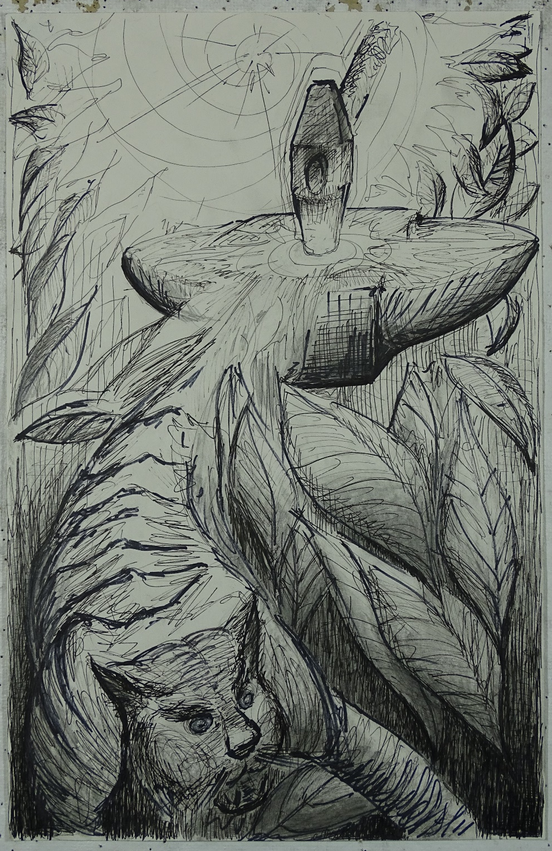
I took the following key words from Blake’s poem:
Bright
Forests
Fearful symmetry
Distant deep skies
Fire
Dread
Furnace
Brain
Terrors
Spears
From these I distilled a few key ideas:
Beauty
Terror
Power
Fire
Deep skies
Design by God

Slide 5
The drawing attempts to capture the vision of an immensely powerful but vastly distant and ultimately unknowable deity forging a fierce and beautiful animal.
The bright spot in the background is the furnace of the deity. The hammer and anvil in the middle ground are wielded by the deity. The hand holding the hammer is invisible to mortals, but the evidence of its past work (the jungle) is all around. The tiger – beauty, power, and intelligence – leaps forward from the forge.

Slide 6
Unit 2: Collage based in part on Jungian psychology

Slide 7
This is a collage in four parts, representing stages in the life of an intelligent, Earthbound being. It is based on three threads of ideas.
1. My own interpretation of the origins of biological life: Organic chemistry in the form of muddy (earthy) water, under a quiet, steady, benevolent Sun.
2. The emergent properties of biological intelligence and consciousness, which try to understand the individual’s origin, who finds itself reaching from the profane, life-giving Earth to the sublime sky. I call the physical manifestation of this being “the raised pillar,” although “standing column of mud” might be more appropriate. In the collages, I replace the pillar first with a tree, and then with a bird (once it breaks free of Earth).
3. The order (cosmos) that biological intelligence attempts to impose on a chaotic world (that is, the creation of understanding), and the work of a billion years of evolution to provide useful organizational principles. In humans, these take the forms described by Jung as “racial memory” (and expanded on by Moore and Gillette): King (Queen), Warrior, Magician, and Lover.
Moore, R., and D. Gillette, 1991: King, Warrior, Magician, Lover: Rediscovering the Archetypes of the Mature Masculine, HarperOne, 192 pgs.

Slide 8
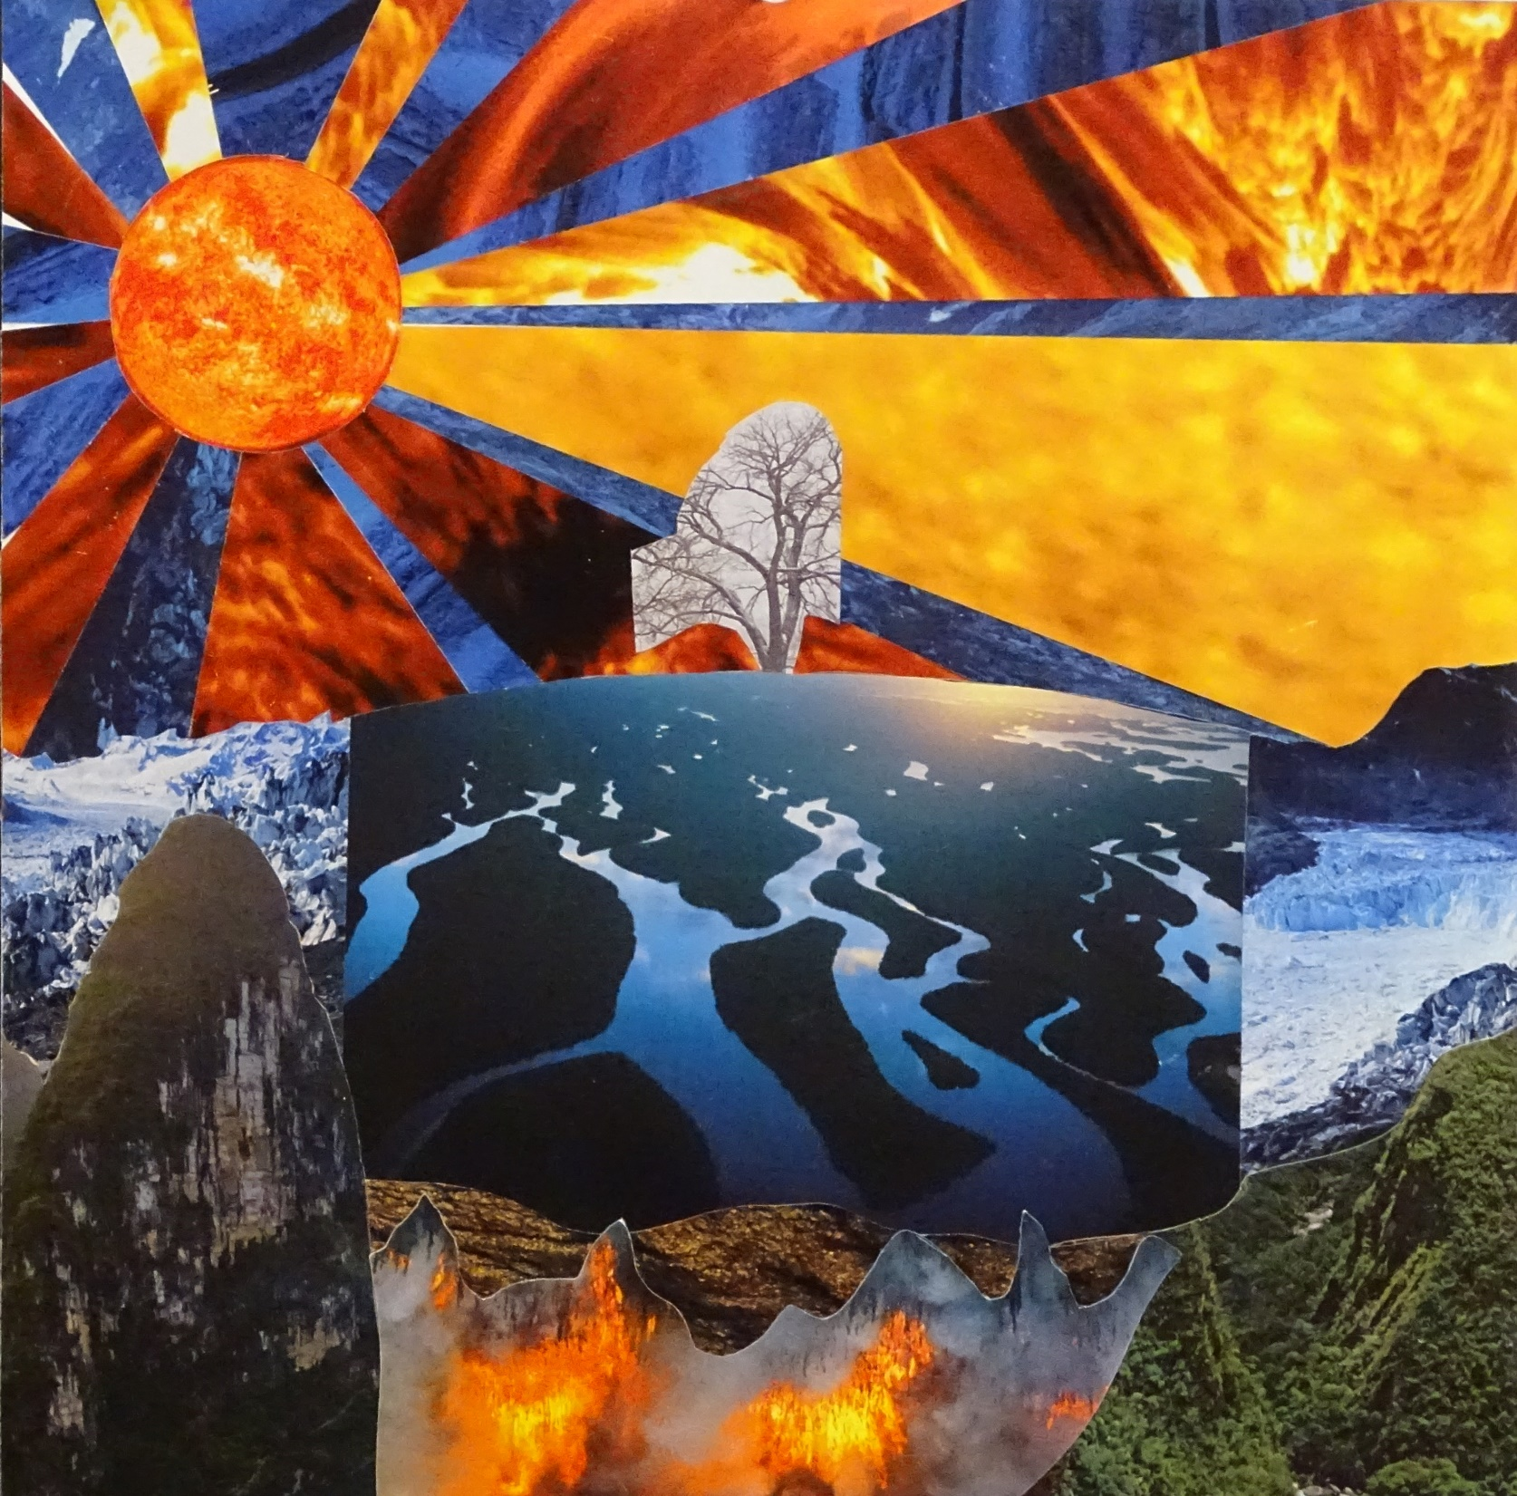
Stage 1: Nascence and emergence.
A fragile tree (a child) stands between fire below, fire above, and ice on all sides.
While rooted in the Earth, it sees and is drawn to the overwhelmingly bright Sun.
[Geometric shapes; organic shapes; radial symmetry; neg/pos.]

Slide 9
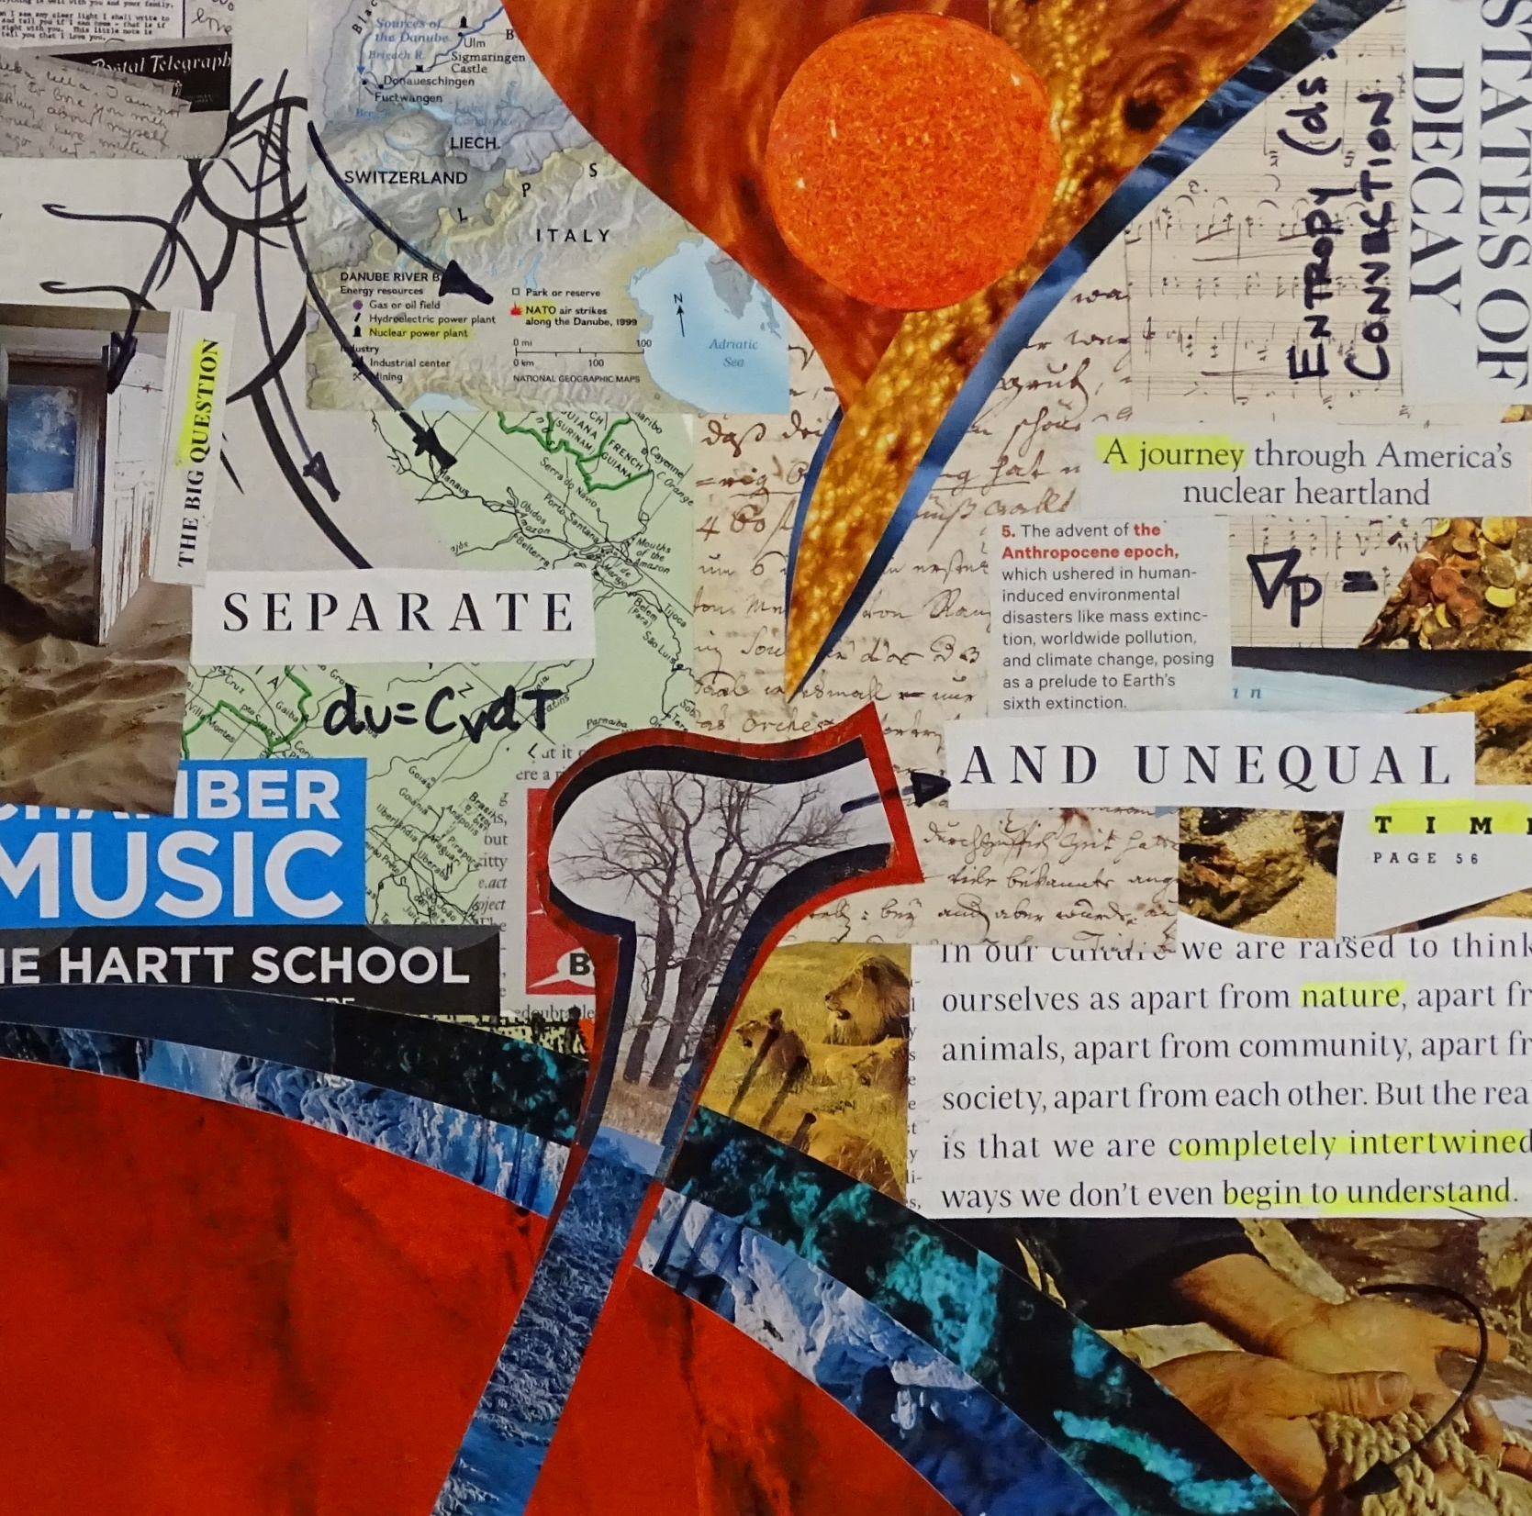
Stage 2: Reaching.
No longer a child, the tree emerges into an atmosphere of confusion.
Its roots go deep into the Earth – its memory of childhood and origins – while a higher consciousness begins to develop, shown here as a finger of fire reaching down from above.
[Asymmetrical (unbalanced); amorphous.]

Slide 10
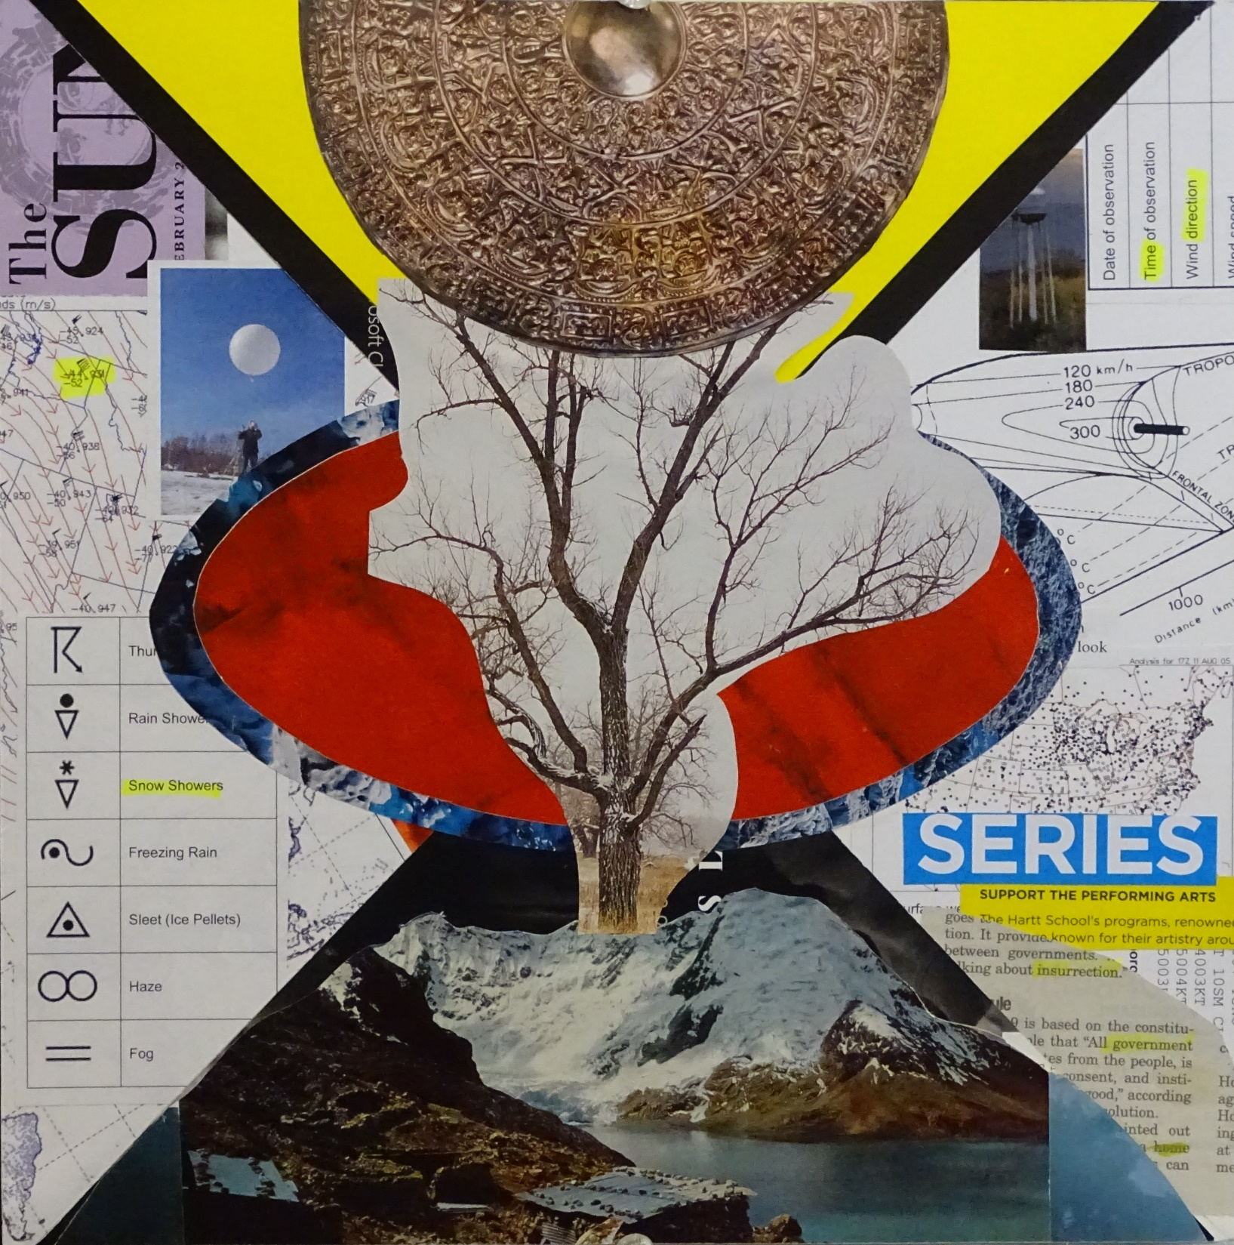
Stage 3: Contact.
The adult comes to know himself, which helps him understand the complex order of the universe.
The red oval is the fire within the individual, and the diagonal cross structure symbolizes the four Jungian aspects intersecting in the center of the individual. Two of these aspects (King and Magician) are mature, and are connected to the sublime sky. The other two are grown aspects of the child (Warrior and Lover), and are connected to the profane Earth.
In the background, chaos has settled down somewhat.
[neg/pos; radial; geometric; organic; symmetrical.]

Slide 11
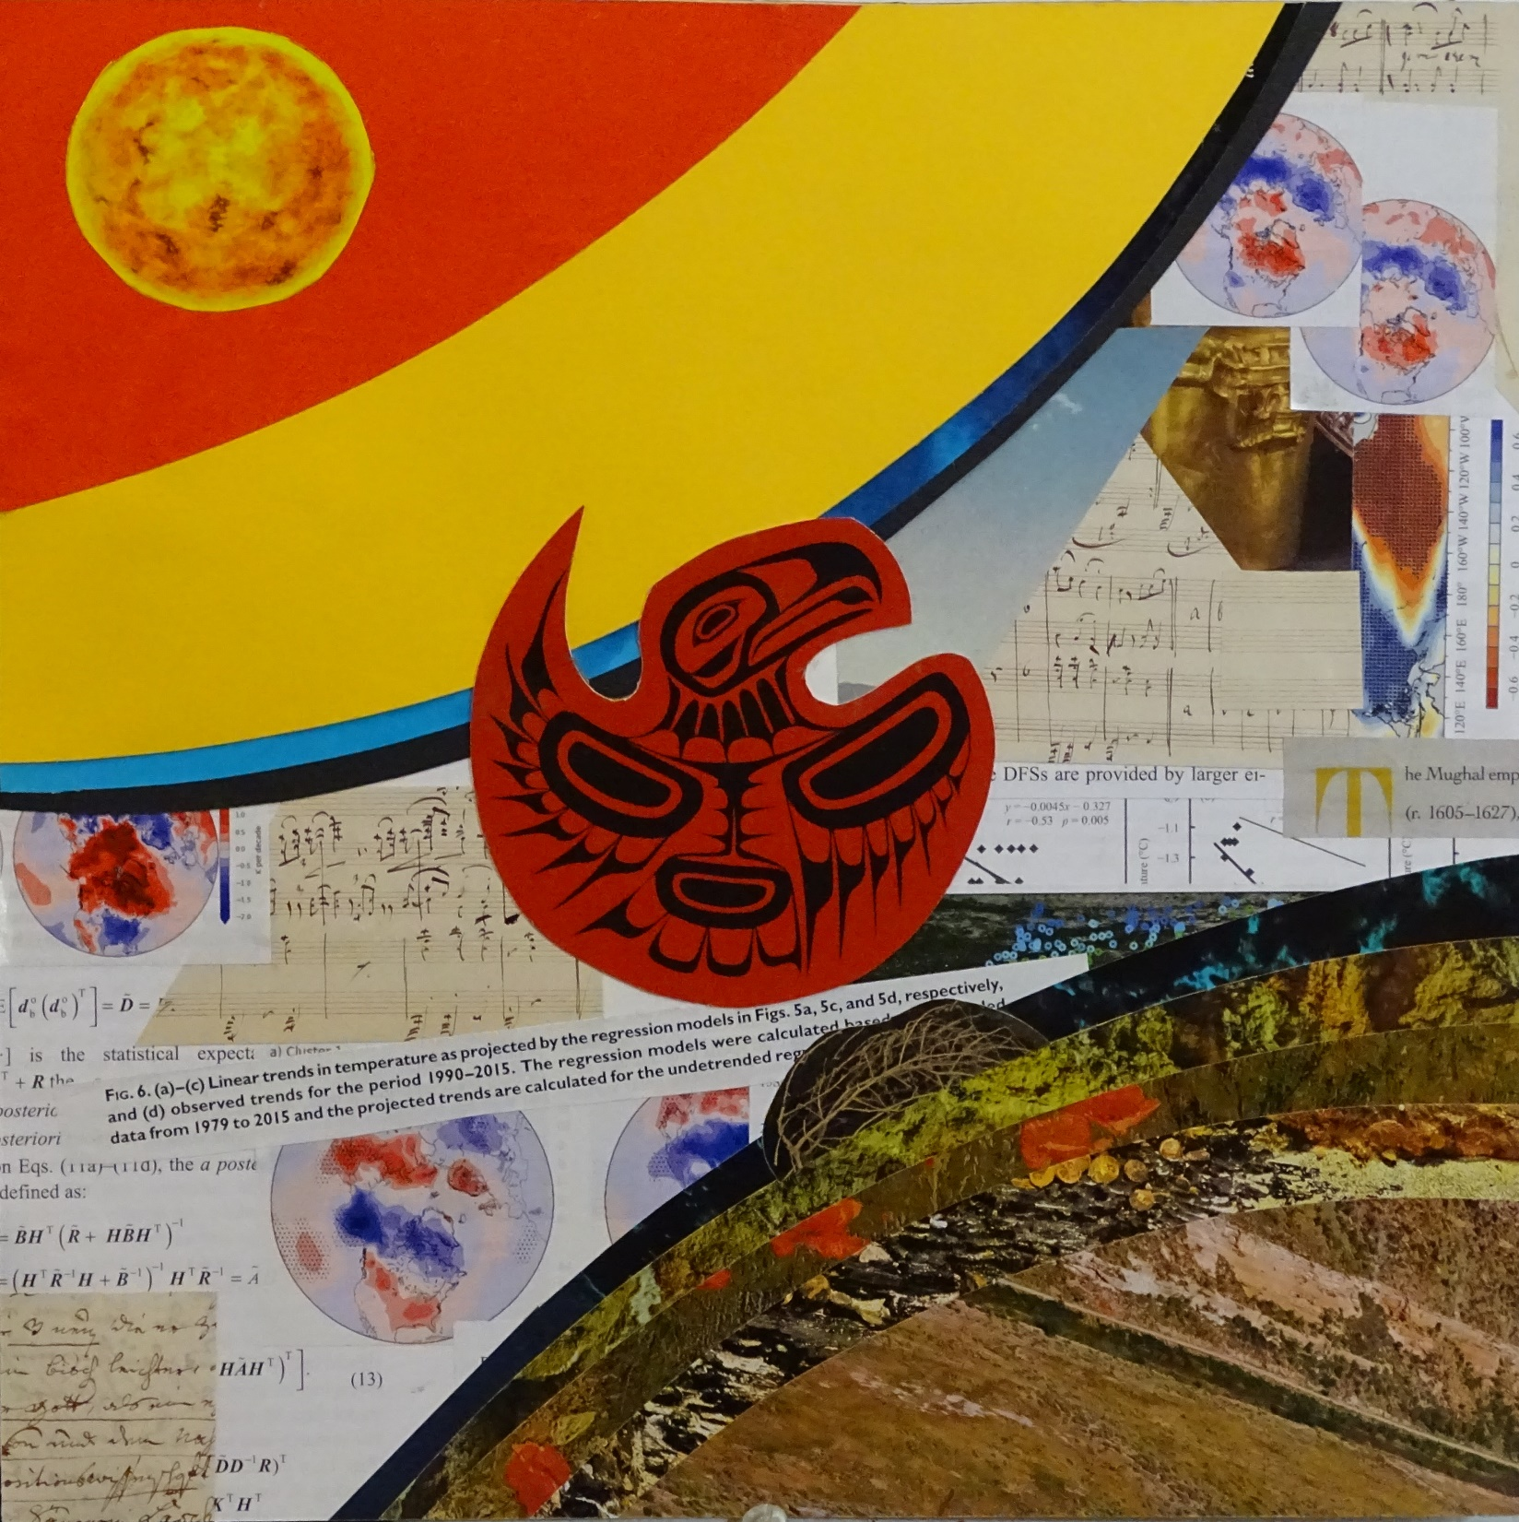
Stage 4: Resolution and departure.
The senior loses his connection to the profane Earth, that is, death. Earth recedes and takes possession of the abandoned shell.
The freed consciousness ascends to the sublime sky and is lost in the Sun’s fire.
In the background there is an interplay of reason (cosmos) and beauty.
[neg/pos; asymmetrical; organic; centered.]

Slide 12
Unit 3: Screen print – group project

Slide 13

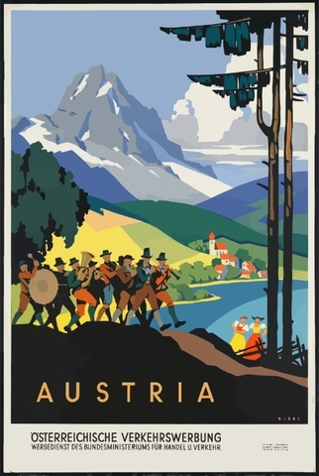
This was a group project. My contribution consisted of assisting with the overall design, creating the stencils for the three mountains in the background, as well as trees, rocks and grass, printing these items, and helping the other students with the remaining components.
I originally imagined the mountains as the simplified cartoon mountains shown in old travel posters, such as these two:

Slide 14
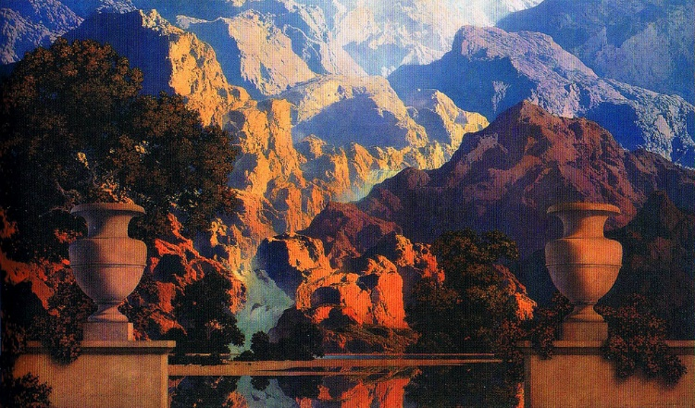
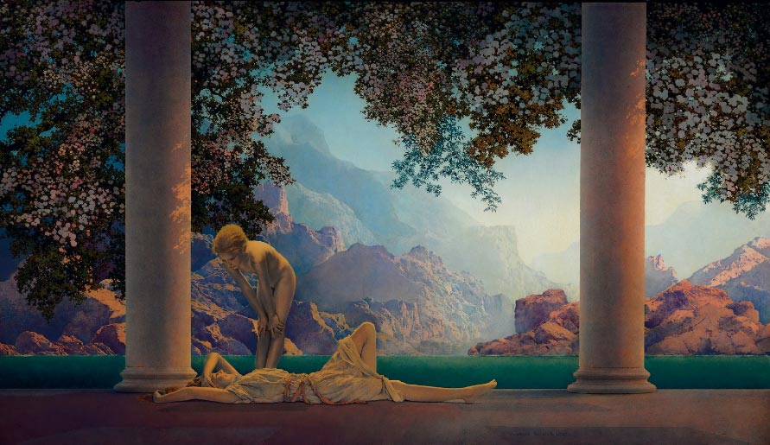
After further thought, I realized I was remembering the artwork of Maxfield Parrish. So I looked up some of his paintings of mountains, and sketched them in my sketchbook. (I also looked up images of glaciers.) Here are some of the images I sketched:

Slide 15
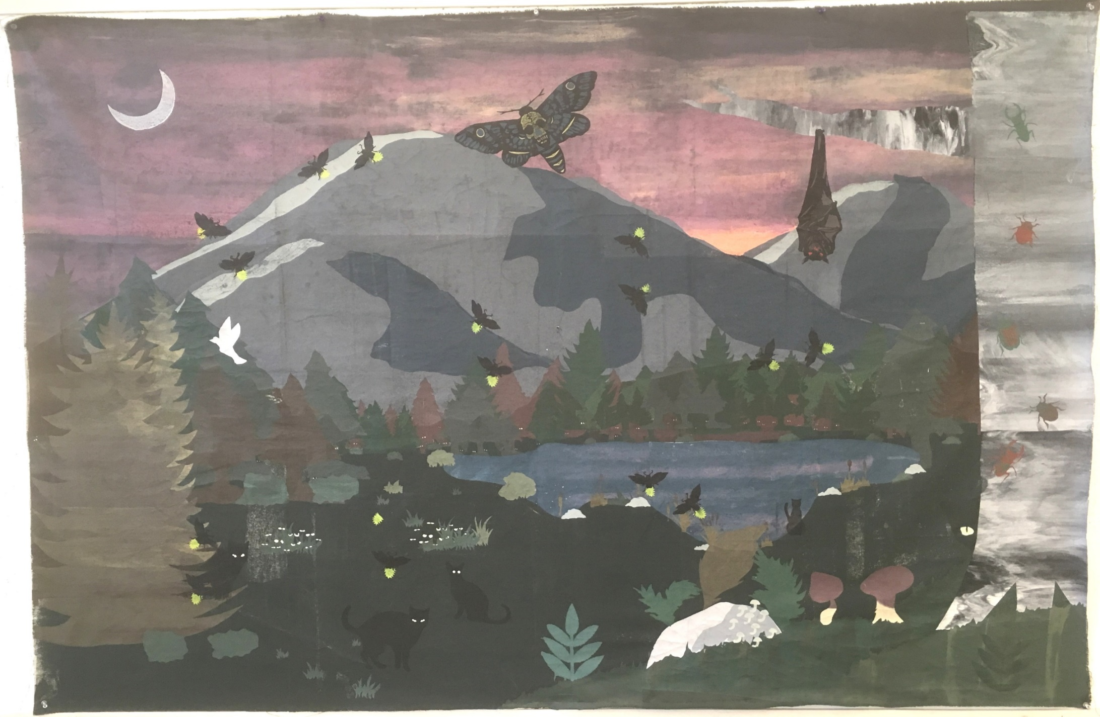
This is the finished product.

Slide 16
Final Project: Artist’s book

Slide 17
Artist’s Statement
When thinking about this project, it occurred to me that a book is a container that holds some kind of story. It may be a fictional story such as Melville’s Moby Dick, or it may be a factual story such as the chapter in Melville that describes the types and uses of different kinds of whales. It may even be a dry textbook with vague attempts at humor, such as my text Applied Thermodynamics for Meteorologists.
Houses are also containers for stories. The house I grew up in during the 1960s contains the stories of my family and of the other families that have lived there. I sometimes drive by that house in western Connecticut and listen to the echoes of that time. I see that the small trees my father planted at the edge of the front yard now form a 60-foot high wall that partially hides the house from the street, and I remember the story of the day he planted those trees. Then I think of everything else connected to my father, who passed away in 2013.

Slide 18
Among other things, he was a composer of contemporary classical music and a professor of music theory, first at Hartt College in West Hartford, Connecticut, and later at Oberlin College Conservatory, in northeastern Ohio. I became a professor myself because he was the best role model I had in my early years, and I’m obviously imitating him. In 1967, he took our family to Italy (as I took my family to Istanbul in 2012), where we lived in Rome for a year, toured Europe, and he wrote music (as I wrote a book during my sabbatical in Istanbul). While in Rome, I attended an international school for the children of diplomats, which was in a sprawling villa surrounded by lawns and gardens. My best friend was the son of the Swiss ambassador to Italy. That villa contained many stories.

Slide 19
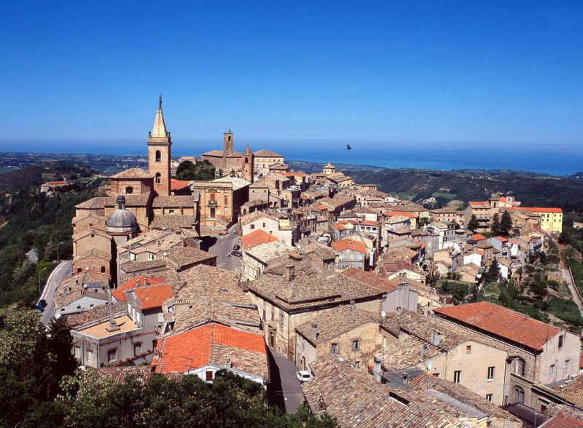
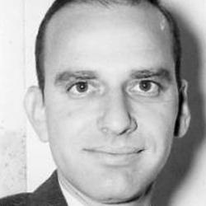
On one of our tours, we visited the mountaintop city of Orvieto. I lifted the picture of Orvieto shown below (left) from Wikipedia. The picture on the right (from the Simon Guggenheim Foundation website) is of my father in 1967, as he looked the day we spent in Orvieto.

Slide 20
Now it occurs to me that each of the houses and buildings in Orvieto contains many stories, similar to a book, making the city a library. It is a library that dates back to the Etruscans, thousands of years ago.
In this sculpture, each book is a text on meteorology. The village, culminating in a hilltop house, represents the collection of stories (both individually and as a whole greater than the sum of its parts) I collected to build my own career. It also represents the story of how I built my “village” based partly on my memories of Italy in the 1960s, as well as the memory of my father.

Slide 21
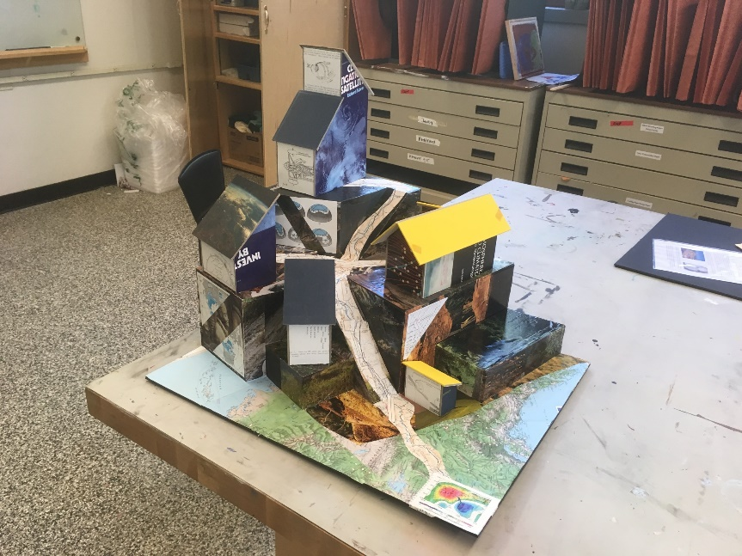
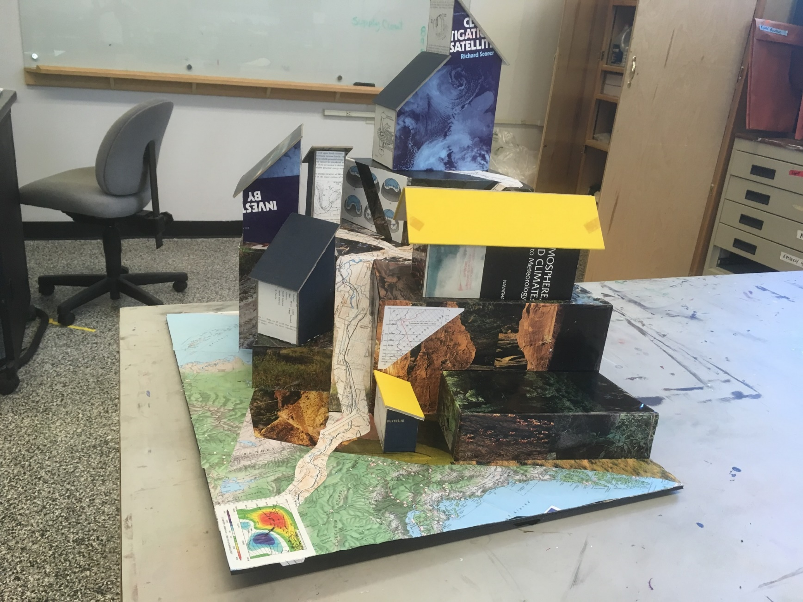
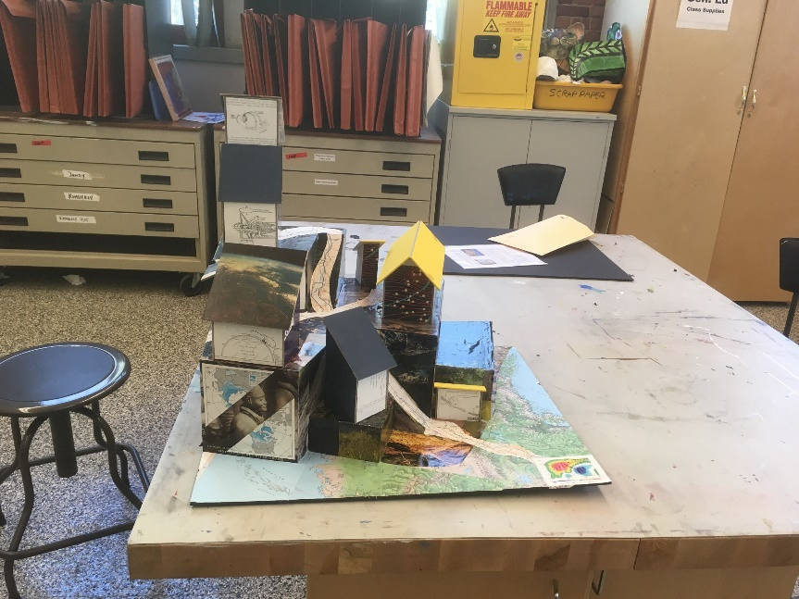
Several views of the sculpture.

Slide 22
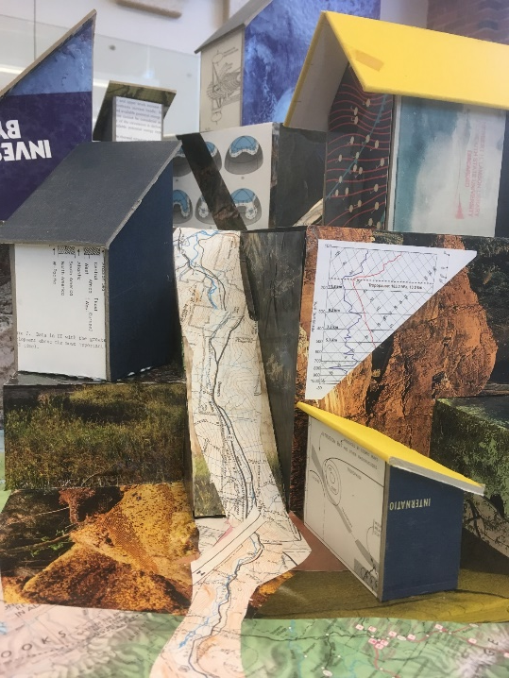
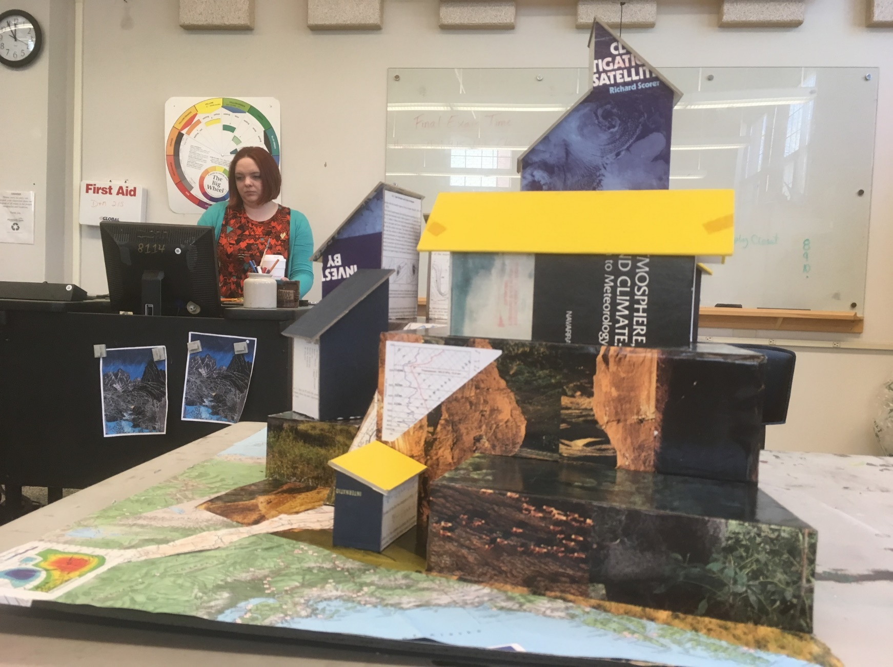
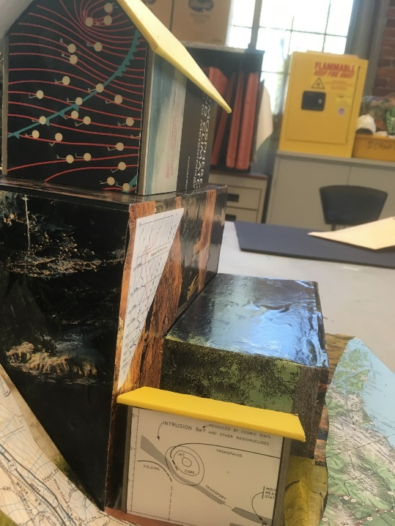
Several views of the sculpture.

